Slide 1
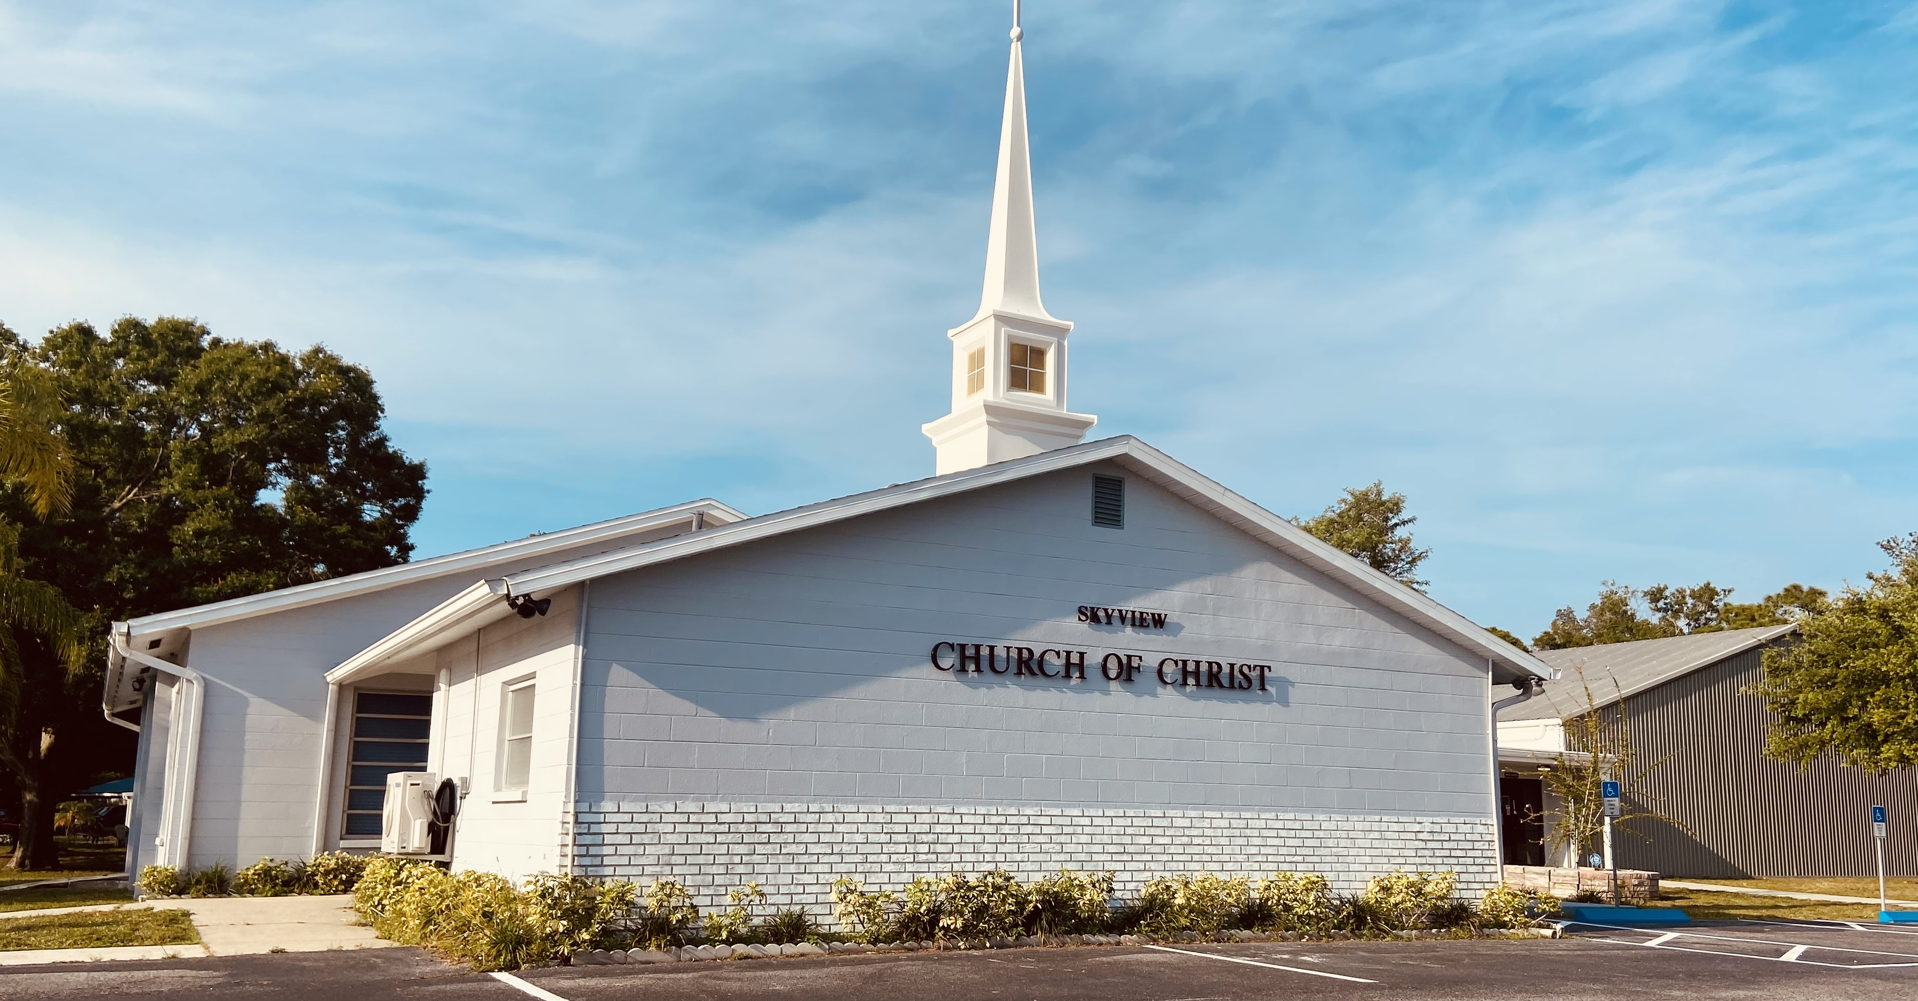
WELCOME TO OUR SERVICES

Slide 2
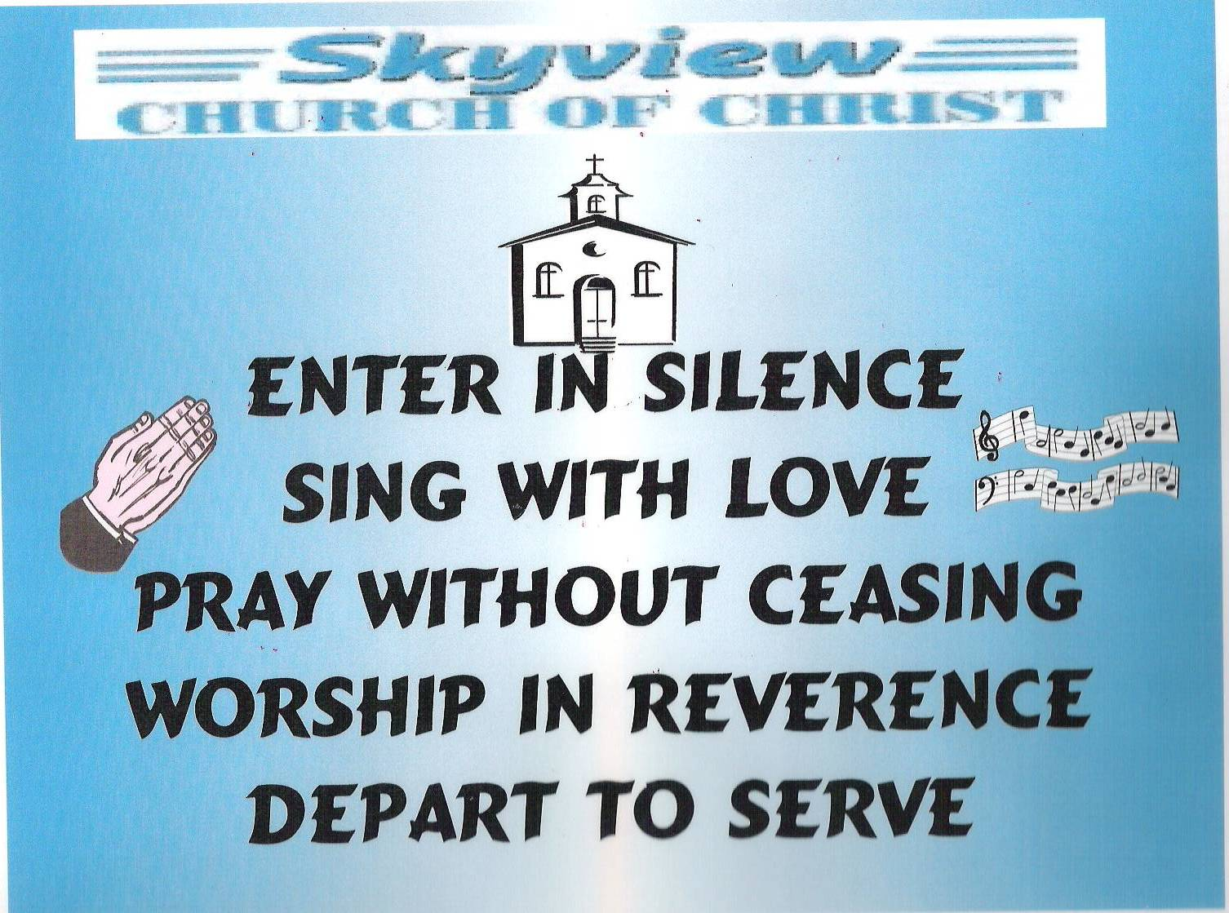
DESIGNED BY JIM INGRAM

Slide 3
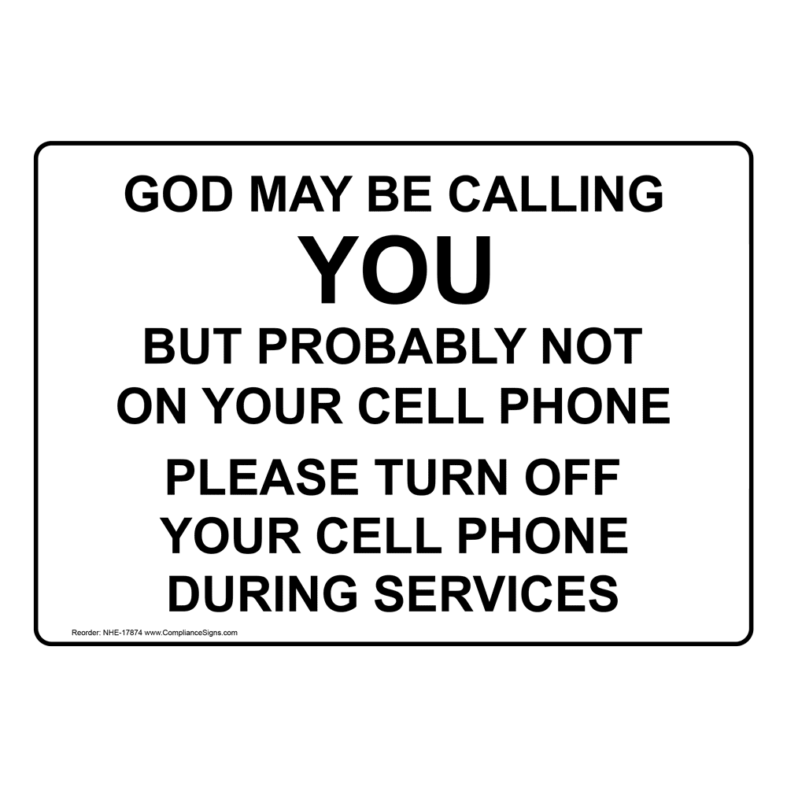

Slide 4


Slide 5

SUNDAY – 9:30 AM
MONDAY BIBLE STUDY – 6:30 PM IN WEST ANNEX
WEDNESDAY BIBLE STUDY – 7:00 PM IN WEST ANNEX
W.I.N.G.S. LADIES CLASS THURSDAY– 10 AM IN WEST ANNEX

Slide 6
TODAY’S WORSHIP LEADERS
CALL TO WORSHIP
PRAYER
SONG LEADER
SCRIPTURE
HEADING TABLE
SERMON
CLOSING PRAYER
ANNOUNCEMENTS
Charles Murray
Pat Skidmore
Sander Fletcher
Barry Brown
Will Duncan
Charles Murray
Chuck RePass
Tom Andrick

Slide 7

MONDAY NIGHT BIBLE STUDY 6:30PM will meet in the West Annex
WEDNESDAY BIBLE STUDY will meet in the West Annex until further notice
LADIES BIBLE CLASS W.I.N.G.S (Women In God’s Service) Thursday 10:00 AM – meets in the West Annex

Slide 8

FIVE MINUTE RULE

Slide 9


Slide 10


Slide 11
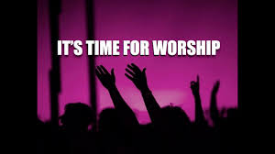

Slide 13
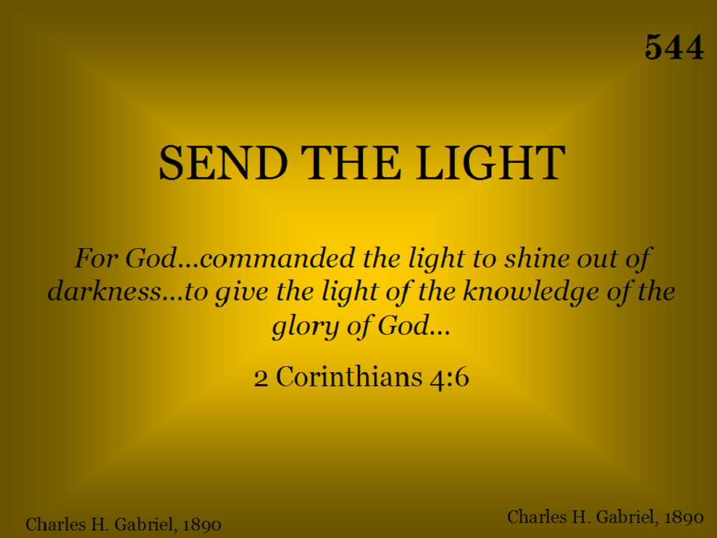
544 - Send The Light - Title
LET’S ALL STAND AS BROTHER DUNCAN LEADS US

Slide 14
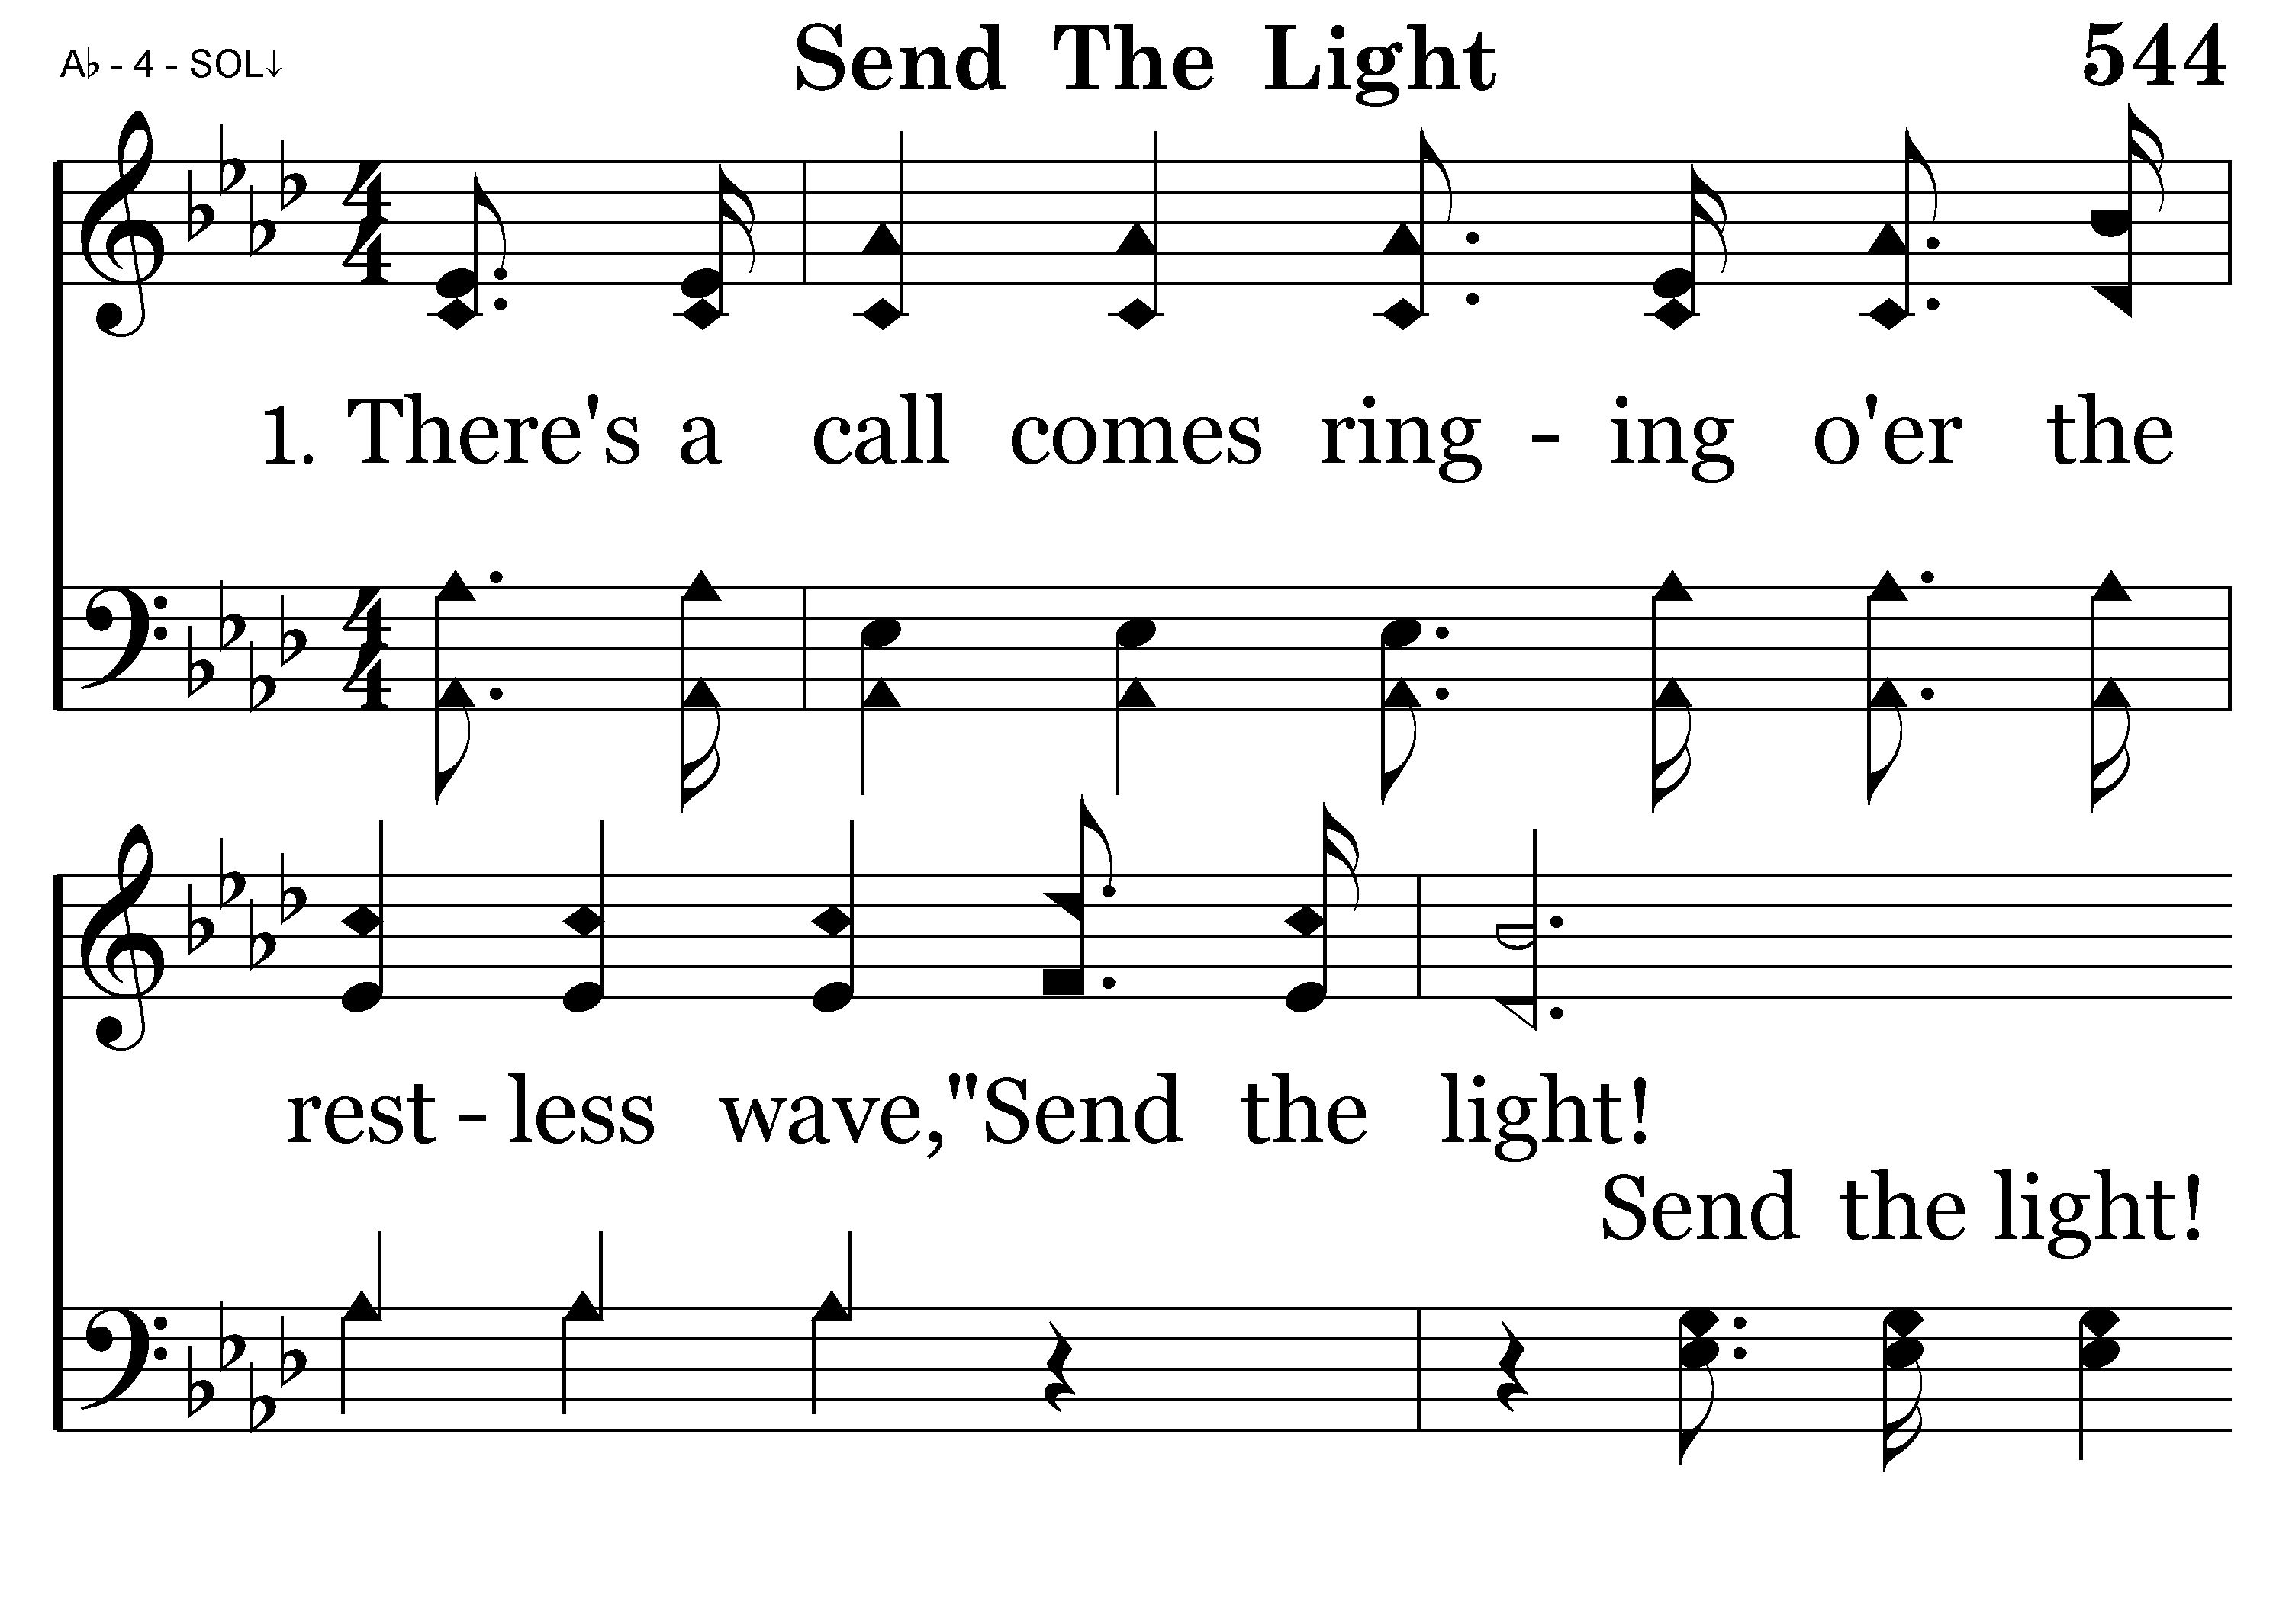
544 - Send The Light - 1.1

Slide 15
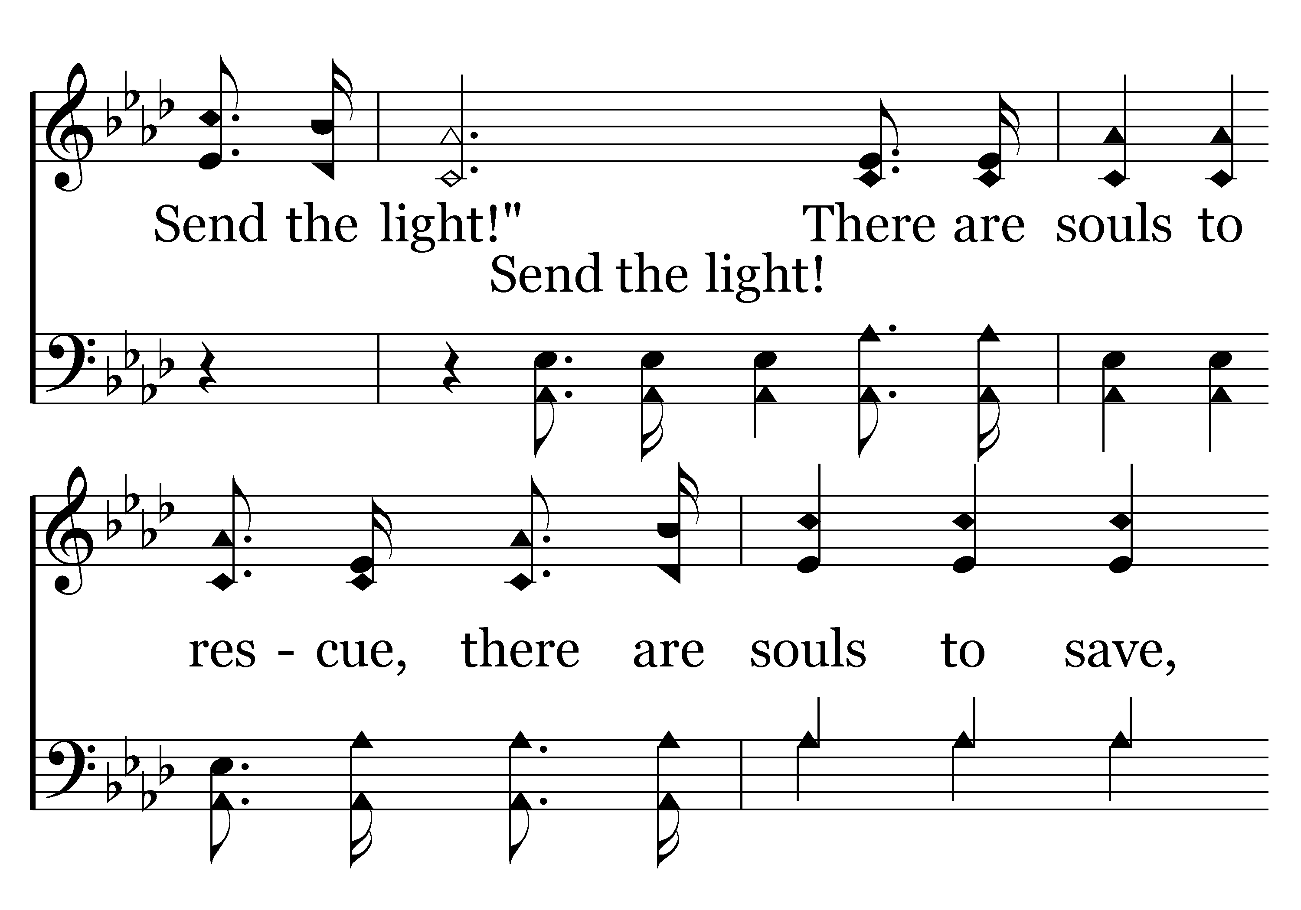
544 - Send The Light - 1.2

Slide 16
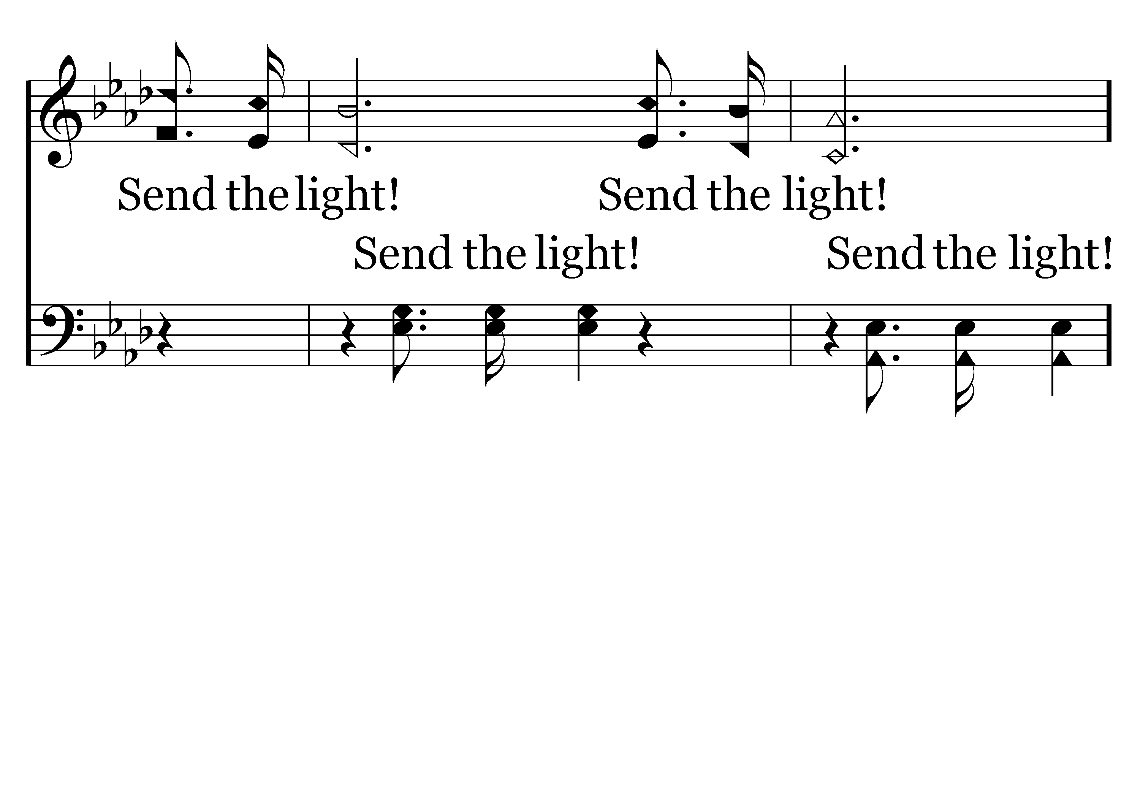
544 - Send The Light - 1.3

Slide 17
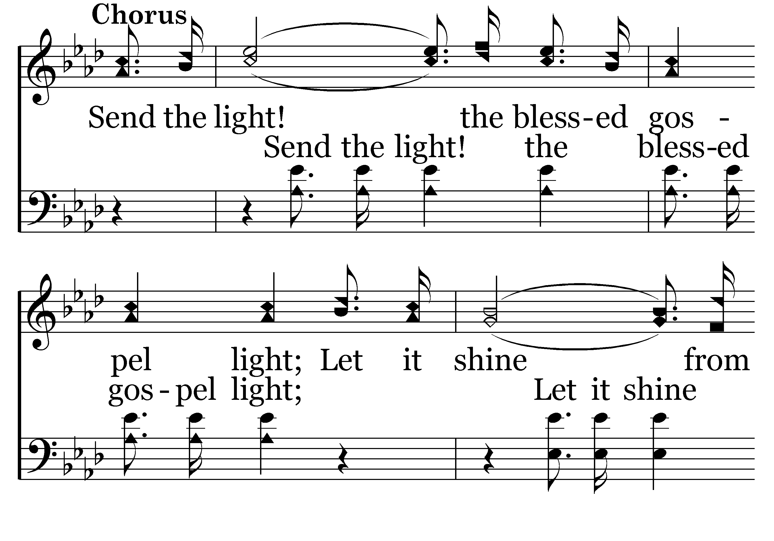
544 - Send The Light - C.1

Slide 18
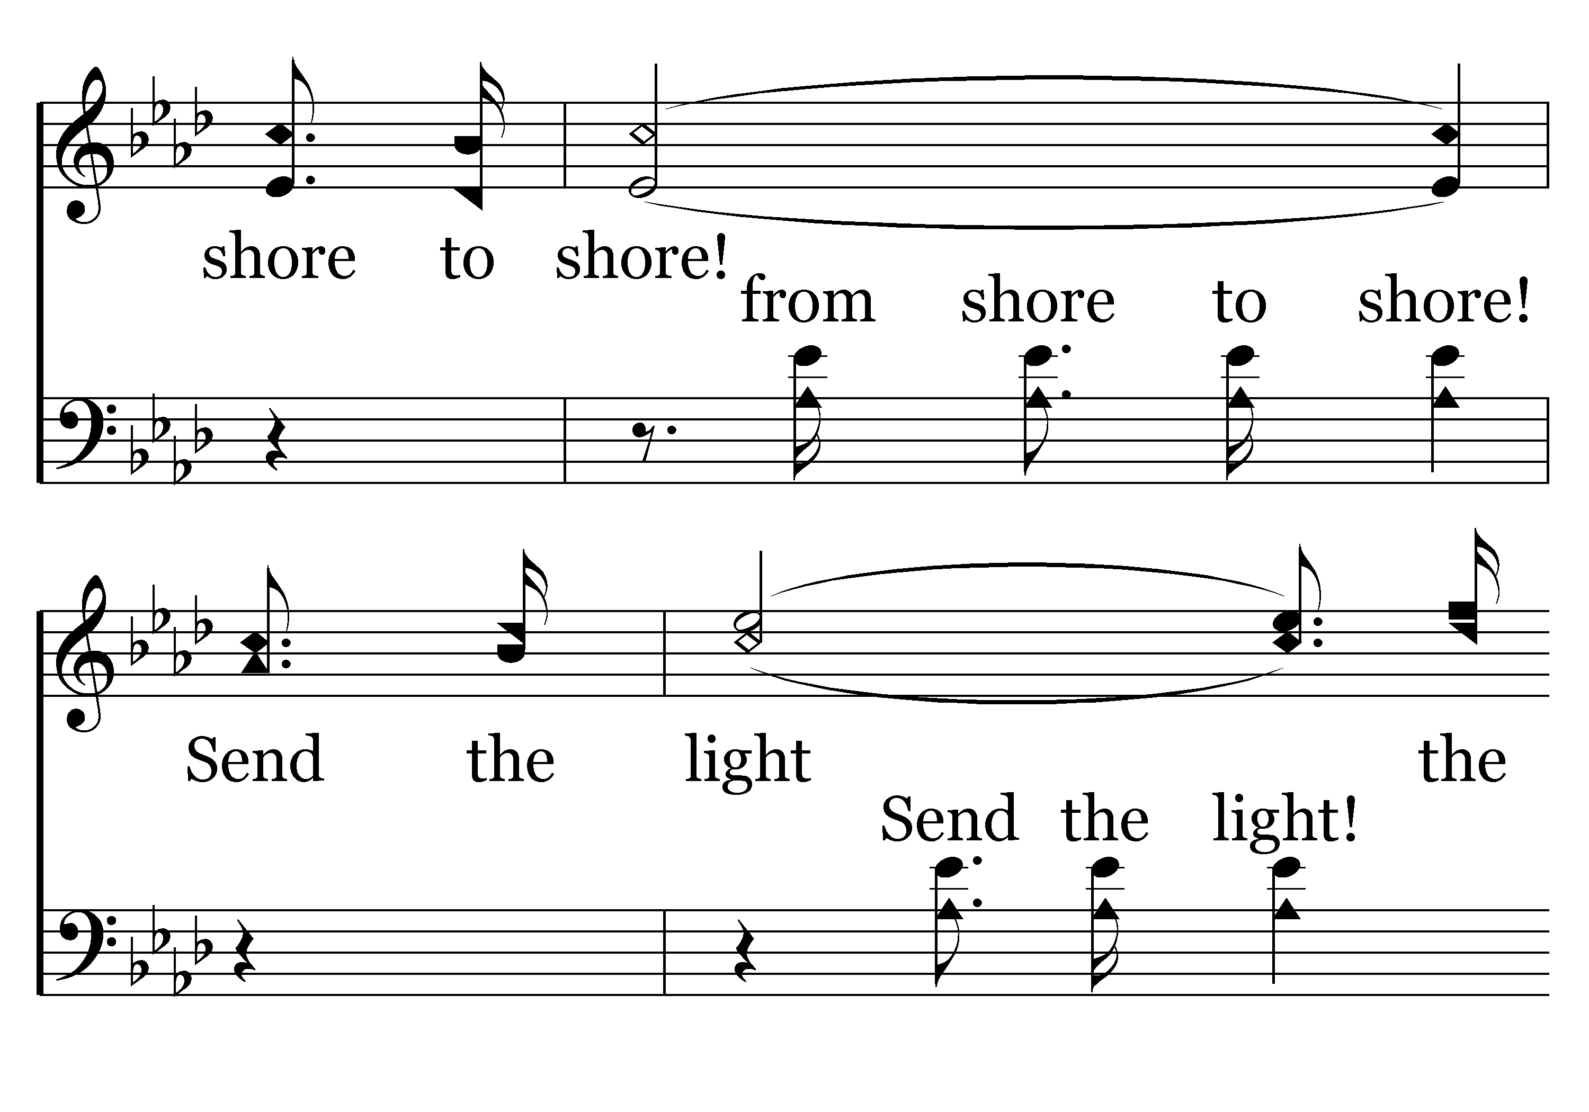
544 - Send The Light - C.2

Slide 19
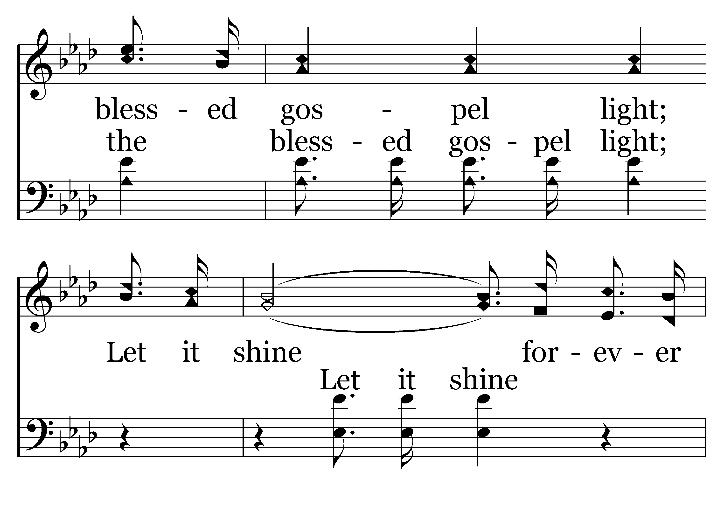
544 - Send The Light - C.3

Slide 20
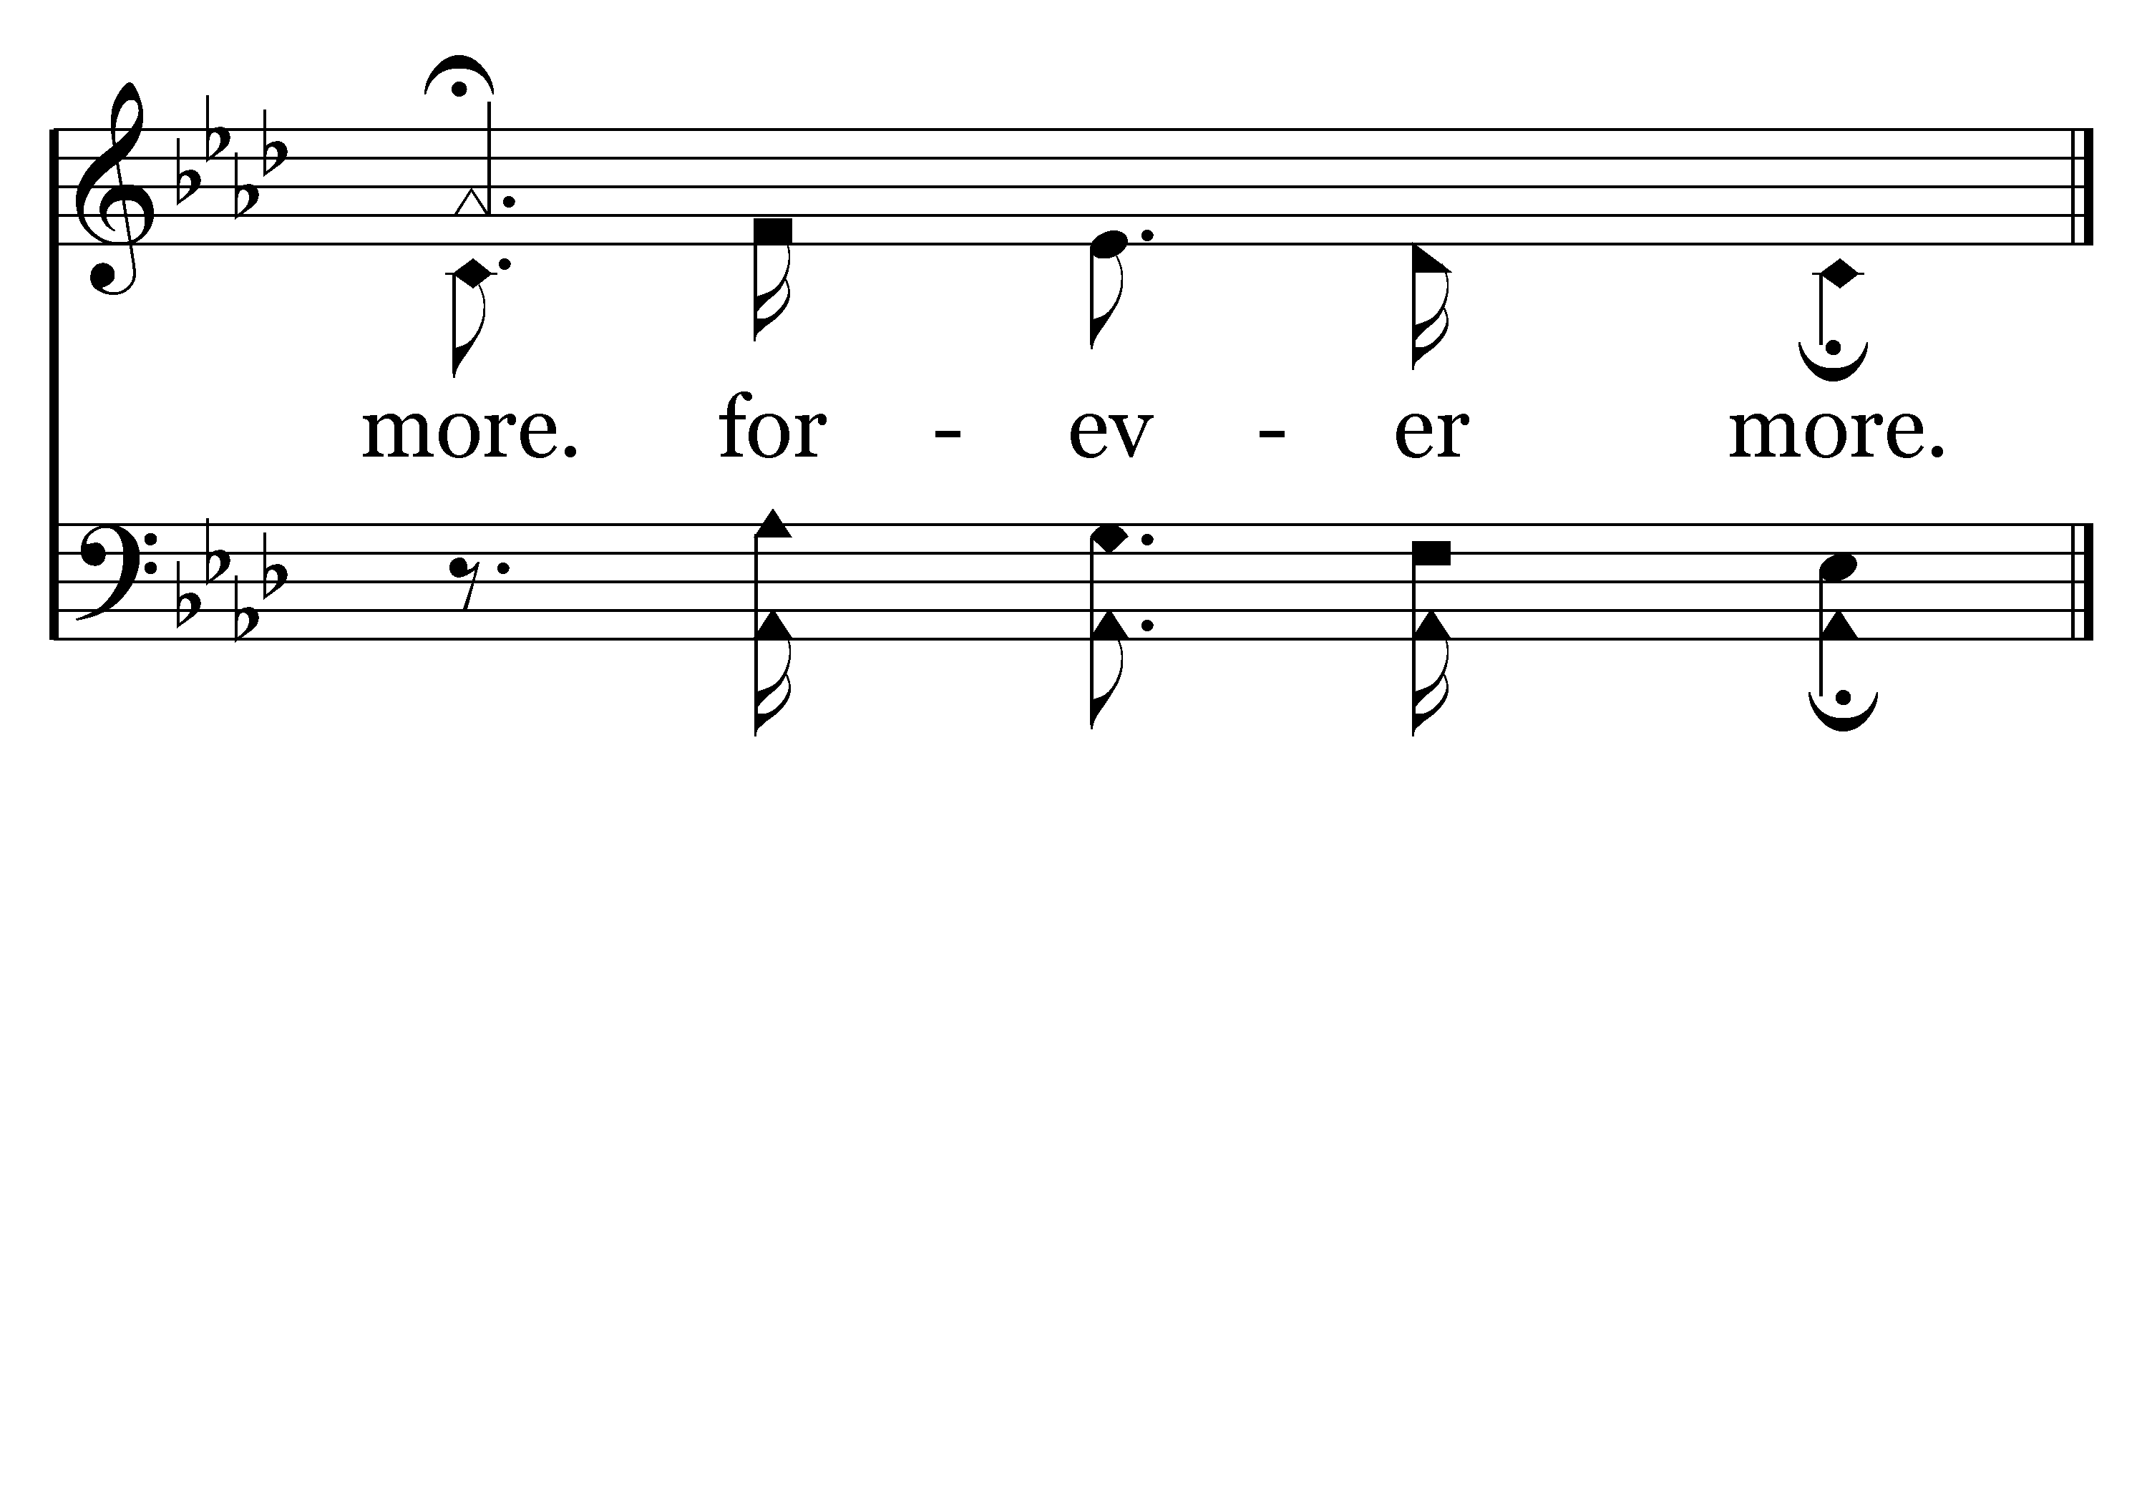
544 - Send The Light - C.4
End of Verse 1

Slide 21
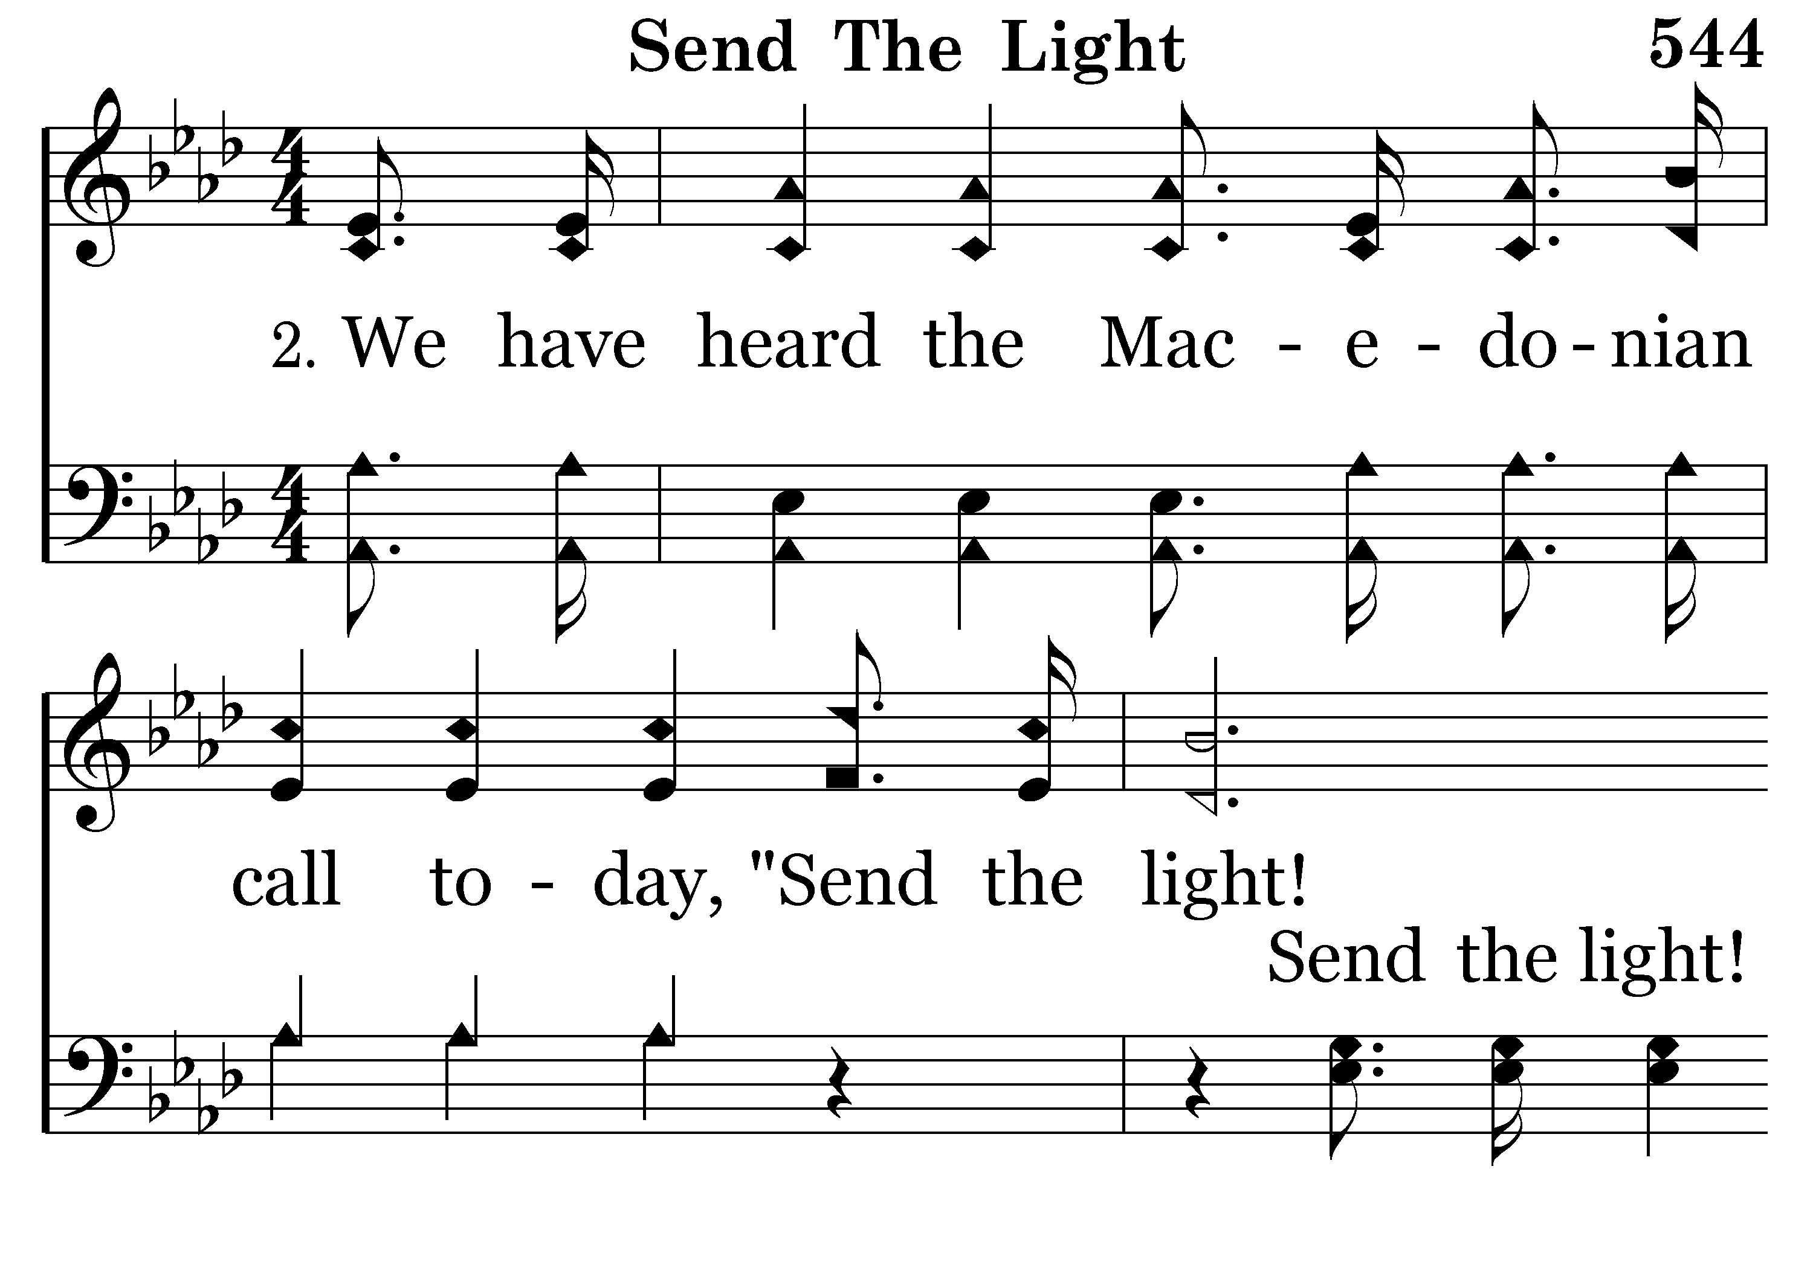
544 - Send The Light - 2.1

Slide 22
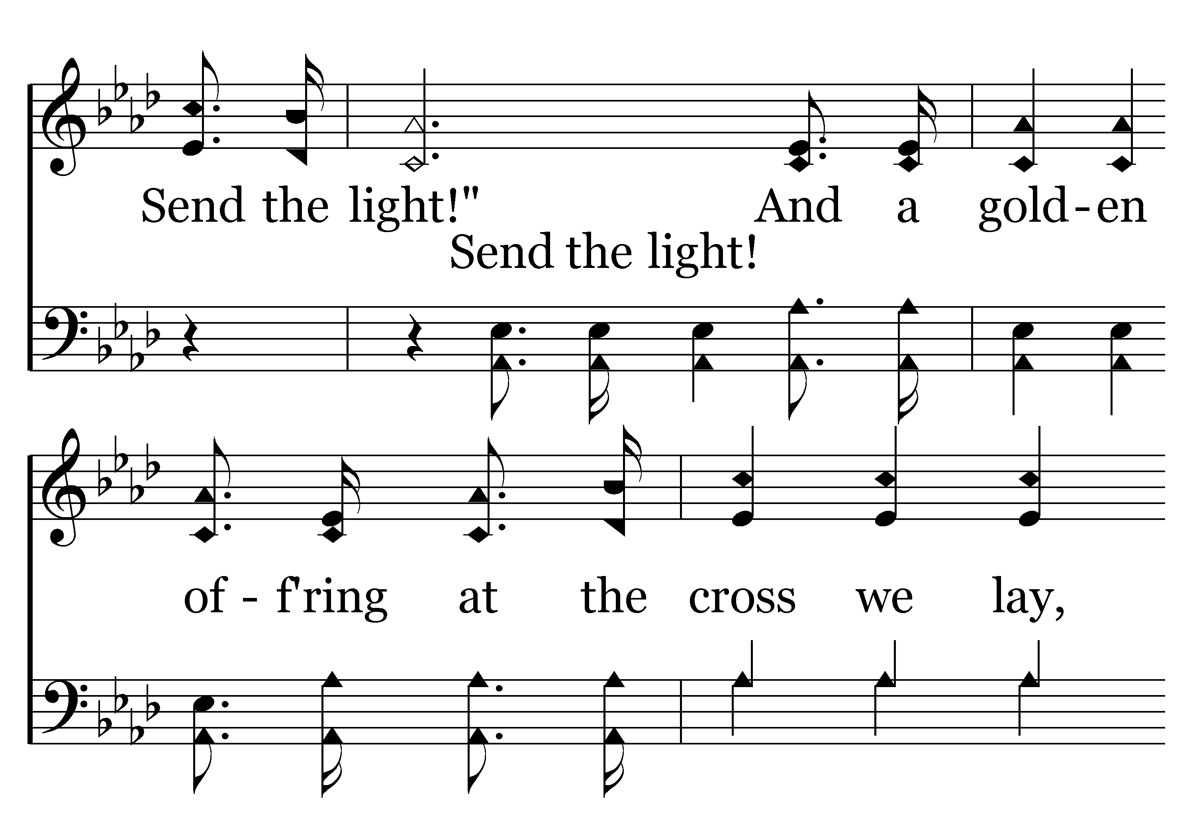
544 - Send The Light - 2.2

Slide 23
544 - Send The Light - 2.3

Slide 24
544 - Send The Light - C.1

Slide 25
544 - Send The Light - C.2

Slide 26
544 - Send The Light - C.3

Slide 27
544 - Send The Light - C.4
End of Verse 2

Slide 28
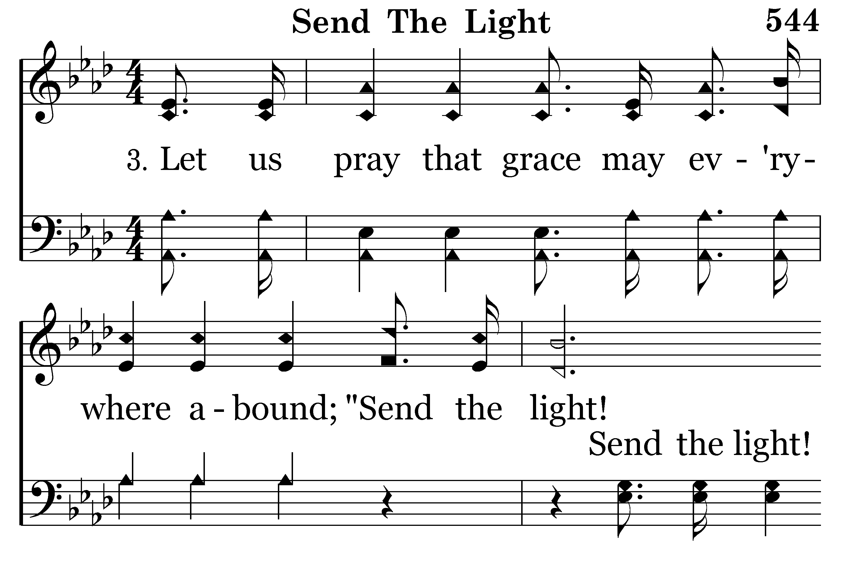
544 - Send The Light - 3.1

Slide 29
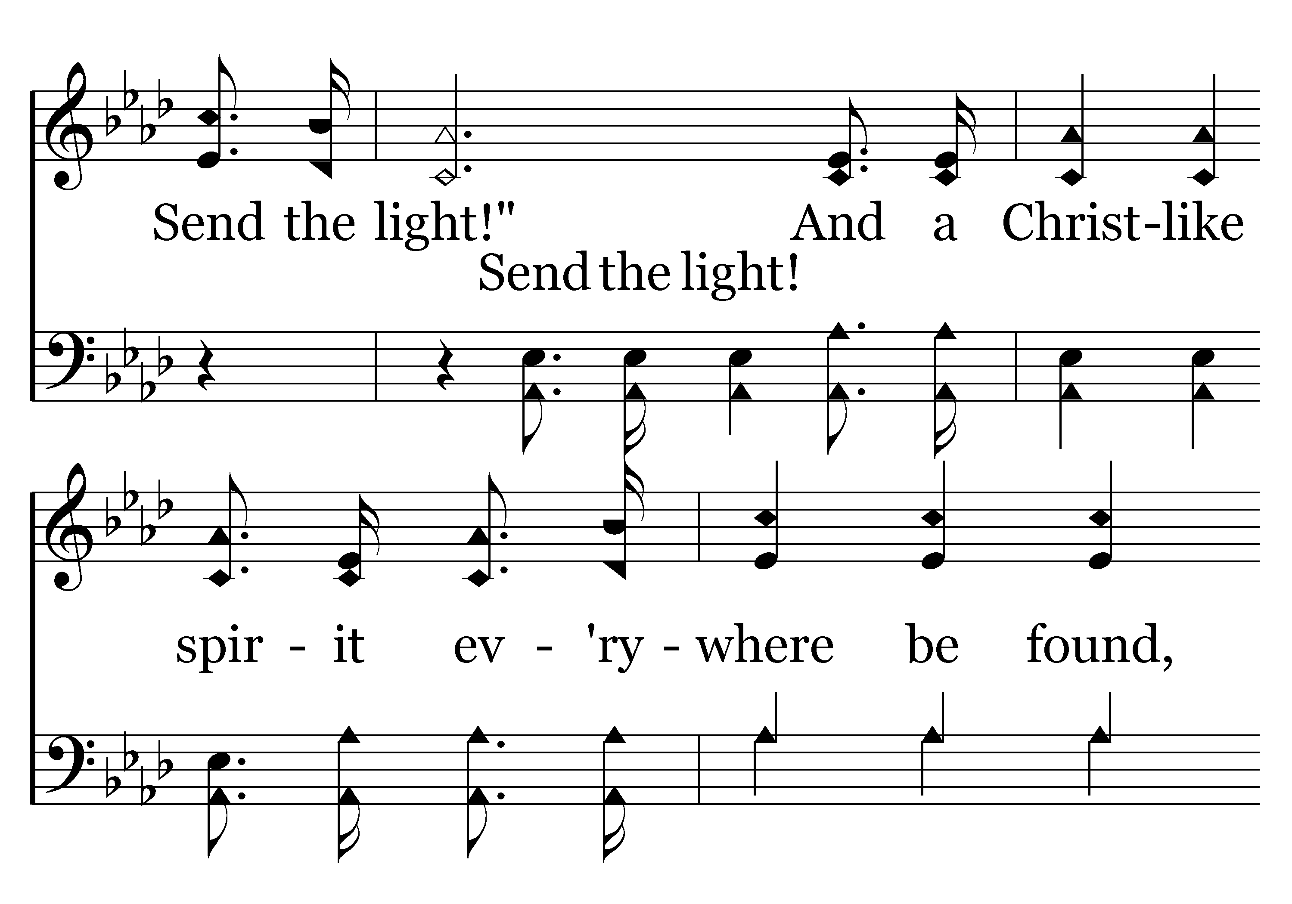
544 - Send The Light - 3.2

Slide 30
544 - Send The Light - 3.3

Slide 31
544 - Send The Light - C.1

Slide 32
544 - Send The Light - C.2

Slide 33
544 - Send The Light - C.3

Slide 34
544 - Send The Light - C.4
End of Verse 3

Slide 35
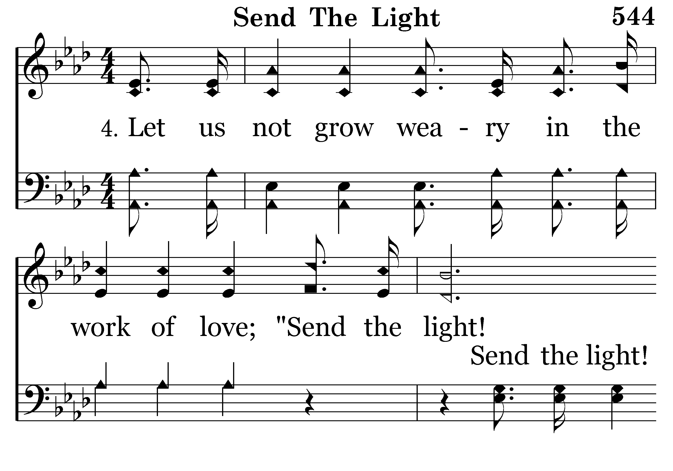
544 - Send The Light - 4.1

Slide 36
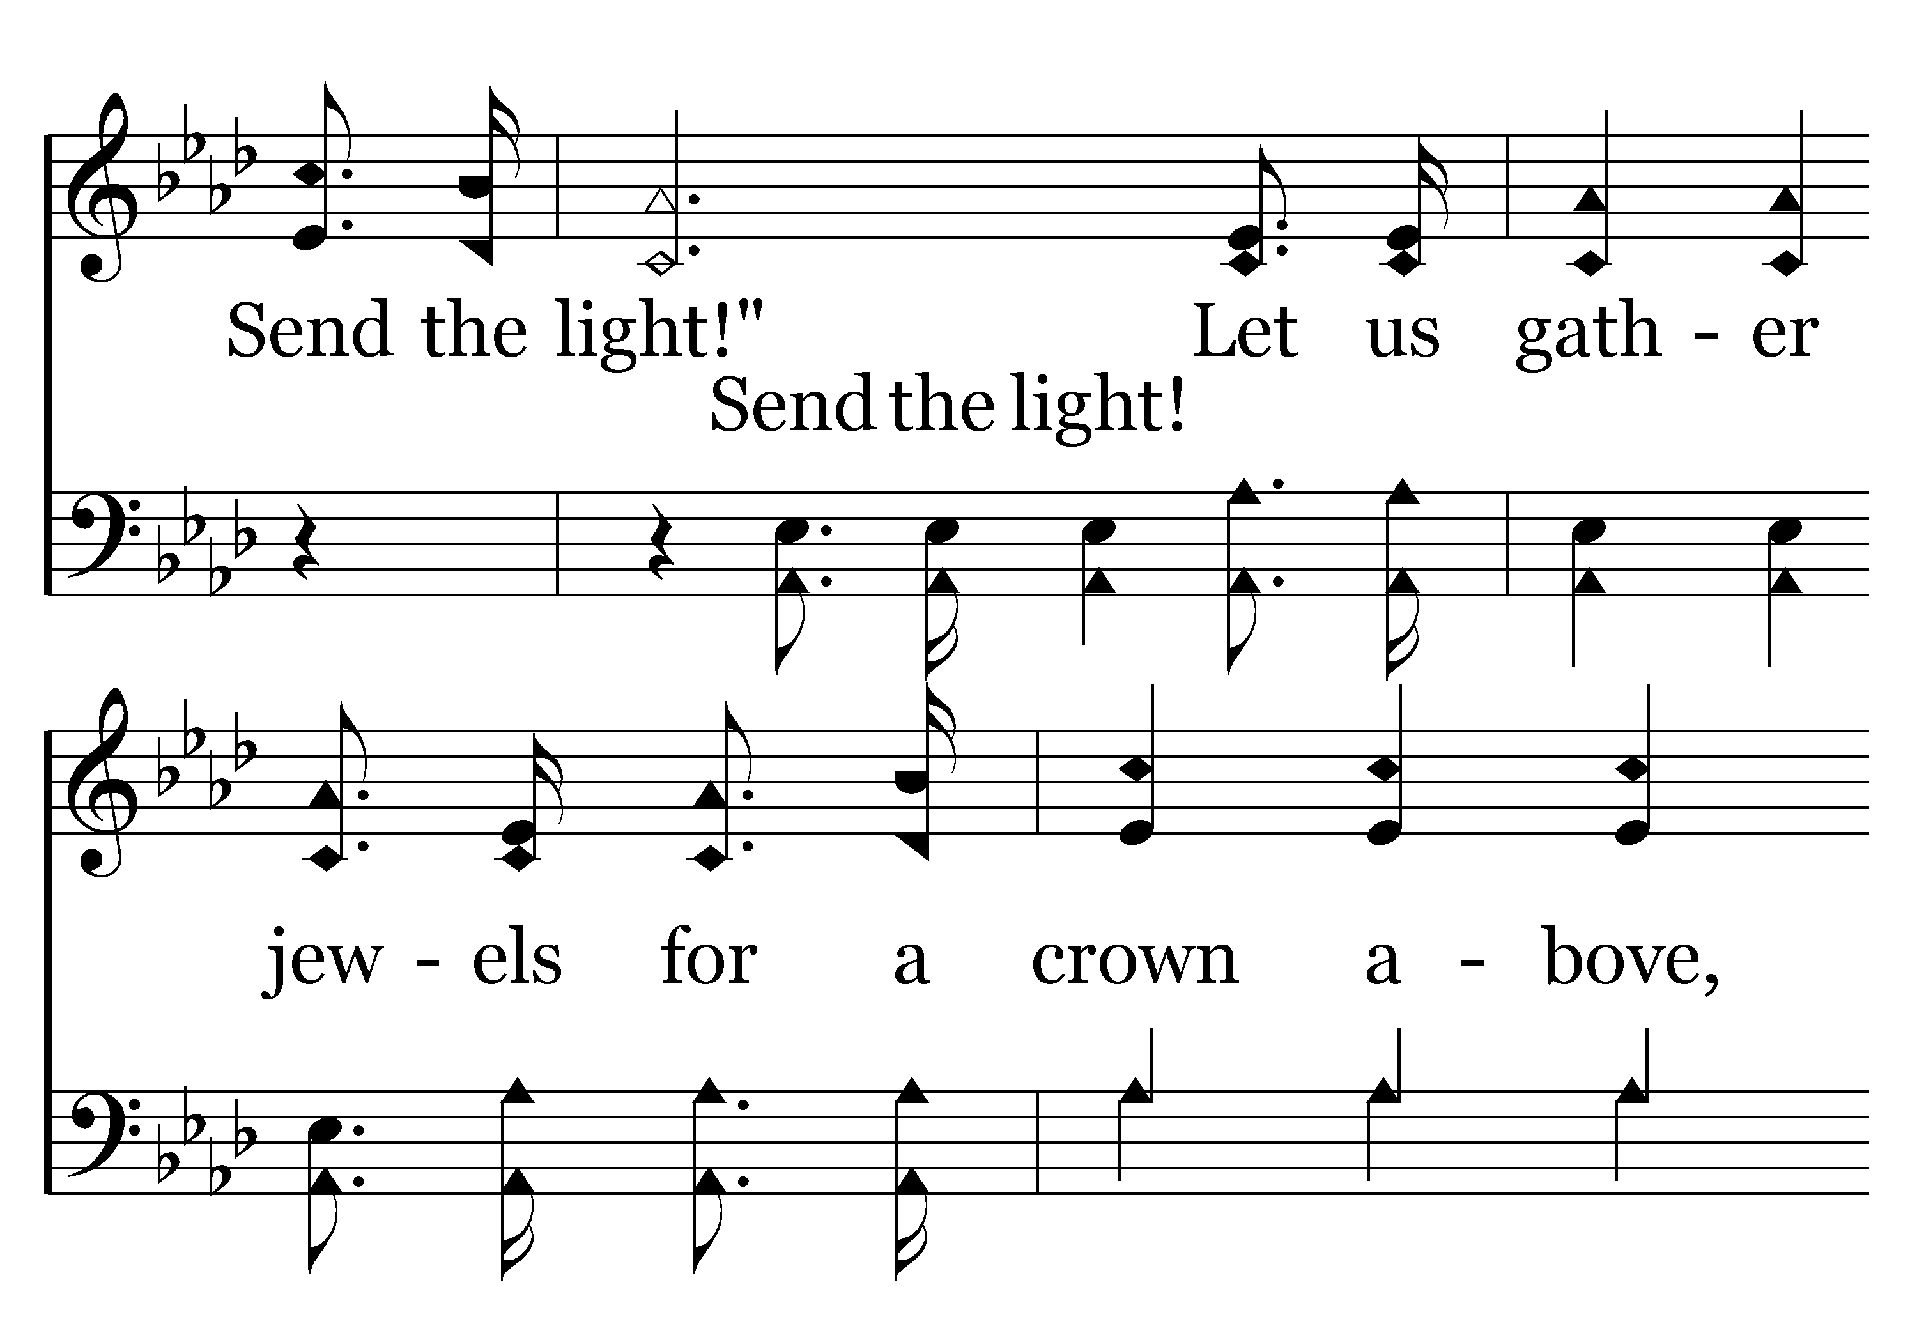
544 - Send The Light - 4.2

Slide 37
544 - Send The Light - 4.3

Slide 38
544 - Send The Light - C.1

Slide 39
544 - Send The Light - C.2

Slide 40
544 - Send The Light - C.3

Slide 41
544 - Send The Light - C.4
End of Song

Slide 43

WELCOME BY CHARLES MURRAY

Slide 44
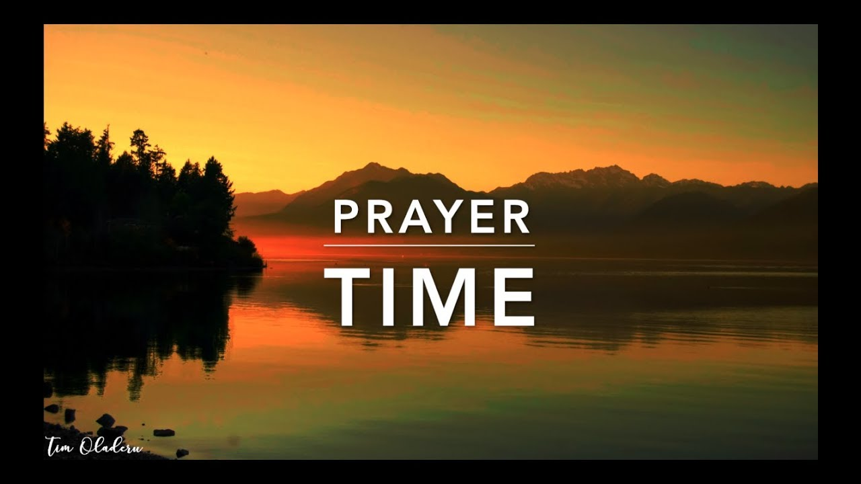
PRAYER
Jerry Mellish
LED BY PAT SKIDMORE

Slide 46
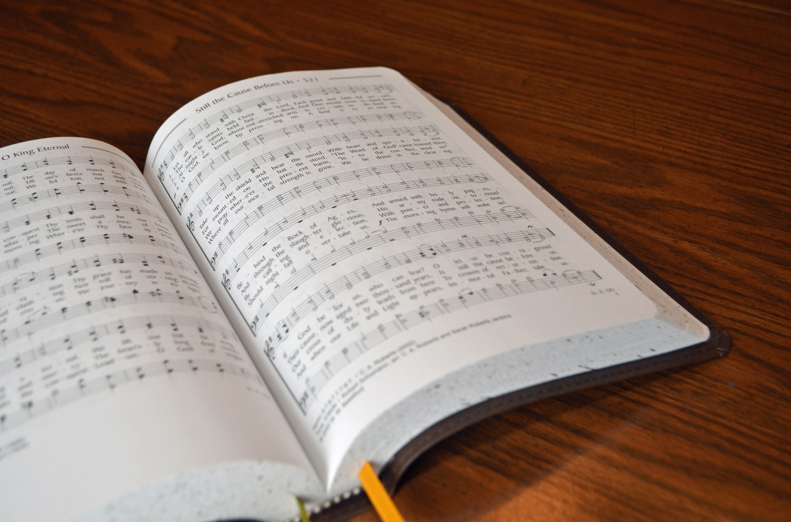
SONG LEADER
SANDER FLETCHER

Slide 47
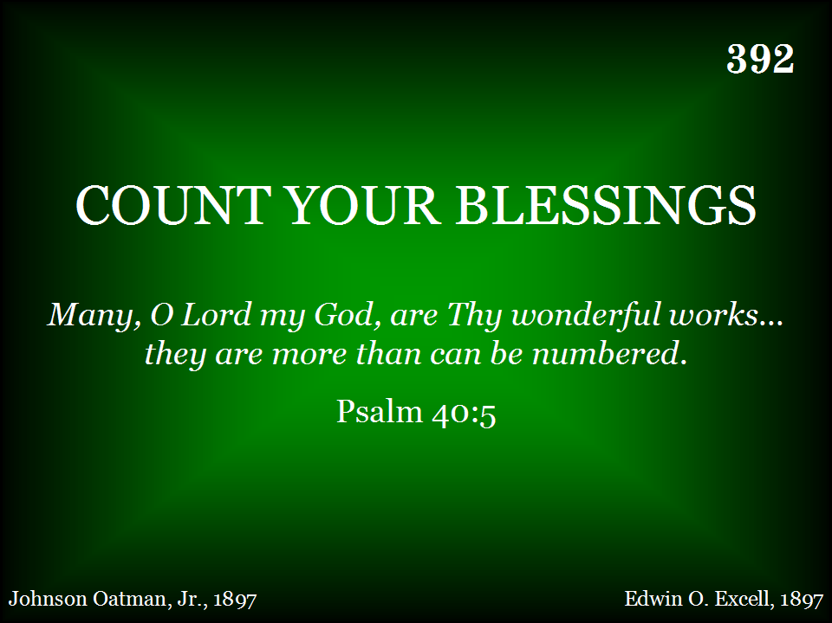
392 - Count Your Blessings - Title

Slide 48
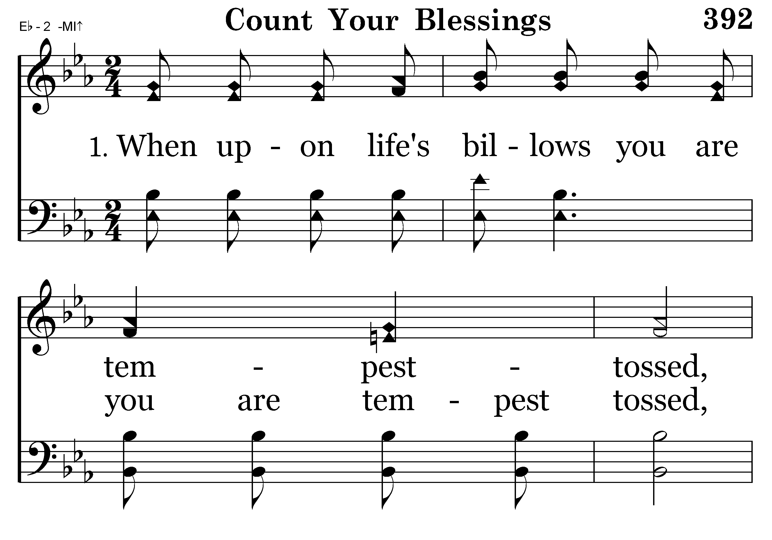
392 - Count Your Blessings - 1.1

Slide 49
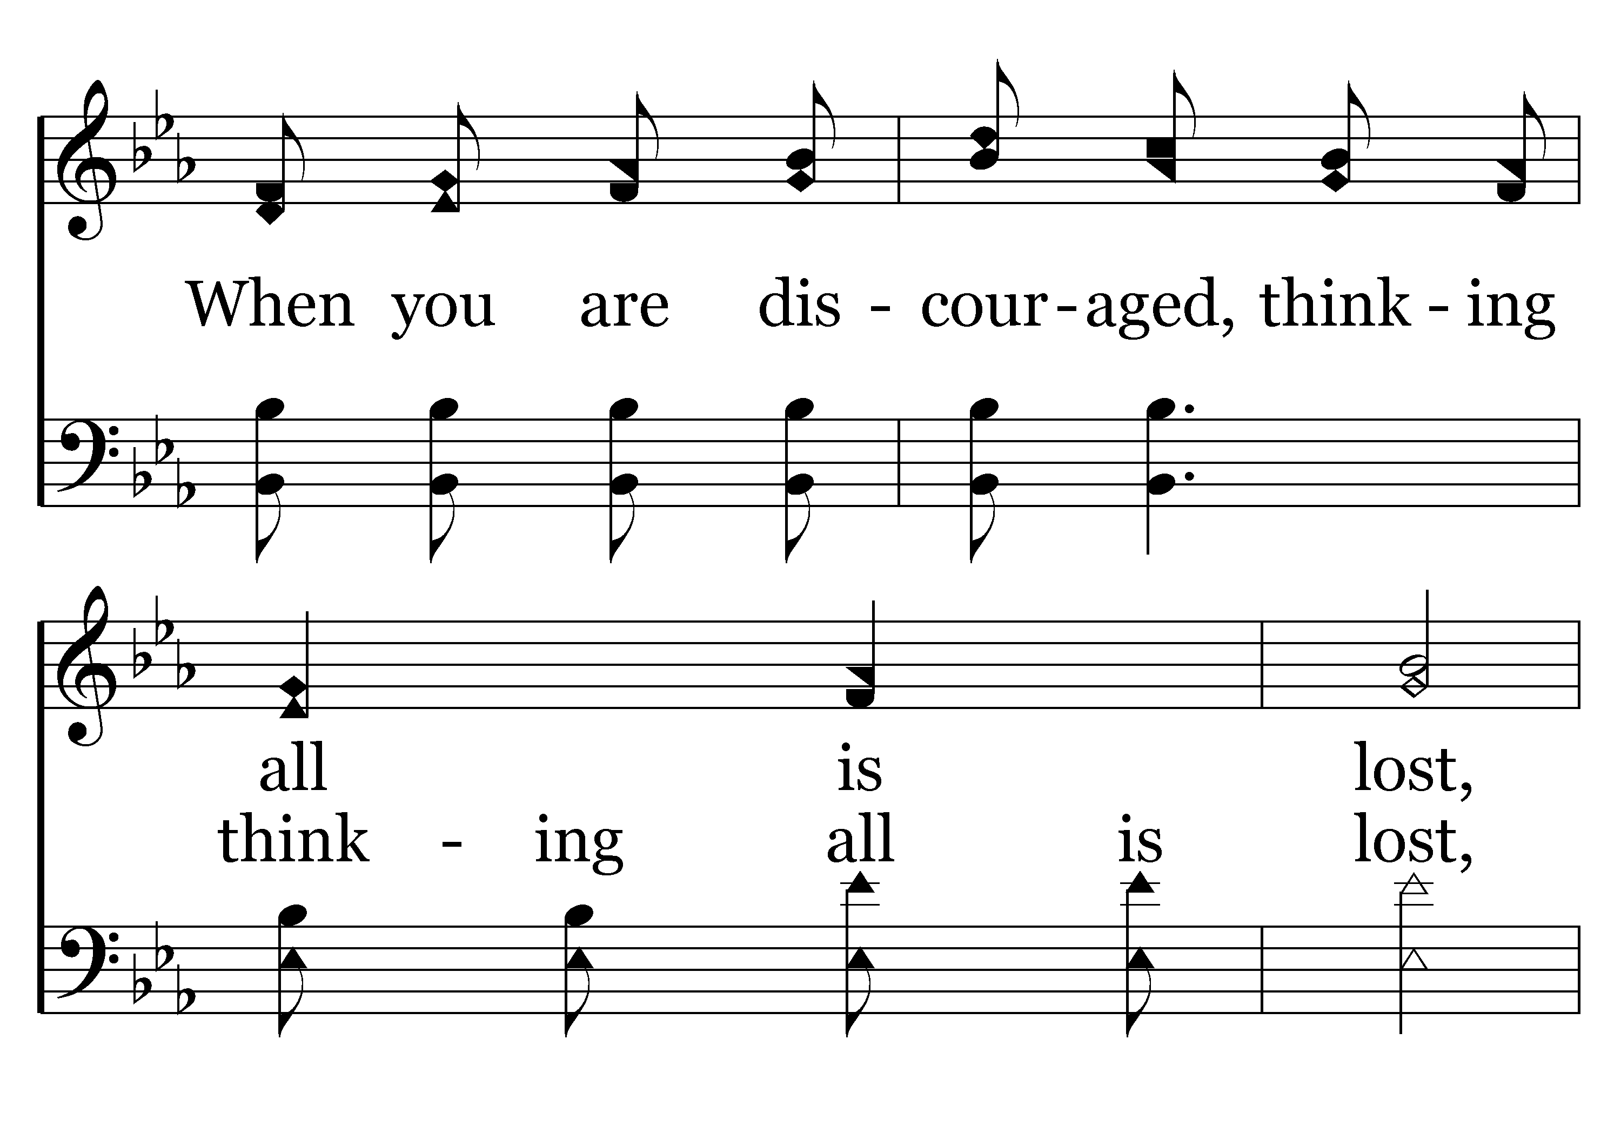
392 - Count Your Blessings - 1.2

Slide 50
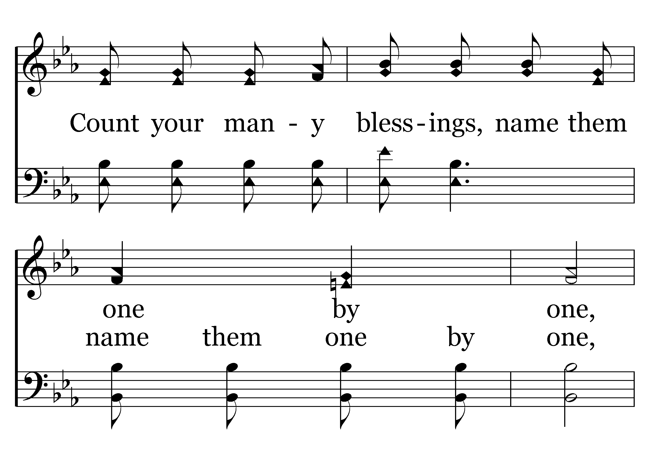
392 - Count Your Blessings - 1.3

Slide 51
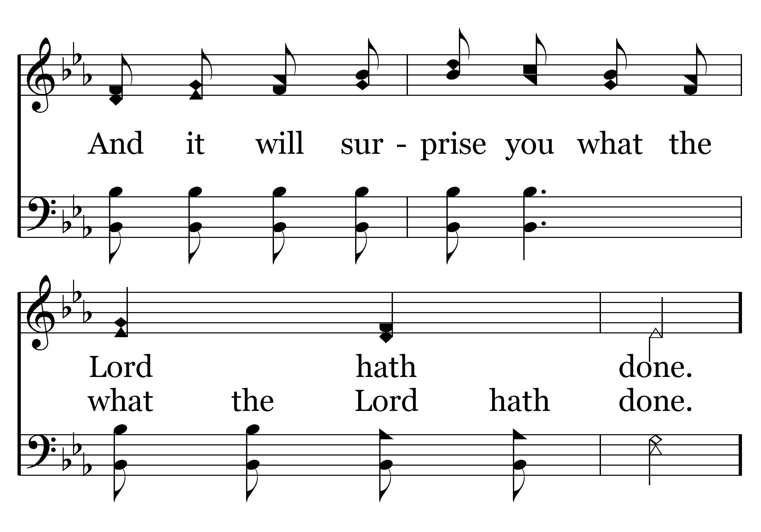
392 - Count Your Blessings - 1.4

Slide 52
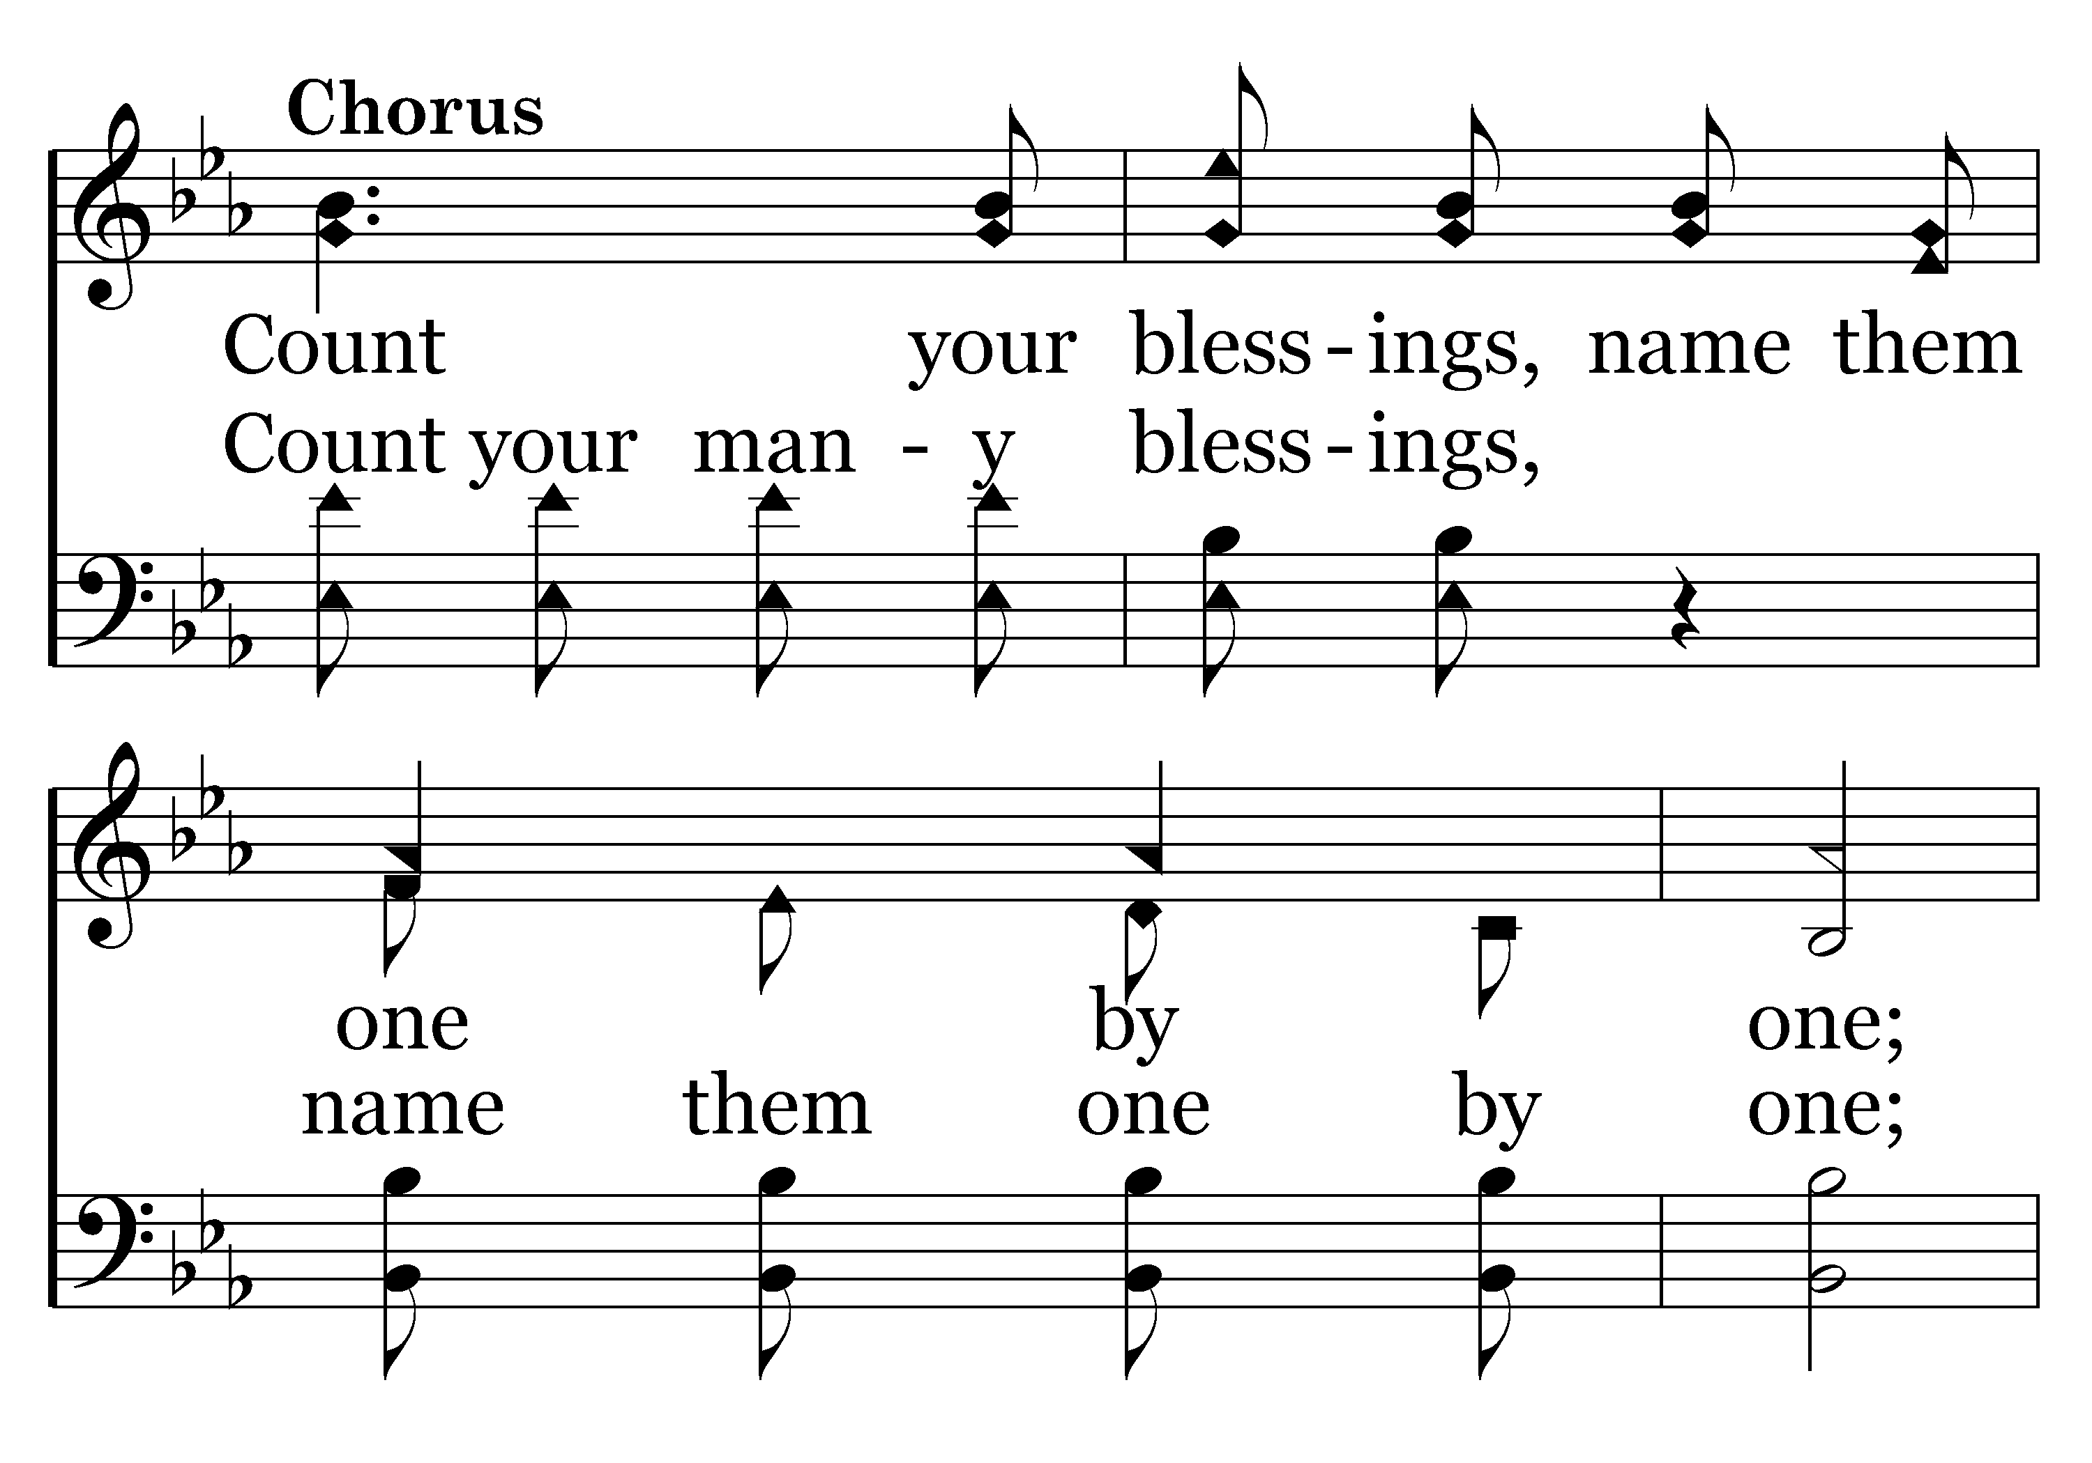
392 - Count Your Blessings - C.1

Slide 53
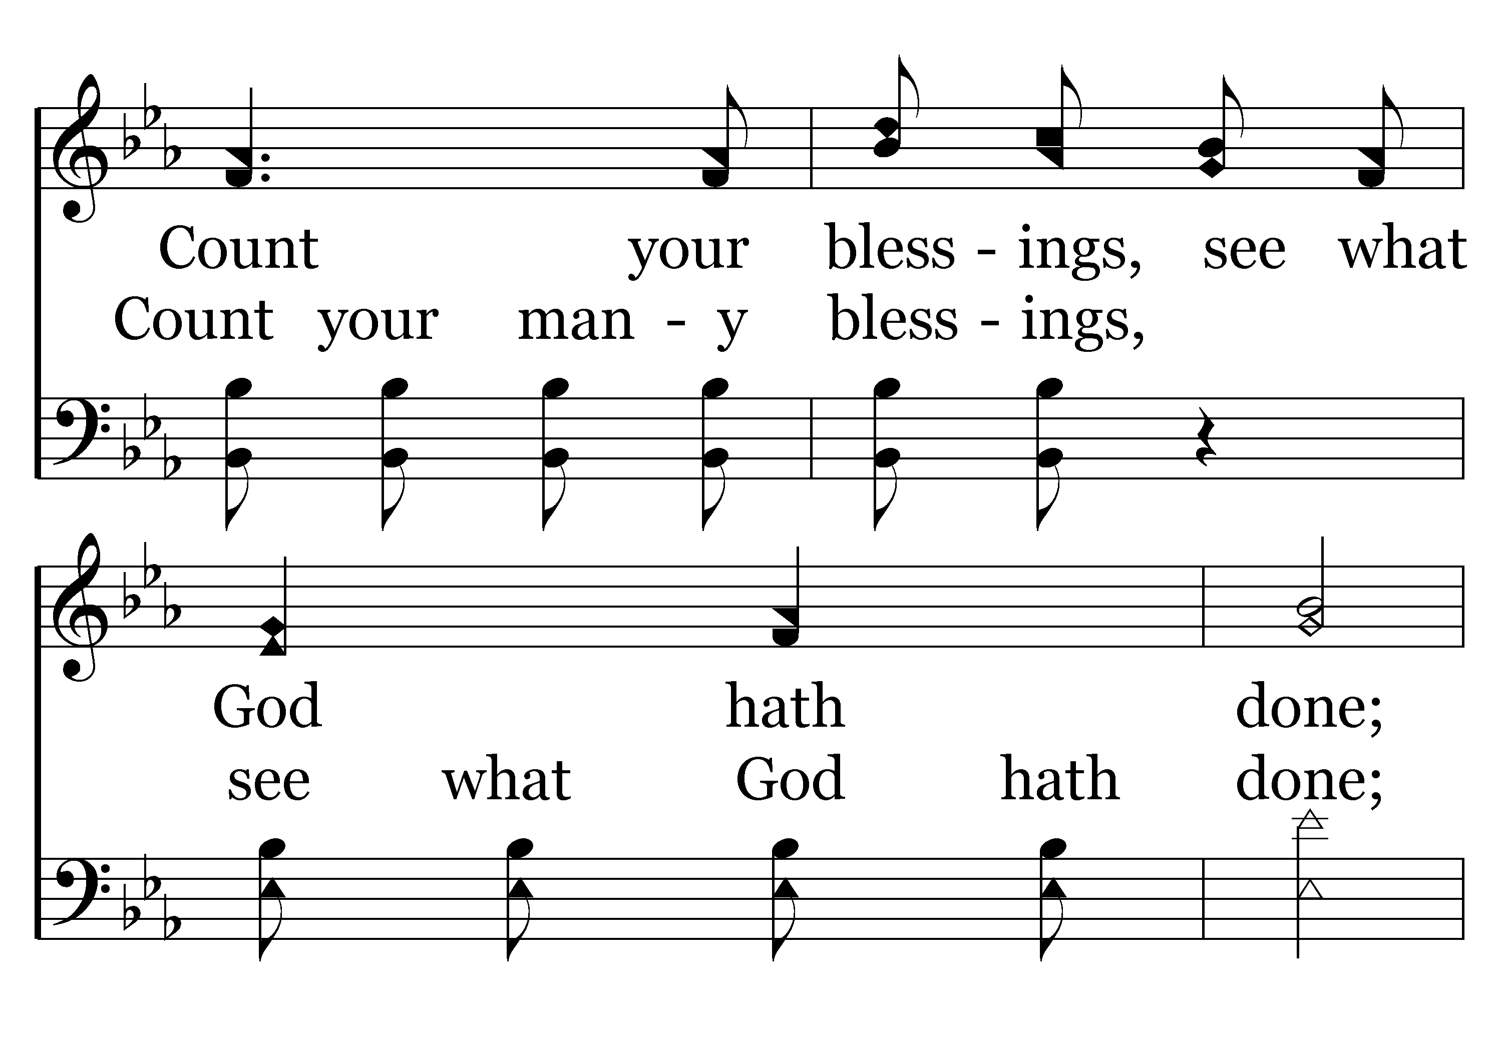
392 - Count Your Blessings - C.2

Slide 54
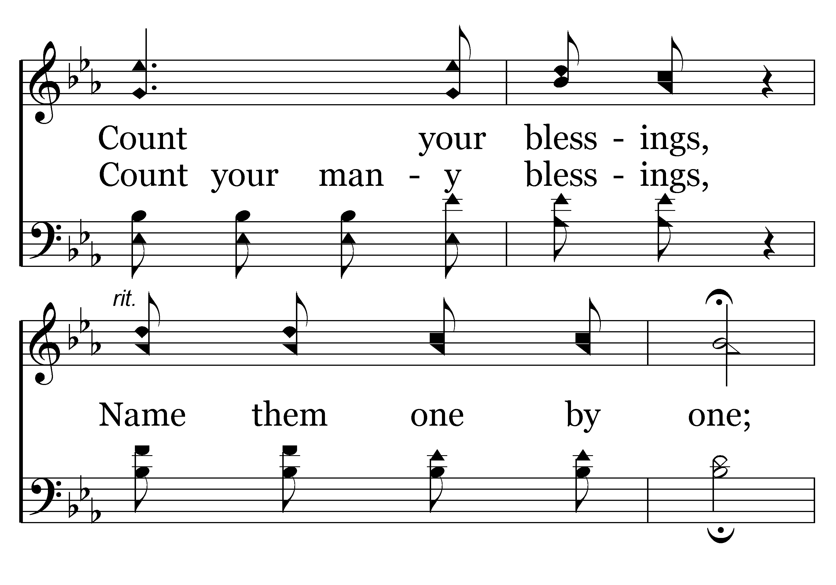
392 - Count Your Blessings - C.3

Slide 55
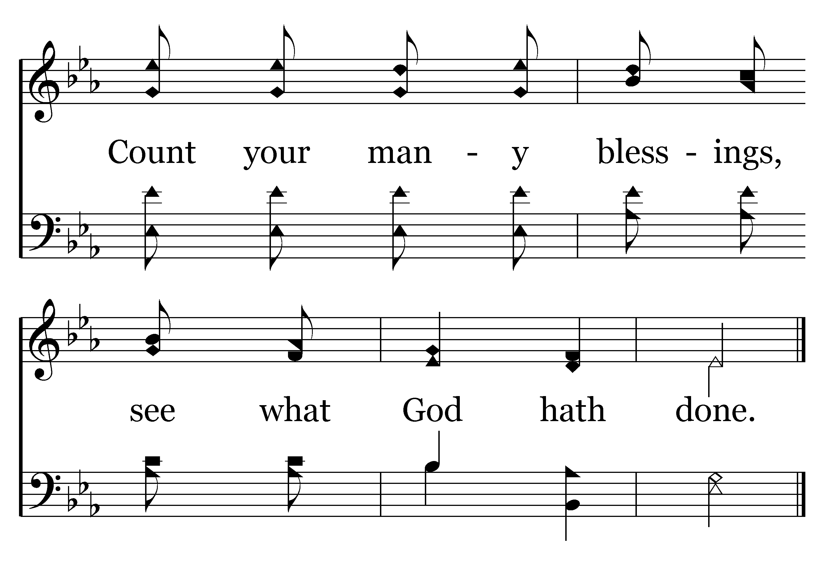
392 - Count Your Blessings - C.4
End of Verse 1

Slide 56
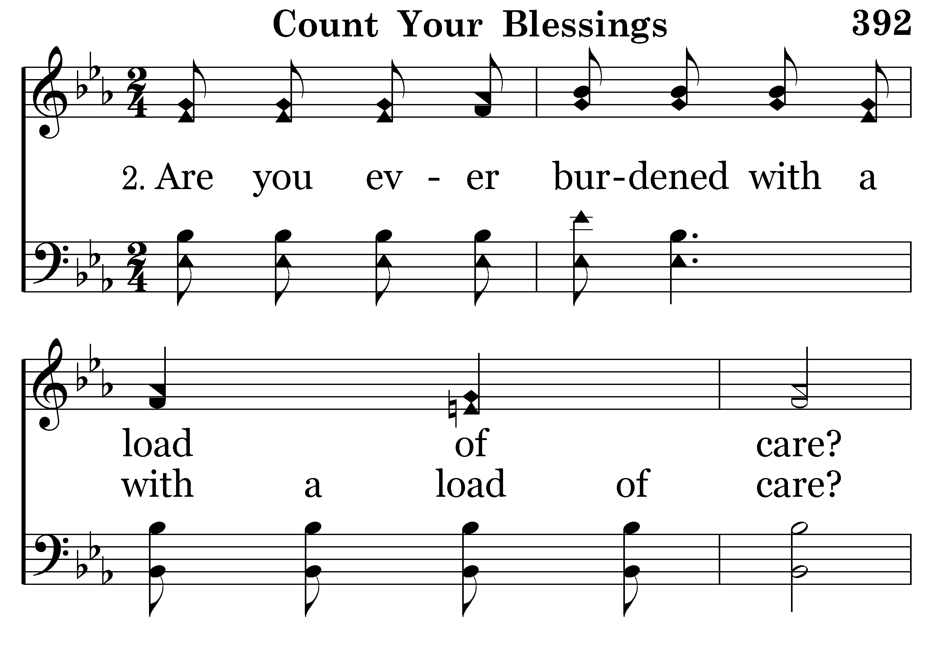
392 - Count Your Blessings - 2.1

Slide 57
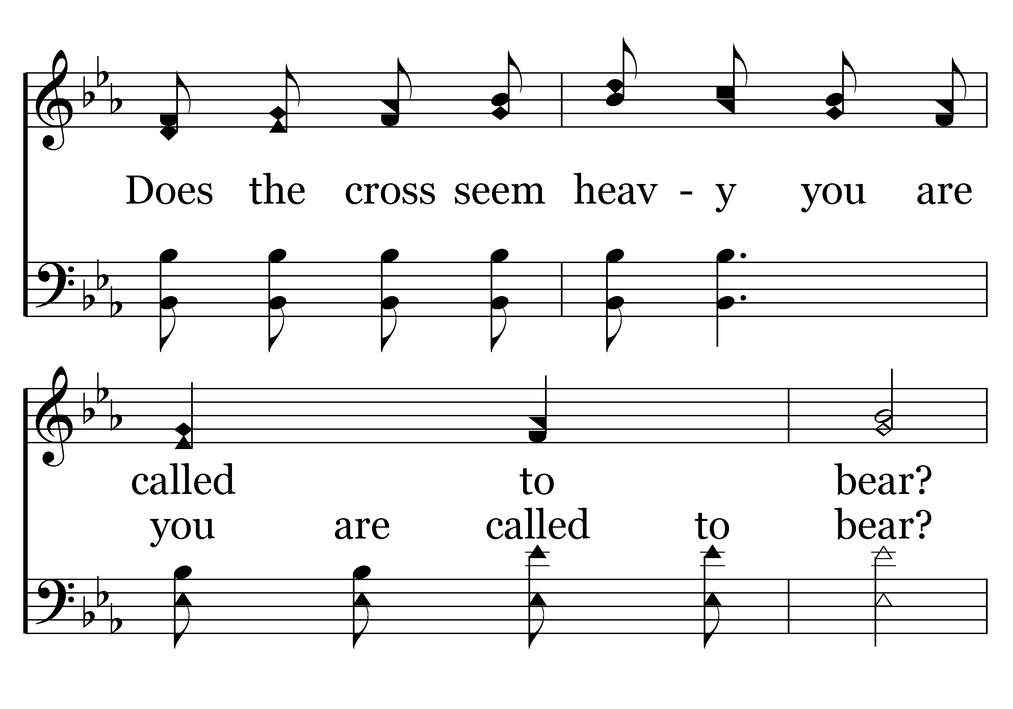
392 - Count Your Blessings - 2.2

Slide 58
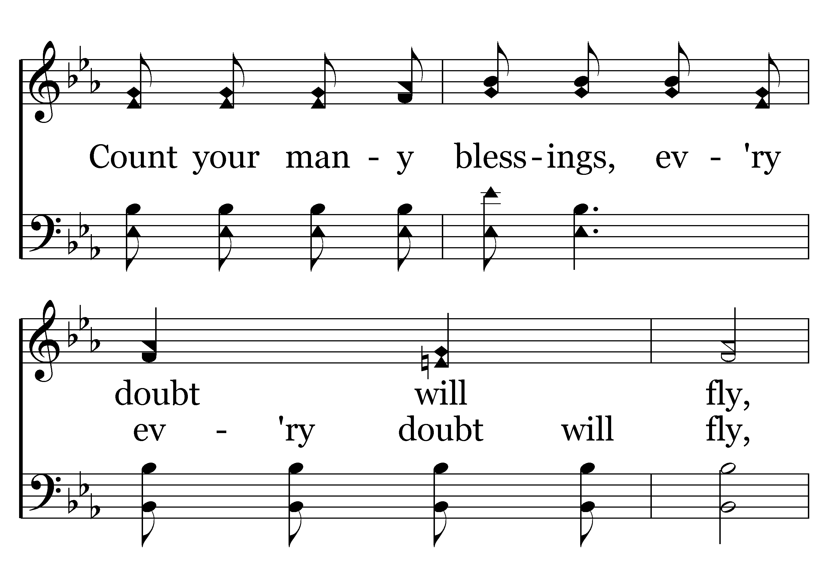
392 - Count Your Blessings - 2.3

Slide 59
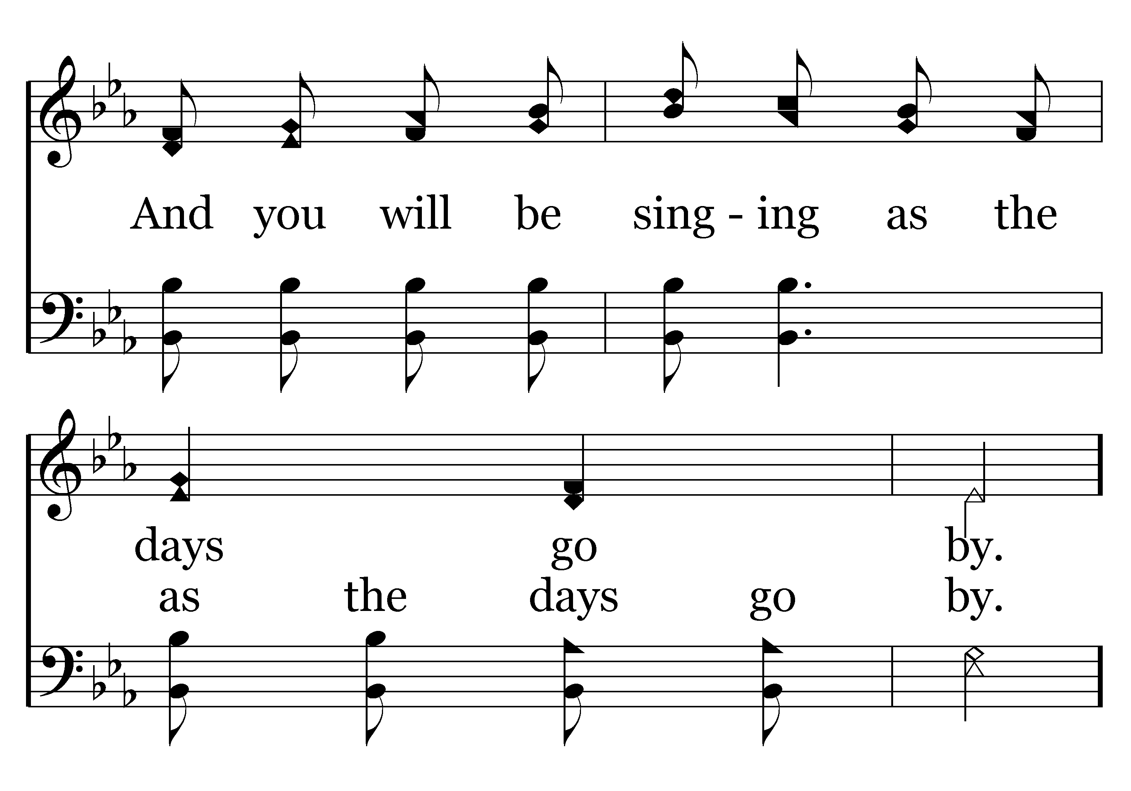
392 - Count Your Blessings - 2.4

Slide 60
392 - Count Your Blessings - C.1

Slide 61
392 - Count Your Blessings - C.2

Slide 62
392 - Count Your Blessings - C.3

Slide 63
392 - Count Your Blessings - C.4
End of Verse 2

Slide 64
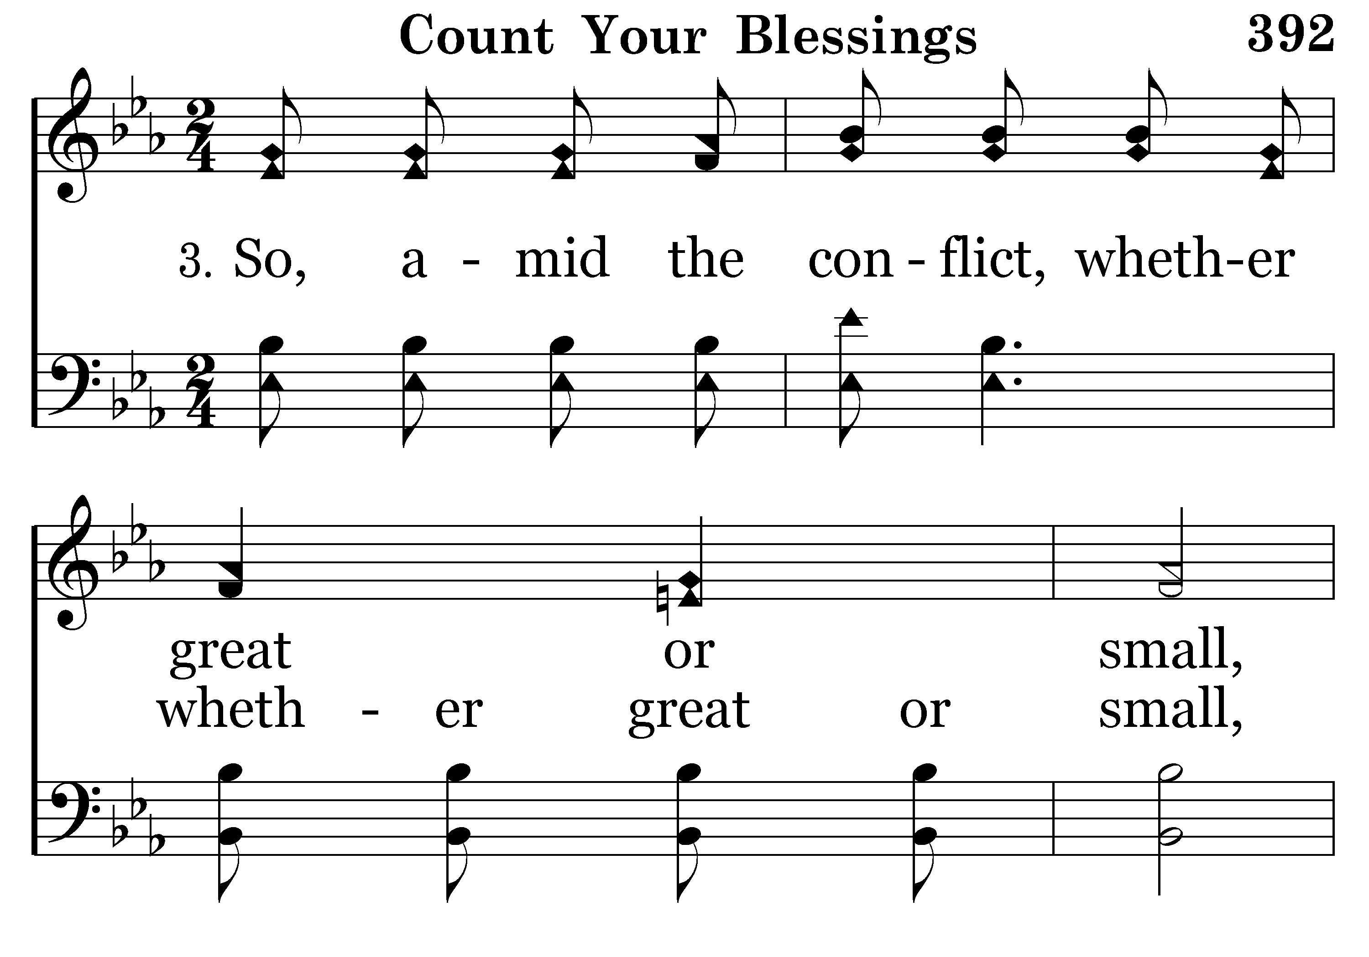
392 - Count Your Blessings - 3.1

Slide 65
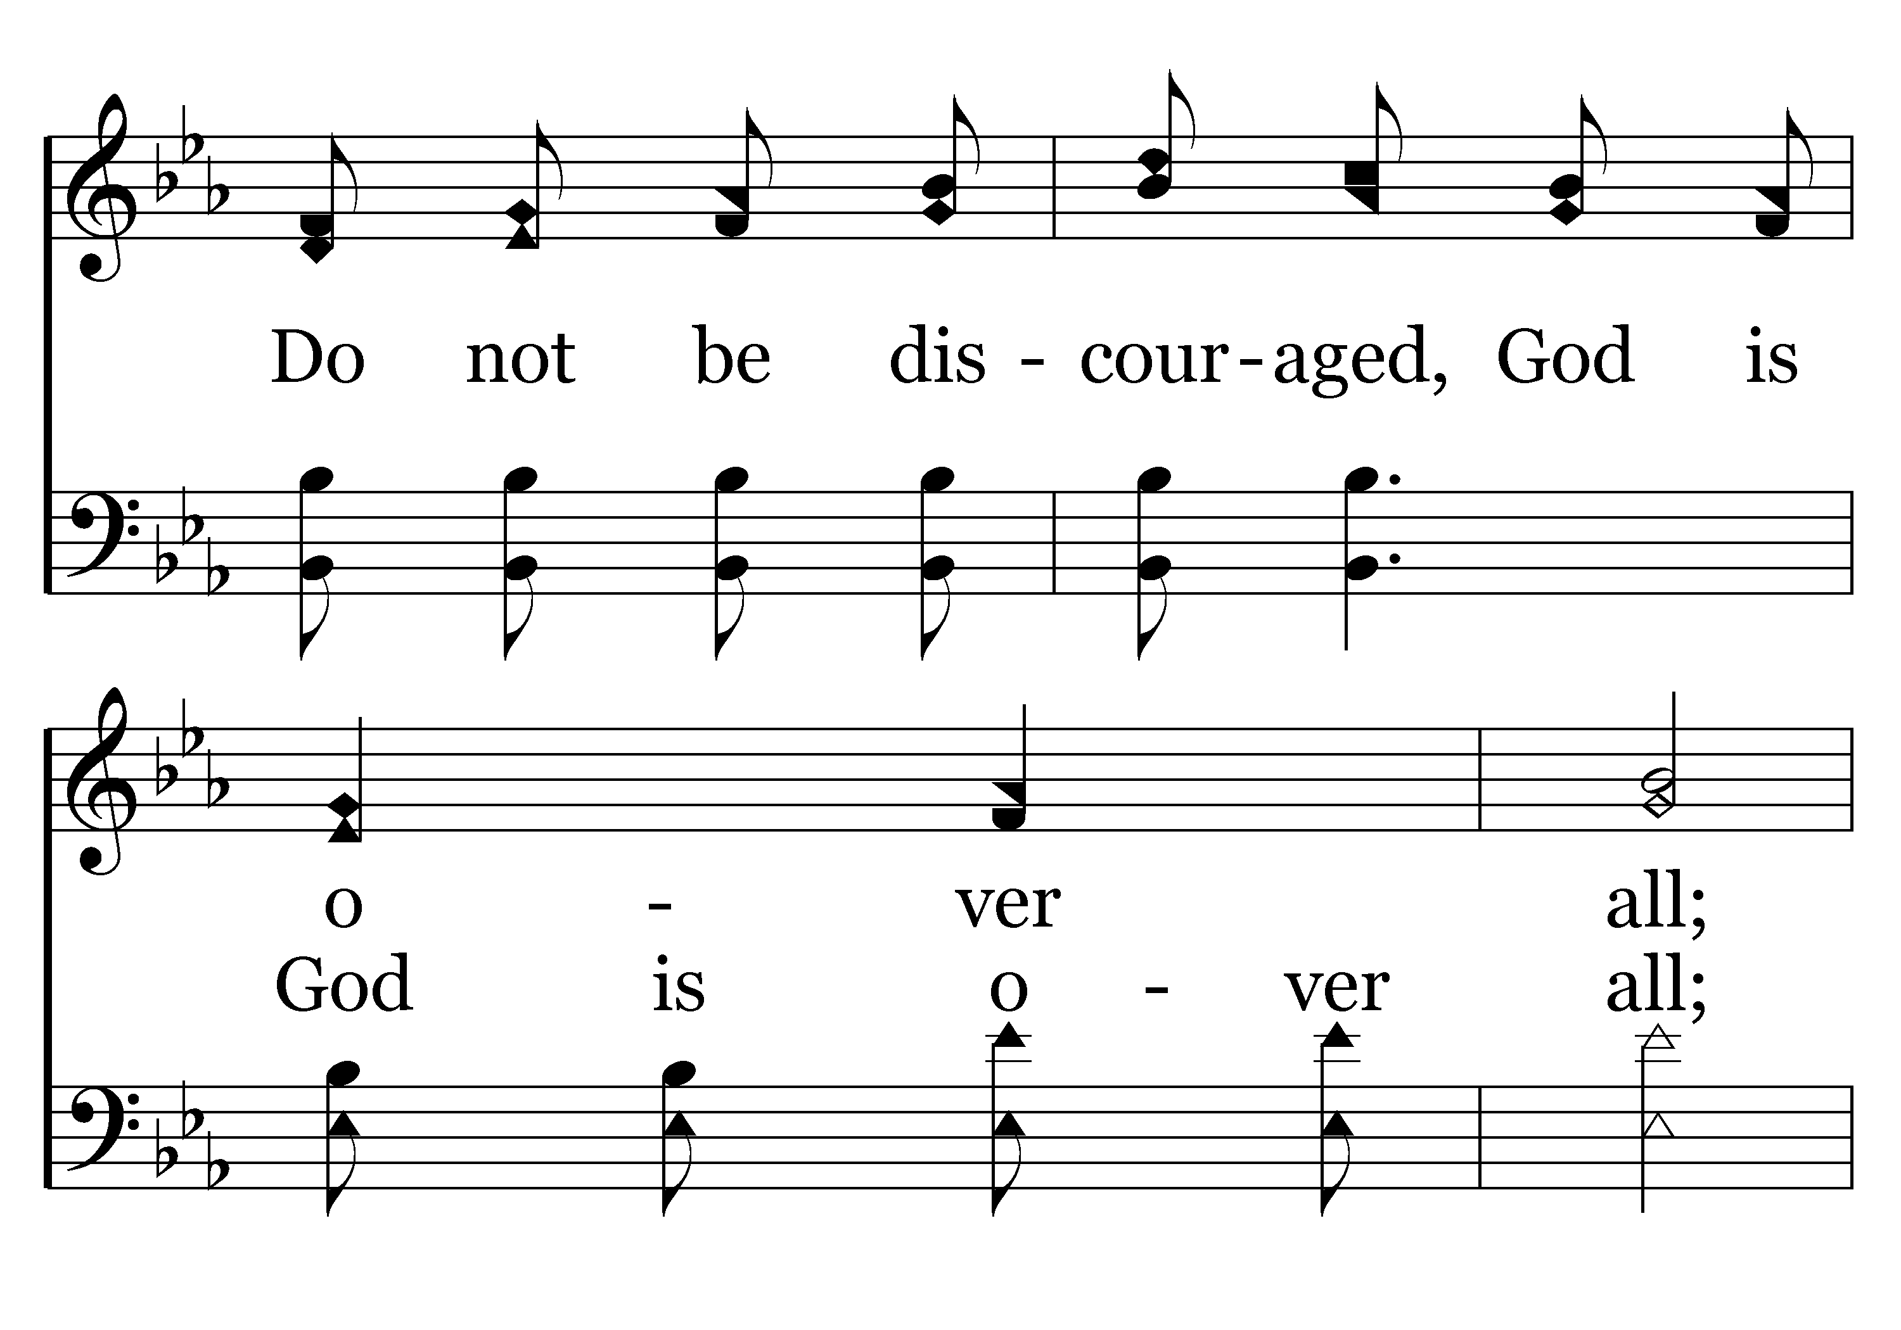
392 - Count Your Blessings - 3.2

Slide 66
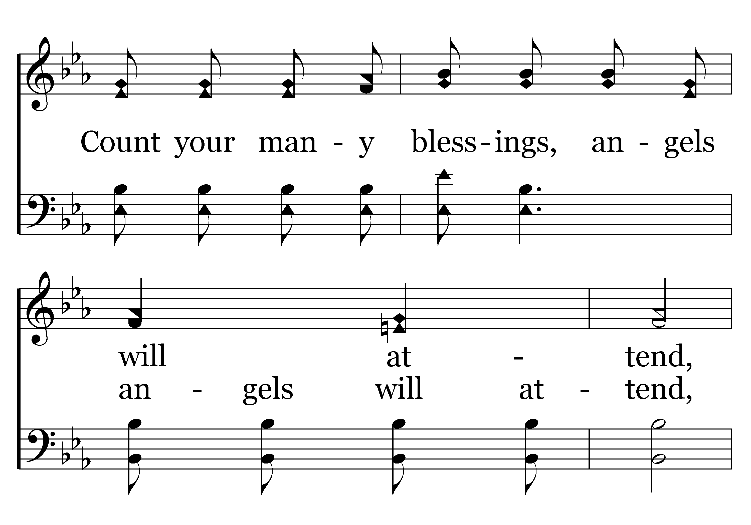
392 - Count Your Blessings - 3.3

Slide 67
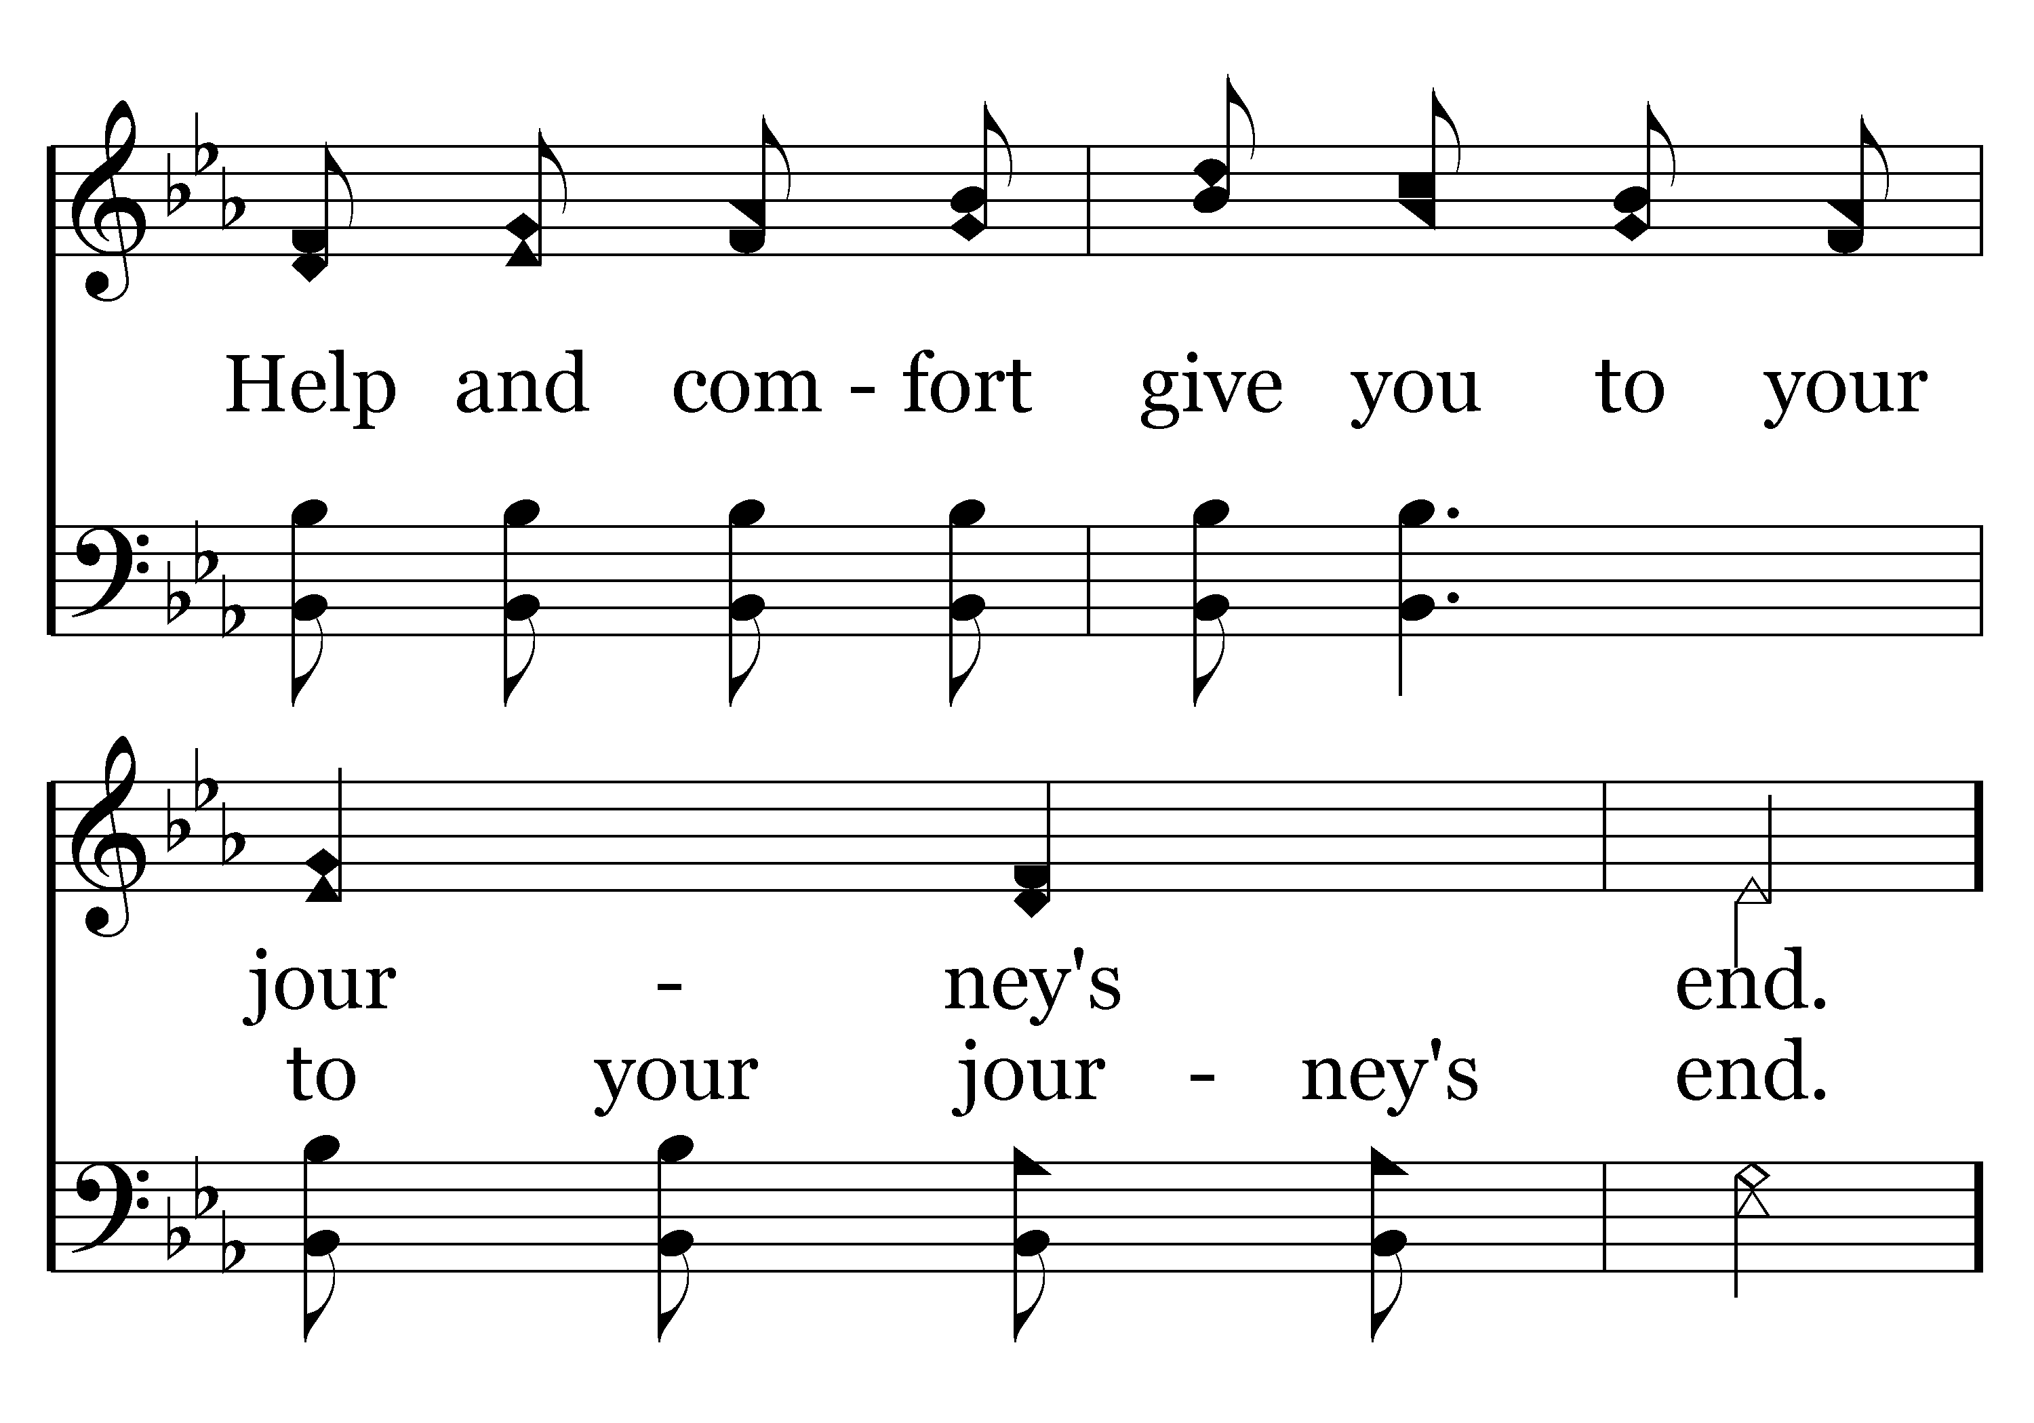
392 - Count Your Blessings - 3.4

Slide 68
392 - Count Your Blessings - C.1

Slide 69
392 - Count Your Blessings - C.2

Slide 70
392 - Count Your Blessings - C.3

Slide 71
392 - Count Your Blessings - C.4
End of Song

Slide 73
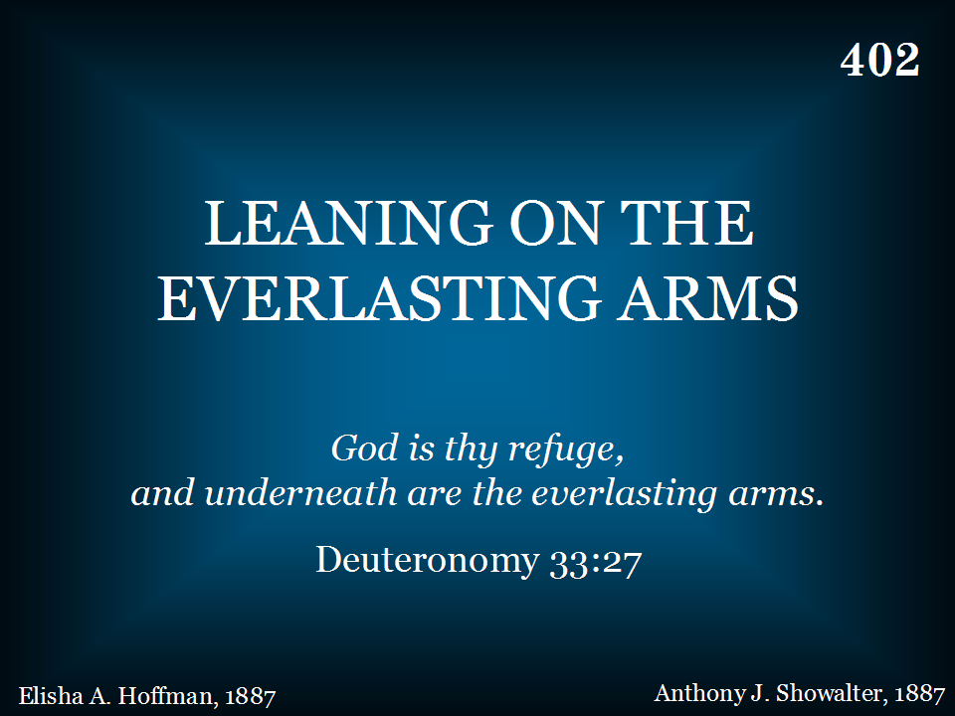
402 - Leaning On The Everlasting Arms - Title

Slide 74
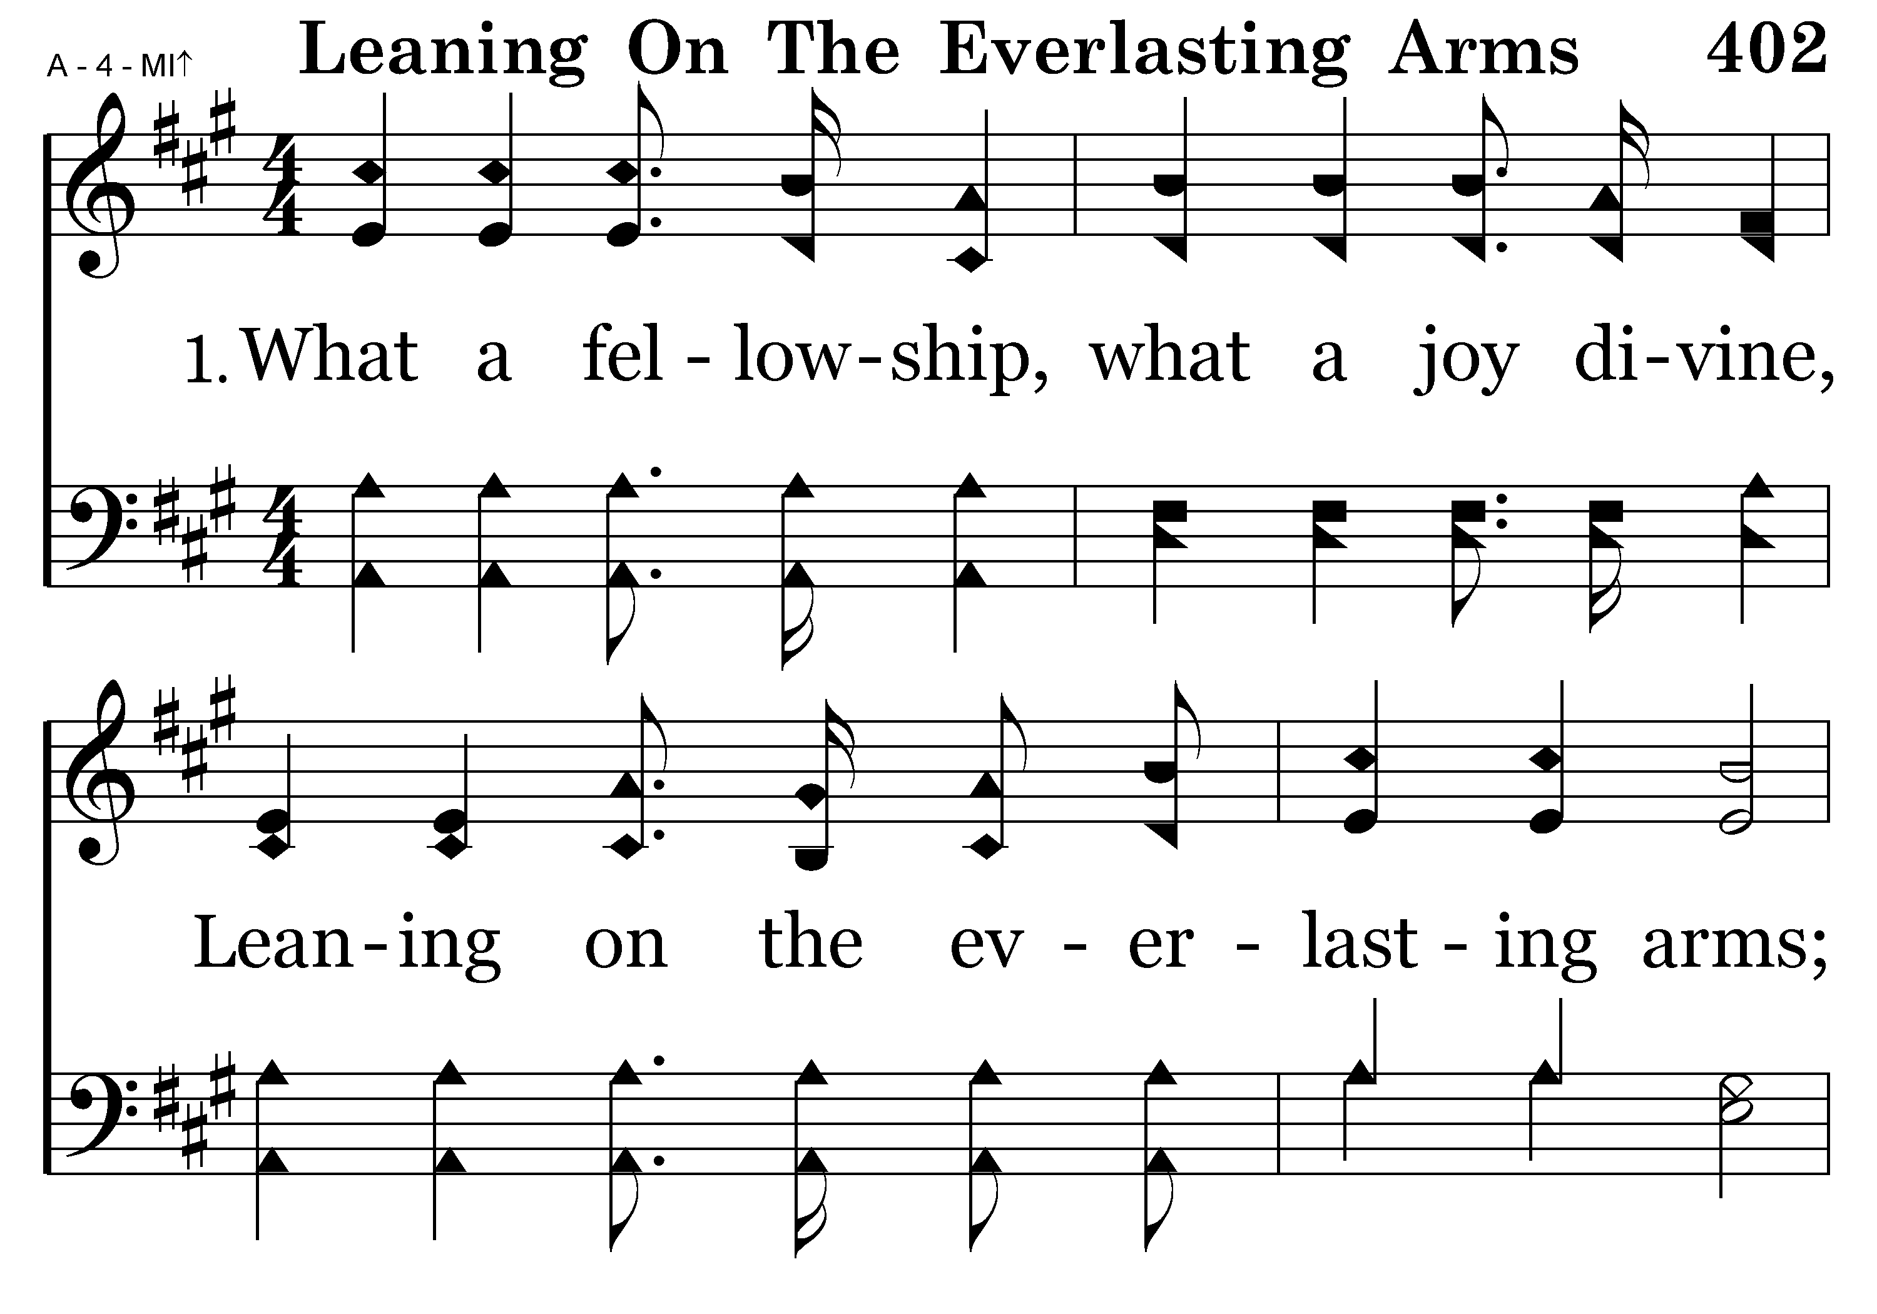
402 - Leaning On The Everlasting Arms - 1.1

Slide 75
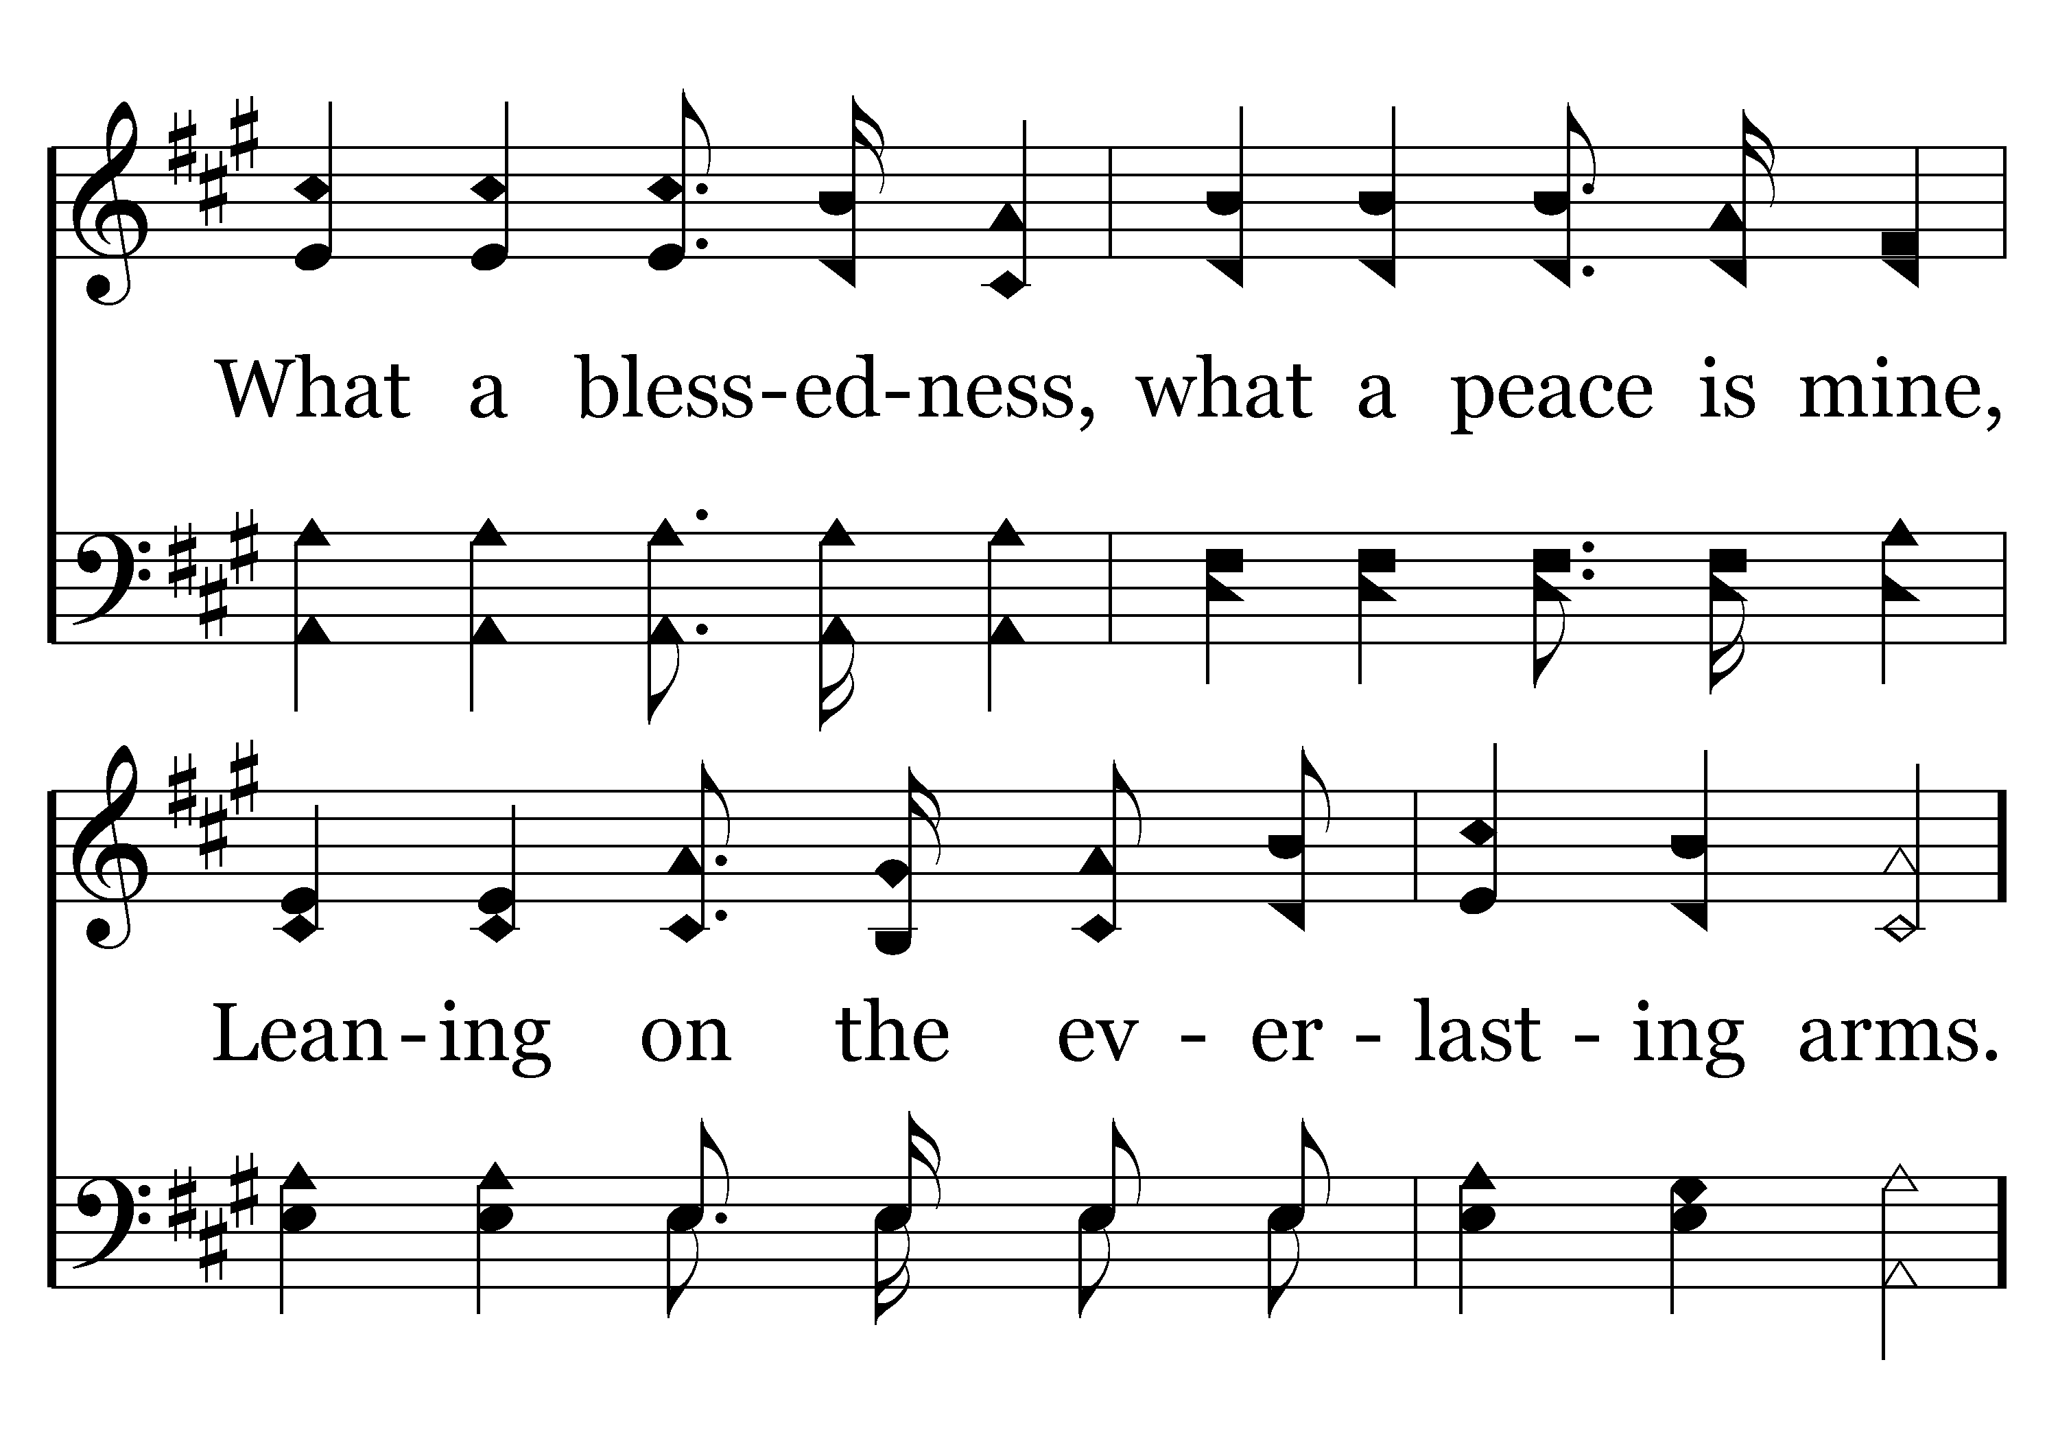
402 - Leaning On The Everlasting Arms - 1.2

Slide 76
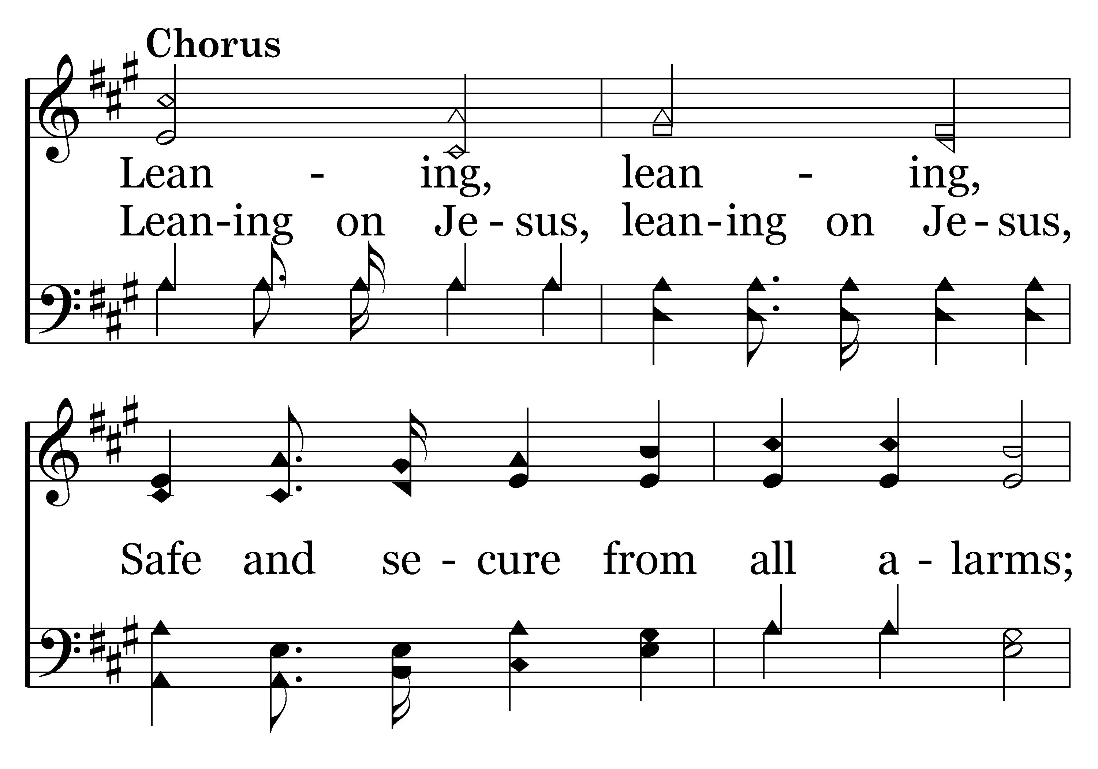
402 - Leaning On The Everlasting Arms - C.1

Slide 77
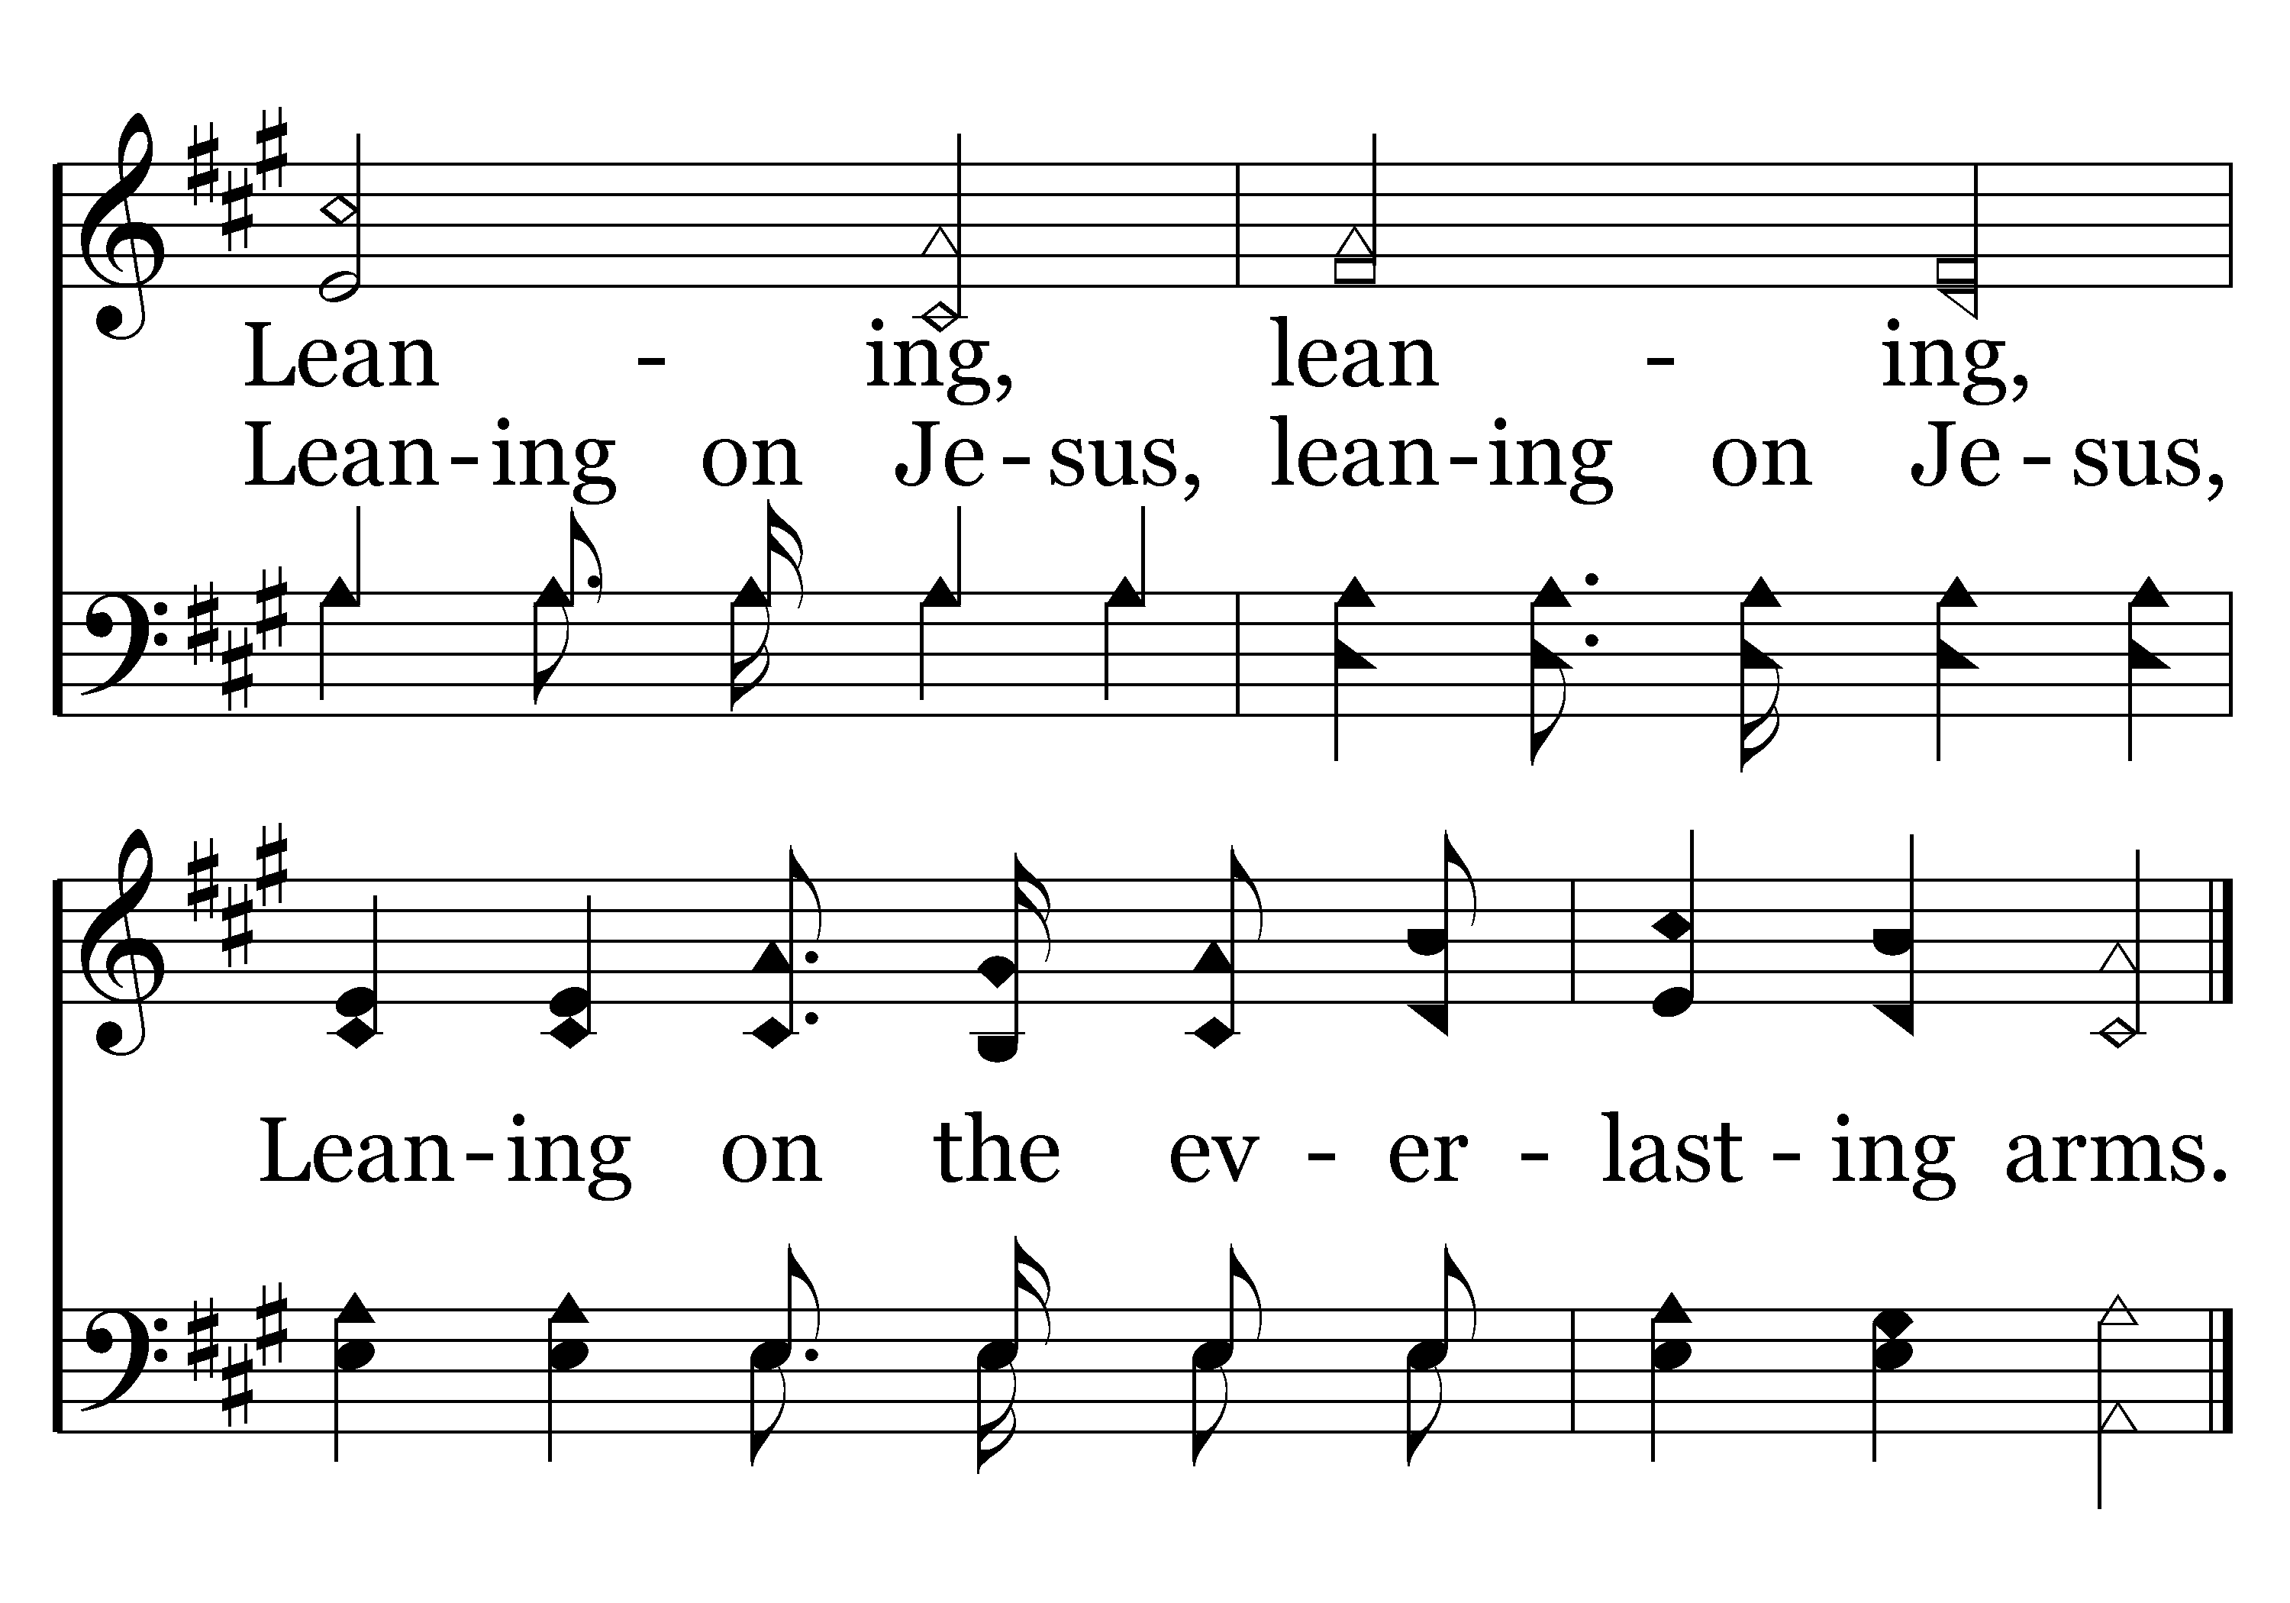
402 - Leaning On The Everlasting Arms - C.2
End of Verse 1

Slide 78
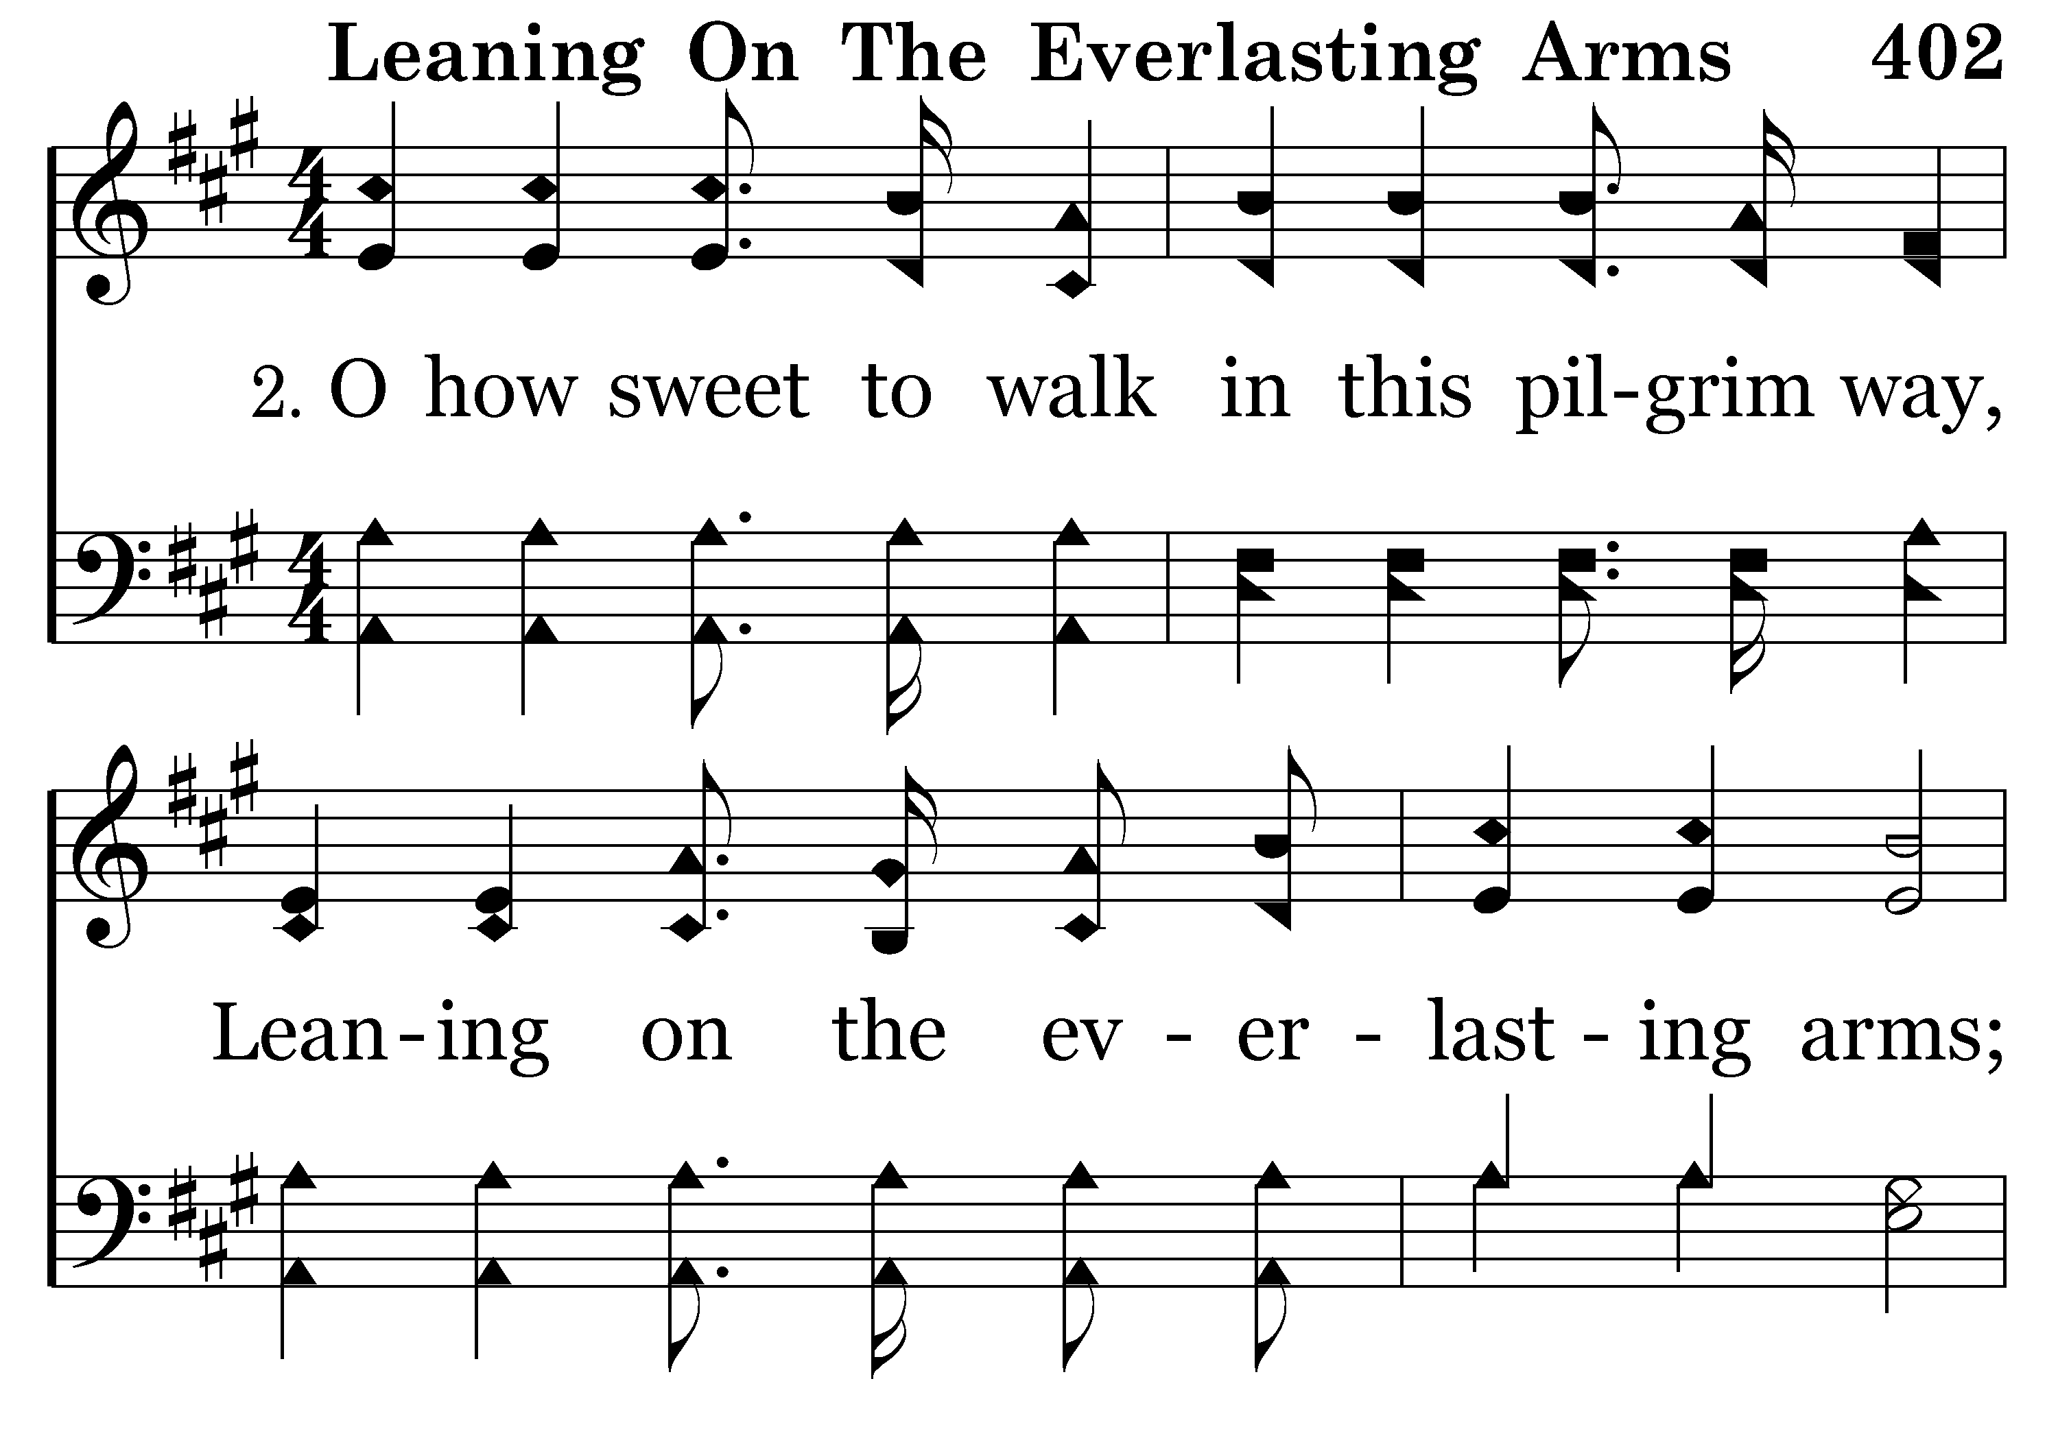
402 - Leaning On The Everlasting Arms - 2.1

Slide 79
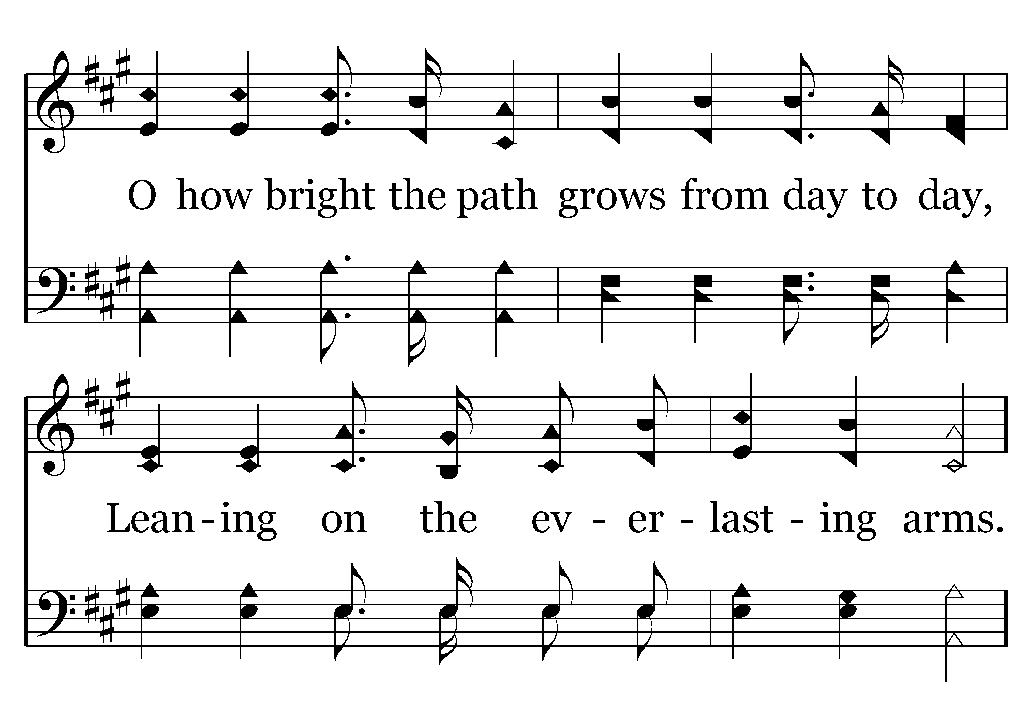
402 - Leaning On The Everlasting Arms - 2.2

Slide 80
402 - Leaning On The Everlasting Arms - C.1

Slide 81
402 - Leaning On The Everlasting Arms - C.2
End of Verse 2

Slide 82
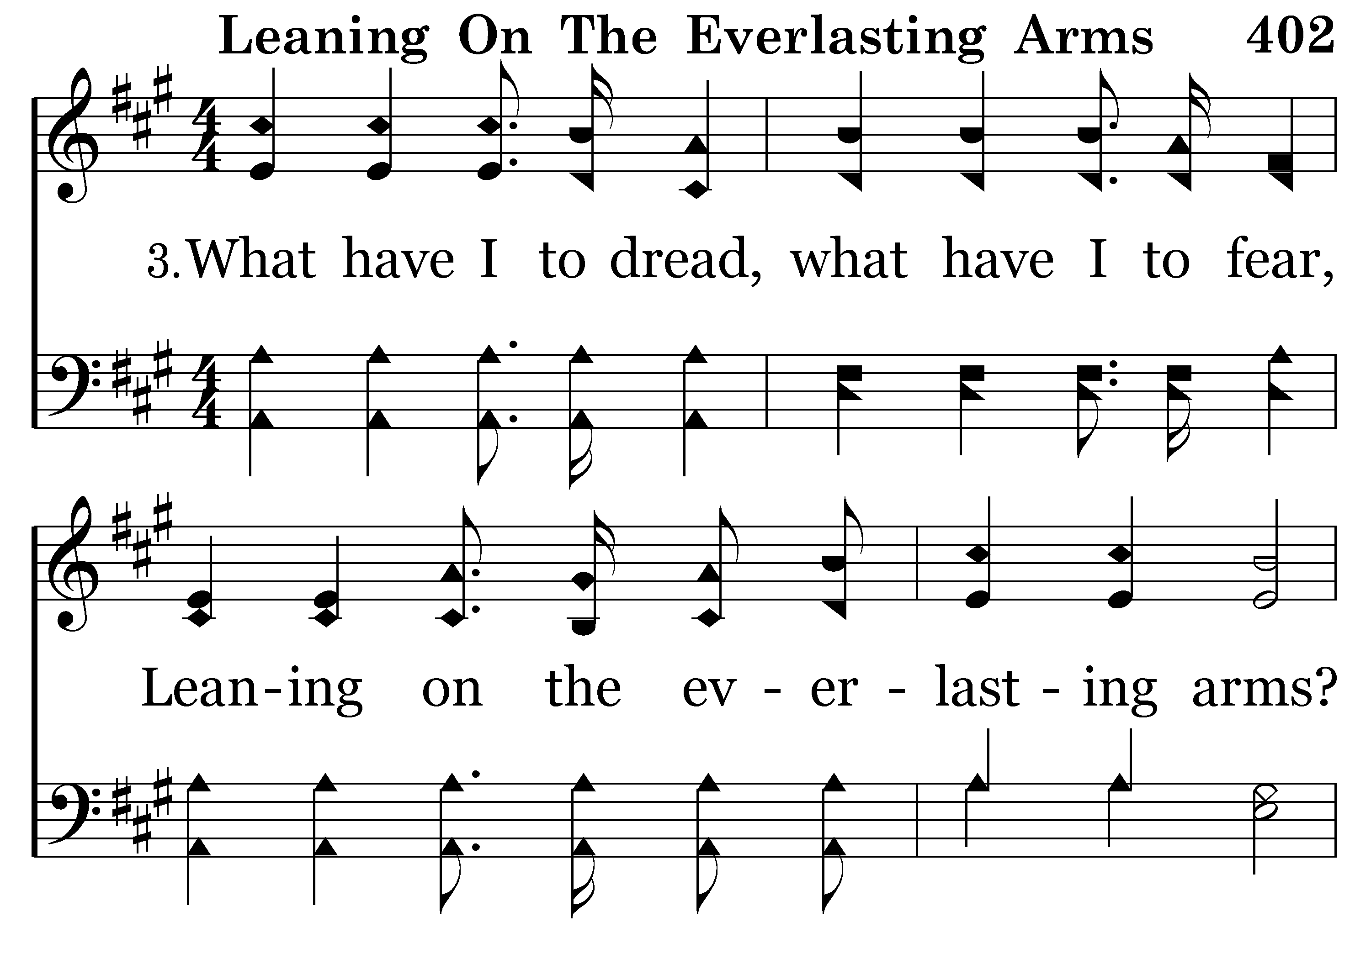
402 - Leaning On The Everlasting Arms - 3.1

Slide 83
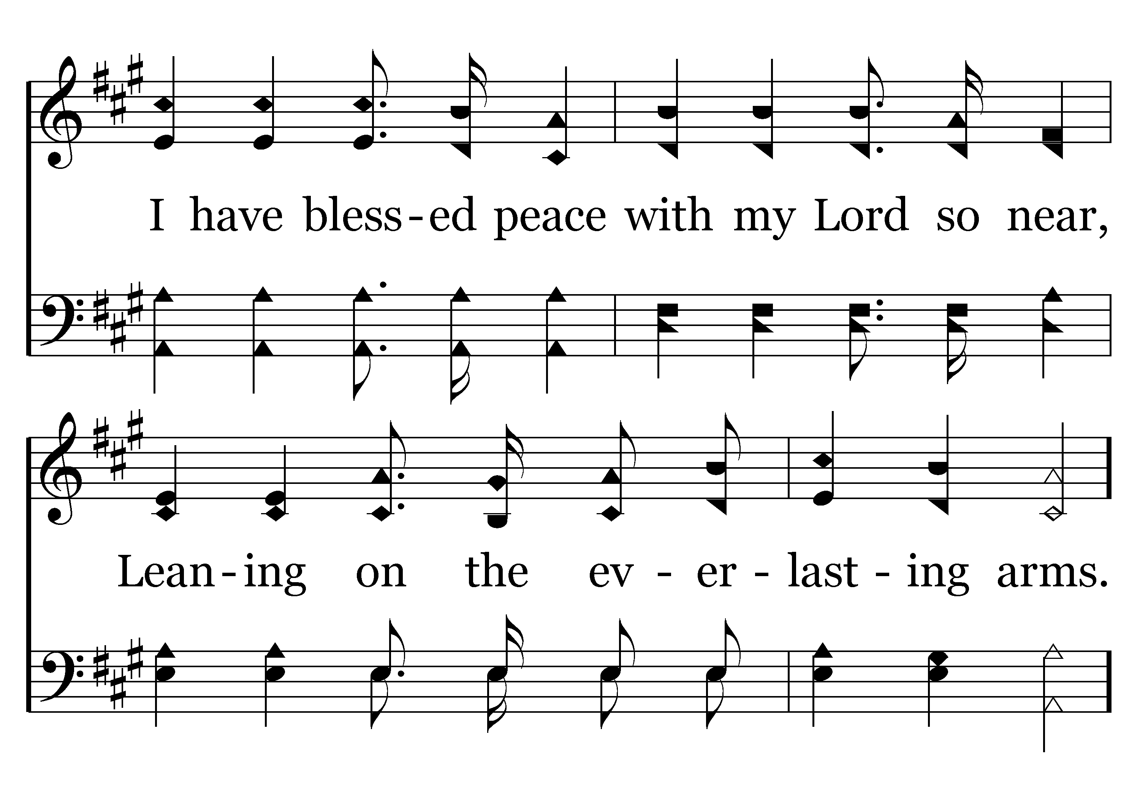
402 - Leaning On The Everlasting Arms - 3.2

Slide 84
402 - Leaning On The Everlasting Arms - C.1

Slide 85
402 - Leaning On The Everlasting Arms - C.2
End of Song

Slide 87
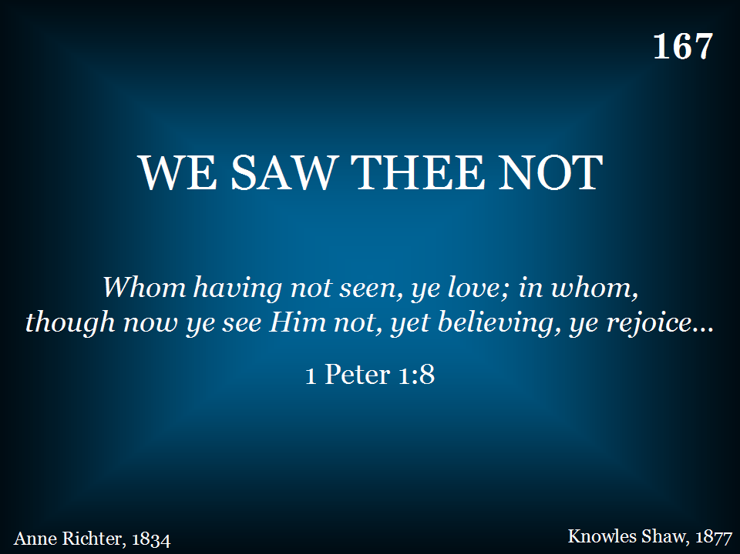
167 - We Saw Thee Not - Title

Slide 88
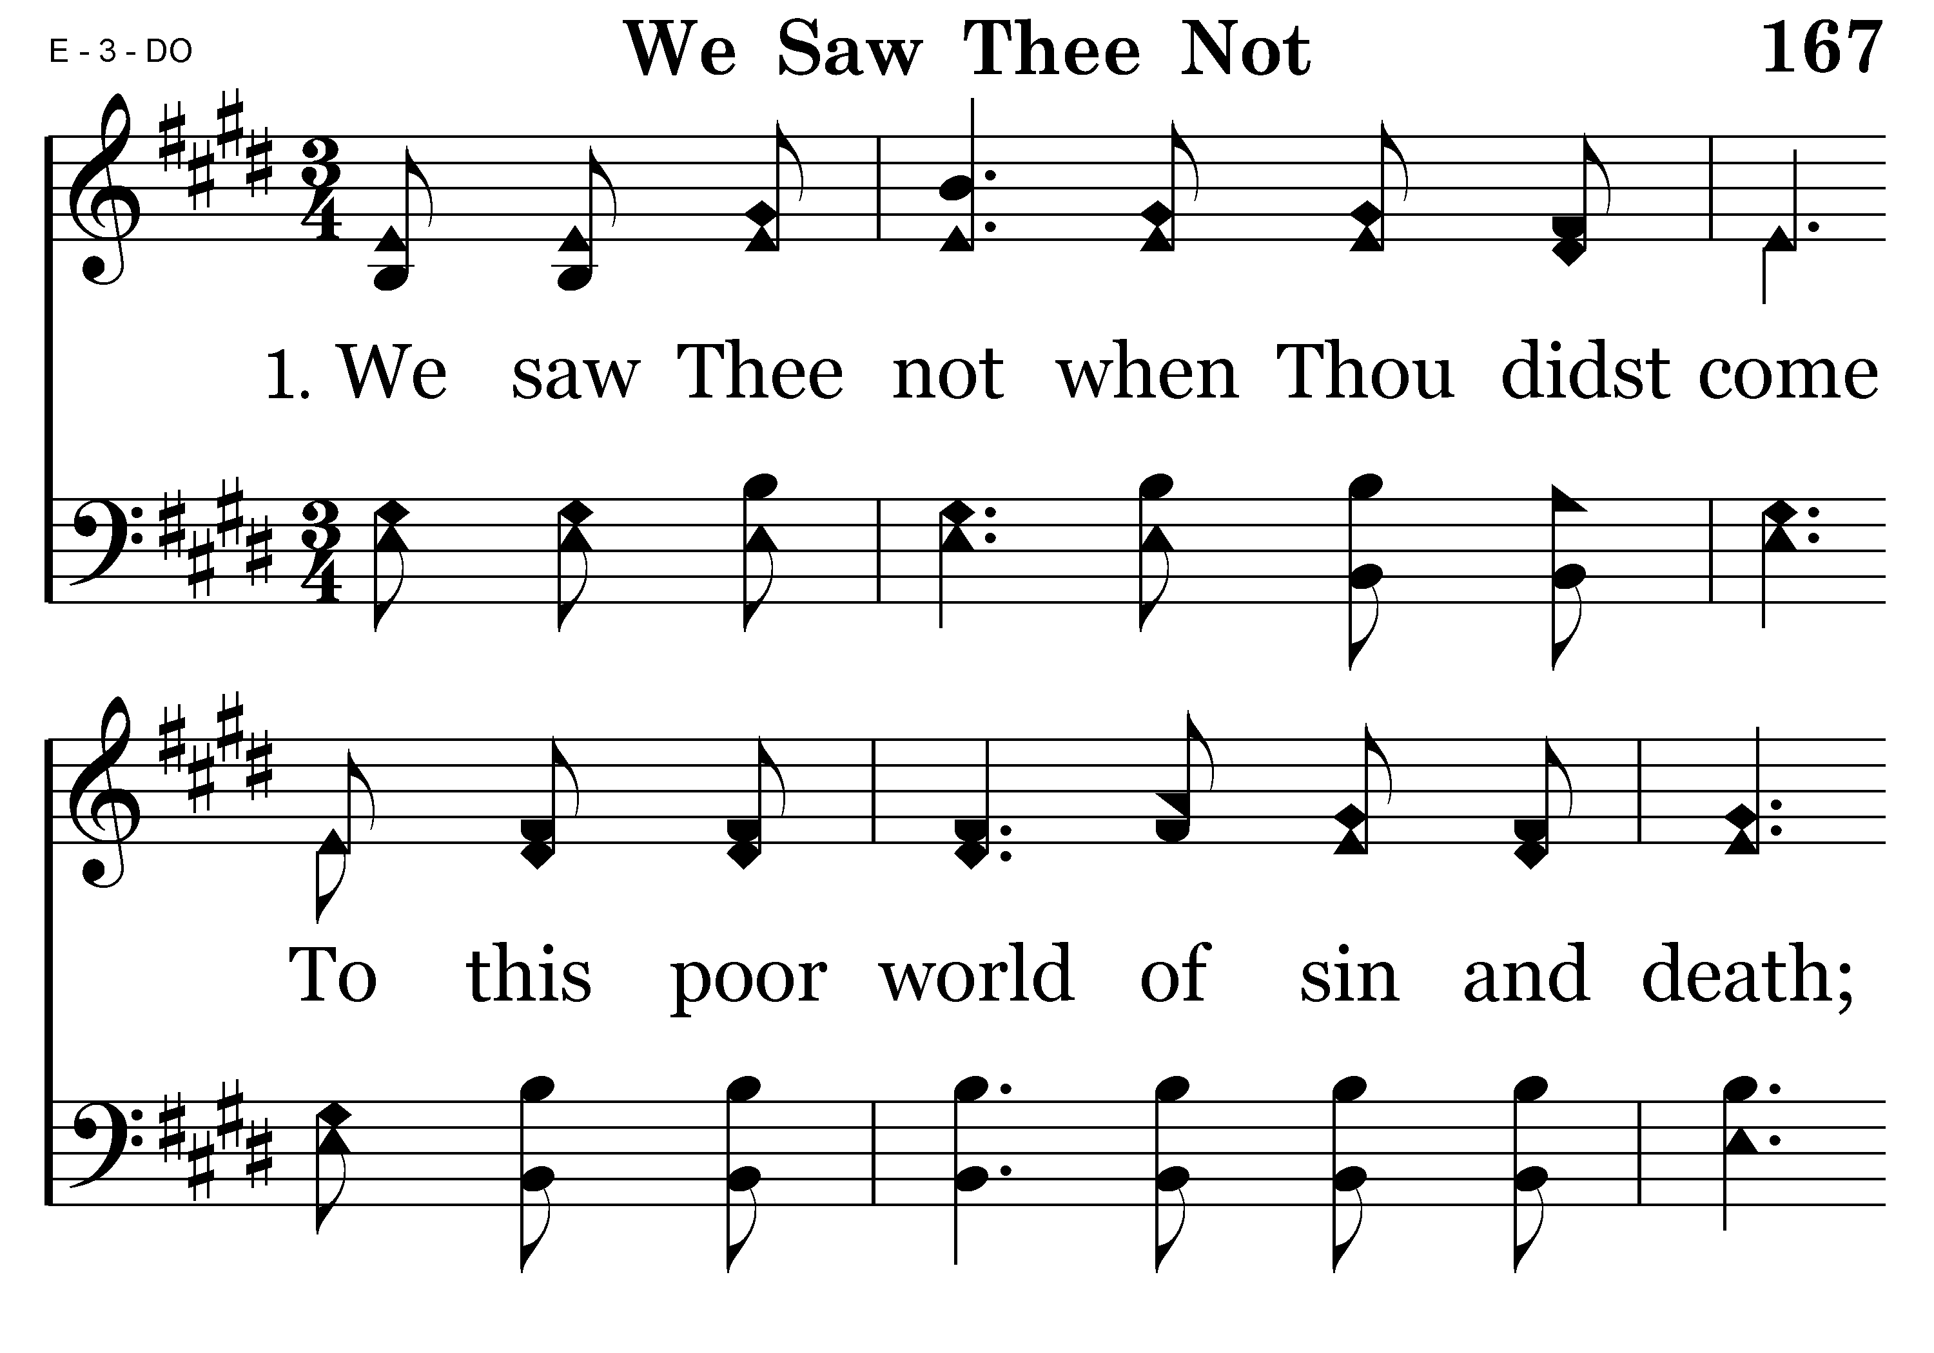
167 - We Saw Thee Not - 1.1

Slide 89
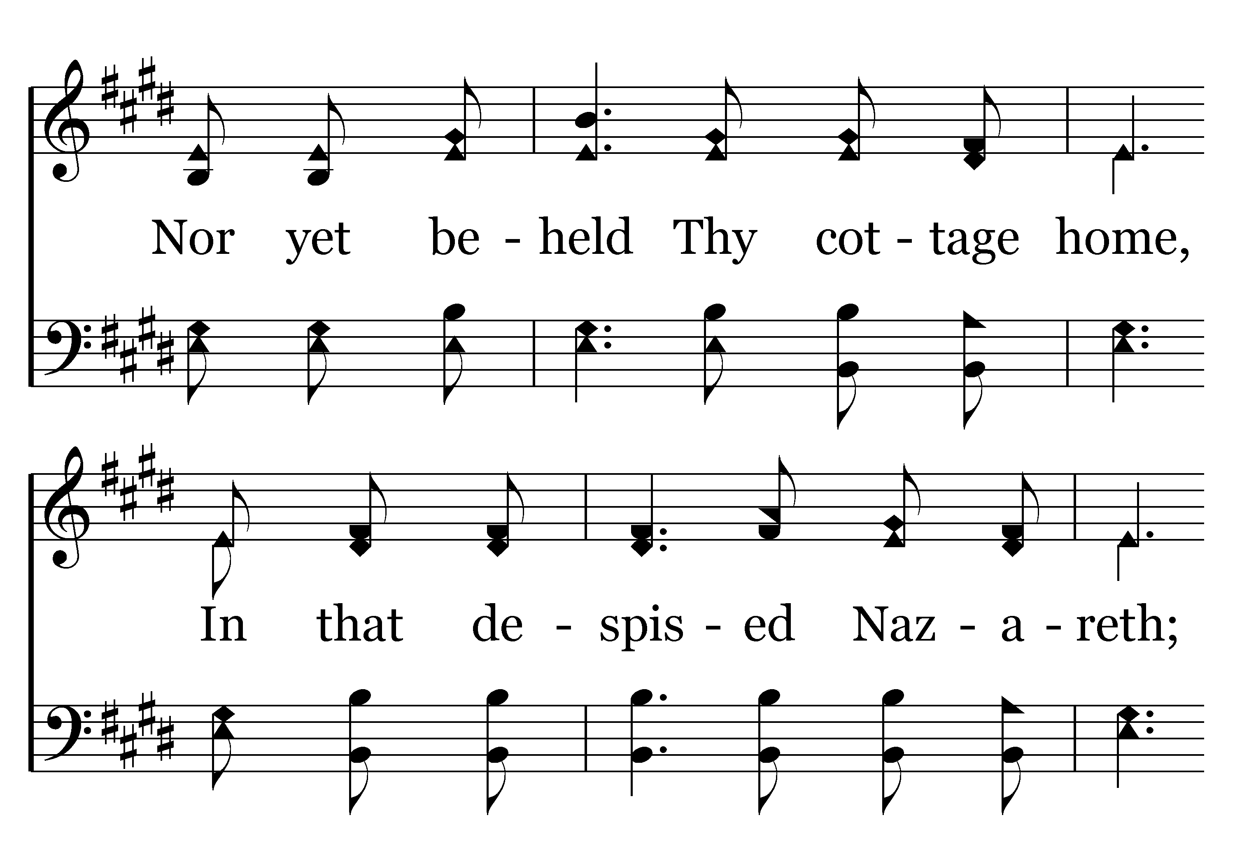
167 - We Saw Thee Not - 1.2

Slide 90
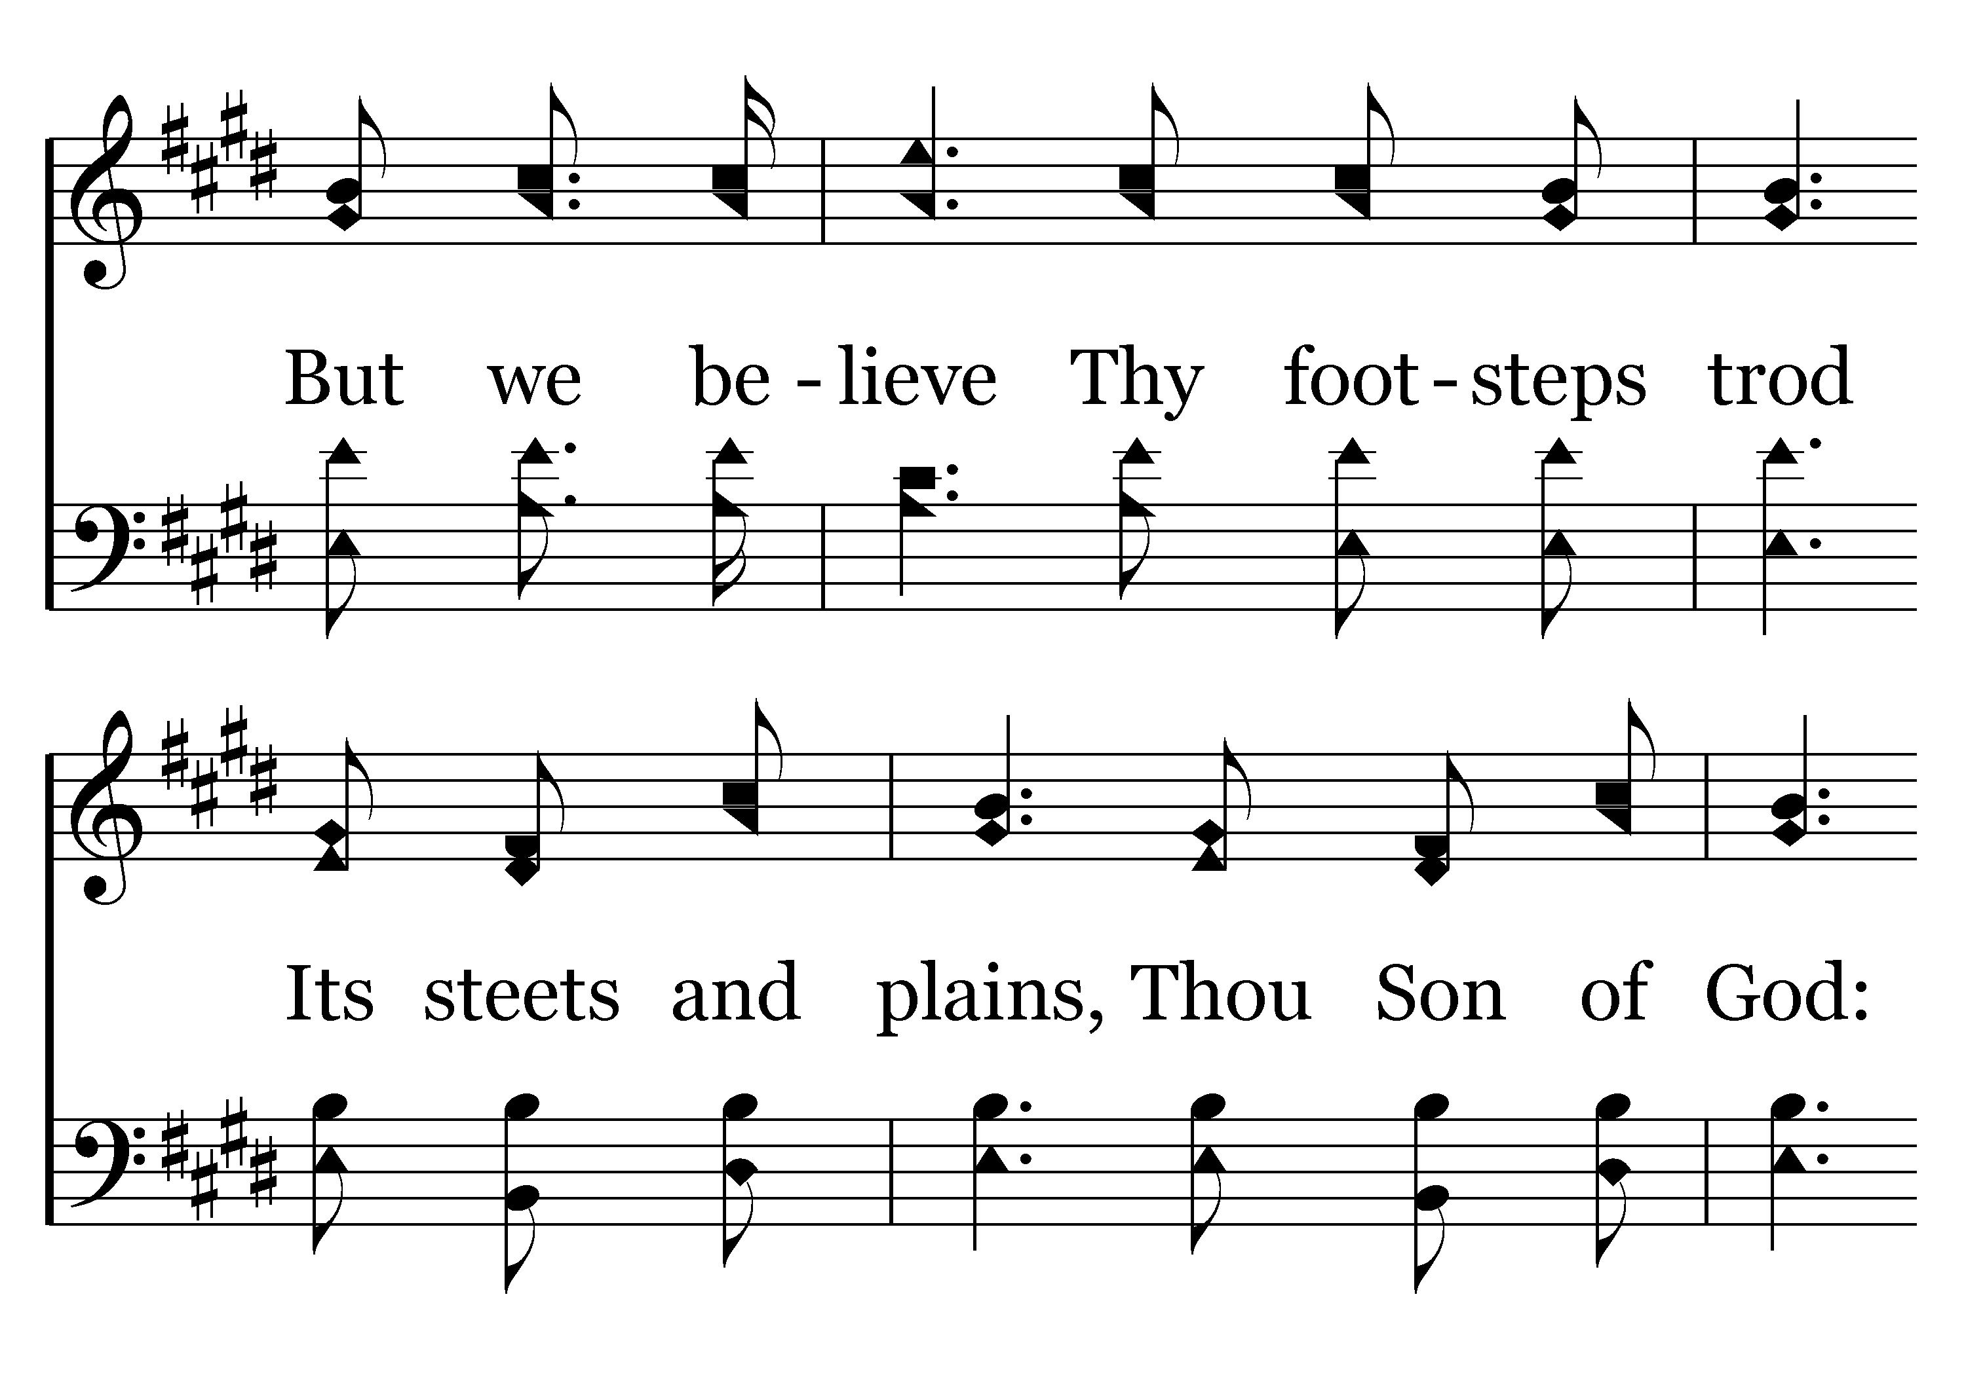
167 - We Saw Thee Not - 1.3

Slide 91

167 - We Saw Thee Not - 1.4
End of Verse 1

Slide 92

167 - We Saw Thee Not - 2.1

Slide 93

167 - We Saw Thee Not - 2.2

Slide 94

167 - We Saw Thee Not - 2.3

Slide 95

167 - We Saw Thee Not - 2.4
End of Verse 2

Slide 96

167 - We Saw Thee Not - 3.1

Slide 97

167 - We Saw Thee Not - 3.2

Slide 98

167 - We Saw Thee Not - 3.3

Slide 99

167 - We Saw Thee Not - 3.4
End of Verse 3

Slide 100

167 - We Saw Thee Not - 4.1

Slide 101

167 - We Saw Thee Not - 4.2

Slide 102

167 - We Saw Thee Not - 4.3

Slide 103

167 - We Saw Thee Not - 4.4
End of Song

Slide 104

REMARKS BY JIM INGRAM

Slide 105

“As often as you eat this bread and drink this cup, you proclaim the Lord’s death….” 1 Corinthians 11:26

Slide 106

157 - At The Cross - Title
SING THE CHORUS FIRST

Slide 107

157 - At The Cross - C.1

Slide 108

157 - At The Cross - C.2

Slide 109

157 - At The Cross - C.3

Slide 110

157 - At The Cross - 1.1

Slide 111

157 - At The Cross - 1.2

Slide 112

157 - At The Cross - 2.1

Slide 113

157 - At The Cross - 2.2

Slide 114
157 - At The Cross - C.1

Slide 115
157 - At The Cross - C.2

Slide 116
157 - At The Cross - C.3
End of Verse 2

Slide 117
157 - At The Cross - C.1

Slide 118
157 - At The Cross - C.2

Slide 119
157 - At The Cross - C.3
End of Song

Slide 120

386 - Jesus Is Coming Soon - Title

Slide 121

386 - Jesus Is Coming Soon - 1.1

Slide 122

386 - Jesus Is Coming Soon - 1.2

Slide 123

386 - Jesus Is Coming Soon - 1.3

Slide 124

386 - Jesus Is Coming Soon - 1.4

Slide 125

386 - Jesus Is Coming Soon - C.1

Slide 126

386 - Jesus Is Coming Soon - C.2

Slide 127

386 - Jesus Is Coming Soon - C.3

Slide 128

386 - Jesus Is Coming Soon - C.4
End of Verse 1

Slide 129

386 - Jesus Is Coming Soon - 2.1

Slide 130

386 - Jesus Is Coming Soon - 2.2

Slide 131

386 - Jesus Is Coming Soon - 2.3

Slide 132

386 - Jesus Is Coming Soon - 2.4

Slide 133
386 - Jesus Is Coming Soon - C.1

Slide 134
386 - Jesus Is Coming Soon - C.2

Slide 135
386 - Jesus Is Coming Soon - C.3

Slide 136
386 - Jesus Is Coming Soon - C.4
Repeat Chorus

Slide 137
386 - Jesus Is Coming Soon - C.1

Slide 138
386 - Jesus Is Coming Soon - C.2

Slide 139
386 - Jesus Is Coming Soon - C.3

Slide 140
386 - Jesus Is Coming Soon - C.4
End of Song

Slide 142

TODAY’S TEXT
BARRY BROWN
2 KINGS 19:14-19

Slide 143
2 Kings 19:14-19 Hezekiah received the letter from the messengers and read it. Then he went up to the temple of the Lord and spread it out before the Lord. 15 And Hezekiah prayed to the Lord: "O Lord, God of Israel, enthroned between the cherubim, you alone are God over all the kingdoms of the earth. You have made heaven and earth. 16 Give ear, O Lord, and hear; open your eyes, O Lord, and see; listen to the words Sennacherib has sent to insult the living God.
17 "It is true, O Lord, that the Assyrian kings have laid waste these nations and their lands. 18 They have thrown their gods into the fire and destroyed them, for they were not gods but only wood and stone, fashioned by men's hands. 19 Now, O Lord our God, deliver us from his hand, so that all kingdoms on earth may know that you alone, O Lord, are God."
NIV

Slide 144
INVITATION SONG
# 334
WHERE HE LEADS ME

Slide 145

YOU ARE A KING
YOUR CAPITAL CITY IS BEING THREATENED BY THE GREATEST ENEMY OF THE TIME
THE CAPTAIN OF THAT ARMY HAS MOCKED YOU
YOU ARE THREATNED WITH DESTRUCTION IF YOU DON’T SURRENDER
YOUR ARMY IS NO MATCH FOR HIS
YOUR CITY CANNOT STAND VERY LONG UNDER SIEGE

Slide 146


Slide 147
YOU ARE A KING
IMAGINE THE FEAR IN THE CITY
IMAGINE YOUR OWN FEAR
IMAGINE THE INNER TURMOIL IN YOUR MIND
IMAGINE THE FEAR—THE ANXIETY—THE STRESS
WHAT WOULD YOU DO?
LET’S NOTICE WHAT A KING IN THIS SITUATION DID

Slide 148
YOU ARE A KING
KING HEZEKIAH WAS BEING THREATENED BY THE ASSYRIAN ARMY
THE ASSYRIANS WERE CONQUERING NATIONS & GAINING POWER
HEZEKIAH TRIED TO BRIBE SENNACHERIB, KING OF ASSYRIA – BUY HIS WAY OUT OF BATTLE
SENNACHERIB CONTINUED HIS THREATS—MOCKING JEHOVAH – SENT A LETTER TO HEZEKIAH

Slide 149
2 Kings 19:14-19
14 Hezekiah received the letter from the messengers and read it. Then he went up to the temple of the Lord and spread it out before the Lord. 15 And Hezekiah prayed to the Lord: "O Lord, God of Israel, enthroned between the cherubim, you alone are God over all the kingdoms of the earth. You have made heaven and earth. 16 Give ear, O Lord, and hear; open your eyes, O Lord, and see; listen to the words Sennacherib has sent to insult the living God.

Slide 150
17 "It is true, O Lord, that the Assyrian kings have laid waste these nations and their lands. 18 They have thrown their gods into the fire and destroyed them, for they were not gods but only wood and stone, fashioned by men's hands. 19 Now, O Lord our God, deliver us from his hand, so that all kingdoms on earth may know that you alone, O Lord, are God."
HEZEKIAH PRAYED
GOD ANSWERED HIS PRAYER

Slide 151
2 Kings 19:35-36 That night the angel of the Lord went out and put to death a hundred and eighty-five thousand men in the Assyrian camp. When the people got up the next morning — there were all the dead bodies! 36 So Sennacherib king of Assyria broke camp and withdrew. He returned to Nineveh and stayed there.
GOD BROUGHT NATIONAL & PERSONAL PEACE TO HEZEKIAH
WE NEED TO SEE THE IMPORTANCE OF PRAYER & IT’S CONNECTION TO PEACE FOR US

Slide 152
Phil 4:6-7 Do not be anxious about anything, but in everything, by prayer and petition, with thanksgiving, present your requests to God. 7 And the peace of God, which transcends all understanding, will guard your hearts and your minds in Christ Jesus.
WHEN WE PRAY PROPERLY—INTERNAL PEACE WILL ALWAYS RESULT

Slide 153
Phil 4:6-7 Do not be anxious about anything, but in everything, by prayer and petition, with thanksgiving, present your requests to God. 7 And the peace of God, which transcends all understanding, will guard your hearts and your minds in Christ Jesus.
WHEN WE PRAY PROPERLY—INTERNAL PEACE WILL ALWAYS RESULT
LET’S LEARN FROM HEZEKIAH SOME PRINCIPLES THAT WILL MAKE PRAYER A CONNECTION THAT CALMS

Slide 154
BELIEVE IN THE POWER OF PRAYER
2 Kings 19:15 And Hezekiah prayed to the Lord: "O Lord, God of Israel, enthroned between the cherubim, you alone are God over all the kingdoms of the earth. You have made heaven and earth.

Slide 155
BELIEVE IN THE POWER OF PRAYER
2 Kings 19:15 And Hezekiah prayed to the Lord: "O Lord, God of Israel, enthroned between the cherubim, you alone are God over all the kingdoms of the earth. You have made heaven and earth.

Slide 156
BELIEVE IN THE POWER OF PRAYER
2 Kings 19:15 And Hezekiah prayed to the Lord: "O Lord, God of Israel, enthroned between the cherubim, you alone are God over all the kingdoms of the earth. You have made heaven and earth.
Genesis 1:1 In the beginning God created the heavens and the earth.
CONSIDER THE GREAT POWER IN THESE WORDS

Slide 157
BELIEVE IN THE POWER OF PRAYER
“Let there be light” (Gen. 1:3)—and there it is
To call to life from that which has no life (Gen. 1:11)—and there it is
To bring a sun, moon & stars into existence by saying “Let it be so” (Gen. 1:14)—and there they are
To speak a fish, a bird, a cow, a rhino into existence (Gen. 1:20,24)—and there they are
To breathe life into a man (Gen. 1:26)—and the clay form becomes a living soul
THAT IS POWER!

Slide 158
Job 38:4-39 "Where were you when I laid the earth's foundation? Tell me, if you understand. 5 Who marked off its dimensions? Surely you know! Who stretched a measuring line across it? 6 On what were its footings set, or who laid its cornerstone— 7 while the morning stars sang together and all the angels shouted for joy? 8 "Who shut up the sea behind doors when it burst forth from the womb, 9 when I made the clouds its garment and wrapped it in thick darkness, 10 when I fixed limits for it and set its doors and bars in place, 11 when I said, 'This far you may come and no farther; here is where your proud waves halt'?

Slide 159
12 "Have you ever given orders to the morning or shown the dawn its place, 13 that it might take the earth by the edges and shake the wicked out of it? 14 The earth takes shape like clay under a seal; its features stand out like those of a garment. 15 The wicked are denied their light ,and their upraised arm is broken.
16 "Have you journeyed to the springs of the sea or walked in the recesses of the deep? 17 Have the gates of death been shown to you? Have you seen the gates of the shadow of death? 18 Have you comprehended the vast expanses of the earth? Tell me, if you know all this.

Slide 160
19 "What is the way to the abode of light? And where does darkness reside? 20 Can you take them to their places? Do you know the paths to their dwellings? 21 Surely you know, for you were already born! You have lived so many years!
22 "Have you entered the storehouses of the snow or seen the storehouses of the hail, 23 which I reserve for times of trouble, for days of war and battle? 24 What is the way to the place where the lightning is dispersed, or the place where the east winds are scattered over the earth? 25 Who cuts a channel for the torrents of rain, and a path for the thunderstorm, 26 to water a land where no man lives, a desert with no one in it,

Slide 161
27 to satisfy a desolate waste land and make it sprout with grass? 28 Does the rain have a father? Who fathers the drops of dew? 29 From whose womb comes the ice? Who gives birth to the frost from the heavens 30 when the waters become hard as stone, when the surface of the deep is frozen?
31 "Can you bind the beautiful Pleiades? Can you loose the cords of Orion? 32 Can you bring forth the constellations in their seasons or lead out the Bear with its cubs? 33 Do you know the laws of the heavens? Can you set up [God's] dominion over the earth?
34 "Can you raise your voice to the clouds and cover yourself with a flood of water?

Slide 162
35 Do you send the lightning bolts on their way? Do they report to you, 'Here we are'? 36 Who endowed the heart with wisdom or gave understanding to the mind? 37 Who has the wisdom to count the clouds? Who can tip over the water jars of the heavens 38 when the dust becomes hard and the clods of earth stick together?
JOB HAD DONE NONE OF THIS
NO MAN HAS DONE THIS
THIS DID NOT JUST “HAPPEN” ON ITS OWN
GOD DID THIS!

Slide 163
Eph 3:20 Now to him who is able to do immeasurably more than all we ask or imagine, according to his power that is at work within us,
IF WE WANT: Prayer to be our connection to God in time of:
FEAR
DOUBT
ANXIETY
STRESS
IF WE WANT: Peace that passes all understanding
We must realize that God is more powerful than we can imagine

Slide 164


Slide 165
BELIEVE GOD ALONE CAN GIVE PEACE
WHY DID HEZEKIAH PRAY TO GOD IN HIS TIME OF NEED?
2 Kings 19:15 And Hezekiah prayed to the Lord: "O Lord, God of Israel, enthroned between the cherubim, you alone are God over all the kingdoms of the earth. You have made heaven and earth.

Slide 166
BELIEVE GOD ALONE CAN GIVE PEACE
WHY DID HEZEKIAH PRAY TO GOD IN HIS TIME OF NEED?
2 Kings 19:15 And Hezekiah prayed to the Lord: "O Lord, God of Israel, enthroned between the cherubim, you alone are God over all the kingdoms of the earth. You have made heaven and earth.
JEHOVAH WAS THE ONLY GOD
HE WAS THE ONLY ONE TO WHOM HEZEKIAH COULD TURN FOR HELP

Slide 167
BELIEVE GOD ALONE CAN GIVE PEACE
MANY TIMES WE TURN TO OTHER PLACES FOR CALMNESS
Money
Drinking
Drugs
Gambling
Eating
Manipulation
Control
Ps 18:1-3 I love you, O Lord, my strength.
2 The Lord is my rock, my fortress and my deliverer; my God is my rock, in whom I take refuge. He is my shield and the horn of my salvation, my stronghold.
3 I call to the Lord, who is worthy of praise, and I am saved from my enemies.

Slide 168
DON’T SUCCUMB TO THE DEVIL’S LIES
2 Kings 19:10-13 "Say to Hezekiah king of Judah: Do not let the god you depend on deceive you when he says, 'Jerusalem will not be handed over to the king of Assyria.' 11 Surely you have heard what the kings of Assyria have done to all the countries, destroying them completely. And will you be delivered? 12 Did the gods of the nations that were destroyed by my forefathers deliver them: the gods of Gozan, Haran, Rezeph and the people of Eden who were in Tel Assar? 13 Where is the king of Hamath, the king of Arpad, the king of the city of Sepharvaim, or of Hena or Ivvah?"

Slide 169
DON’T SUCCUMB TO THE DEVIL’S LIES
He reminded Hezekiah that he had defeated other all other kingdoms
He reminded him that the gods of other nations had not been able to help them
He asked the whereabouts of the other kings he had defeated
He boasted about defeating Hezekiah
He was sure Jehovah could not help Hezekiah
THE DEVIL – WORKING THROUGH SENNACHERIB – WANTED HEZEKIAH TO BELIEVE GOD COULD NOT & WOULD NOT HELP

Slide 170
DON’T SUCCUMB TO THE DEVIL’S LIES
Notice Hezekiah’s prayer
2 Kings 19:17-19 17 "It is true, O Lord, that the Assyrian kings have laid waste these nations and their lands. 18 They have thrown their gods into the fire and destroyed them, for they were not gods but only wood and stone, fashioned by men's hands. 19 Now, O Lord our God, deliver us from his hand, so that all kingdoms on earth may know that you alone, O Lord, are God."

Slide 171
DON’T SUCCUMB TO THE DEVIL’S LIES
Satan will lie to us
He will try to convince us that God’s way will not work
He will try to convince us there is no hope
He will tell us God’s word is not right
He will tell us that others know better than God
He will tell us God doesn’t know what He is doing
His lies steal our peace
We must see through his lies and trust God

Slide 172
TRUST GOD’S WORD
2 Kings 19:20-34
Then Isaiah son of Amoz sent a message to Hezekiah: "This is what the Lord, the God of Israel, says: I have heard your prayer concerning Sennacherib king of Assyria. 21 This is the word that the Lord has spoken against him:
"'The Virgin Daughter of Zion despises you and mocks you. The Daughter of Jerusalem tosses her head as you flee. 22 Who is it you have insulted and blasphemed? Against whom have you raised your voice and lifted your eyes in pride? Against the Holy One of Israel!

Slide 173
23 By your messengers you have heaped insults on the Lord. And you have said, "With my many chariots I have ascended the heights of the mountains, the utmost heights of Lebanon. I have cut down its tallest cedars, the choicest of its pines. I have reached its remotest parts, the finest of its forests. 24 I have dug wells in foreign lands and drunk the water there. With the soles of my feet I have dried up all the streams of Egypt."
25 "'Have you not heard? Long ago I ordained it. In days of old I planned it; now I have brought it to pass, that you have turned fortified cities into piles of stone. 26 Their people, drained of power ,are dismayed and put to shame.

Slide 174
27 "'But I know where you stay and when you come and go and how you rage against me. 28 Because you rage against me and your insolence has reached my ears, I will put my hook in your nose and my bit in your mouth, and I will make you return by the way you came.'
29 "This will be the sign for you, O Hezekiah:
"This year you will eat what grows by itself, and the second year what springs from that. But in the third year sow and reap, plant vineyards and eat their fruit. 30 Once more a remnant of the house of Judah will take root below and bear fruit above. 31 For out of Jerusalem will come a remnant, and out of Mount Zion a band of survivors. The zeal of the Lord Almighty will accomplish this.

Slide 175
32 "Therefore this is what the Lord says concerning the king of Assyria:
"He will not enter this city or shoot an arrow here. He will not come before it with shield or build a siege ramp against it. 33 By the way that he came he will return; he will not enter this city, declares the Lord. 34 I will defend this city and save it, for my sake and for the sake of David my servant."
HEZEKIAH BELIEVED GOD AND TRUSTED GOD TO DO WHAT HE SAID HE WOULD DO

Slide 176
2 Kings 19:35-37 That night the angel of the Lord went out and put to death a hundred and eighty-five thousand men in the Assyrian camp. When the people got up the next morning — there were all the dead bodies! 36 So Sennacherib king of Assyria broke camp and withdrew. He returned to Nineveh and stayed there.
37 One day, while he was worshiping in the temple of his god Nisroch, his sons Adrammelech and Sharezer cut him down with the sword, and they escaped to the land of Ararat. And Esarhaddon his son succeeded him as king.

Slide 177
TRUST GOD’S WORD
THIS IS ONE OF THE MOST IMPORTANT ASPECTS OF PRAYER CALMING US
Many people pray
But they don’t trust God
Trusting God means obeying God
Trusting God means turning things over to Him
Trusting God means doing what He asks us to do
Trusting God means leaving it to Him to do what He has promised

Slide 178
TRUST GOD’S WORD
Phil 4:6-7 Do not be anxious about anything, but in everything, by prayer and petition, with thanksgiving, present your requests to God. 7 And the peace of God, which transcends all understanding, will guard your hearts and your minds in Christ Jesus.
9 Whatever you have learned or received or heard from me, or seen in me — put it into practice. And the God of peace will be with you.

Slide 179
TRUST GOD’S WORD
Rom 8:28 And we know that in all things God works for the good of those who love him, who have been called according to his purpose.
This is one of the hardest promises to trust
Everything will work out for our good
No matter what we face
No matter whether or not we can see it at the moment
We must trust—pray—submit—and receive peace from God

Slide 180
BE MORE CONCERNED ABOUT GOD’S GLORY THAN OUR OWN WILL
This may be the most important key to finding peace through prayer
Often our prayers are self-centered
We treat God like a vending machine
We ask for things to be spent on our own pleasures
When our minds are consumed with our own selfishness—we will never have peace

Slide 181
BE MORE CONCERNED ABOUT GOD’S GLORY THAN OUR OWN WILL
James 4:3 When you ask, you do not receive, because you ask with wrong motives, that you may spend what you get on your pleasures.
2 Kings 19:16 Give ear, O Lord, and hear; open your eyes, O Lord, and see; listen to the words Sennacherib has sent to insult the living God.
HEZEKIAH WASN’T AS CONCERNED ABOUT DANGER TO JERUSALEM AS HE WAS ABOUT GOD’S NAME

Slide 182
BE MORE CONCERNED ABOUT GOD’S GLORY THAN OUR OWN WILL
2 Kings 19:19 Now, O Lord our God, deliver us from his hand, so that all kingdoms on earth may know that you alone, O Lord, are God."
HEZEKIAH WAS CONCERNED ABOUT GOD’S GLORY AND GOD’S WILL
SOMETIMES THIS IS ONE OF THE MAIN PROBLEMS WITH US
KEEPING US FROM HAVING PEACE

Slide 183
BE MORE CONCERNED ABOUT GOD’S GLORY THAN OUR OWN WILL
We worry because things are not working out the way we think they should
We are not as concerned about God’s glory as we are getting what we want
We get all worked up because we are afraid God’s will won’t coincide with what we want

Slide 184
BE MORE CONCERNED ABOUT GOD’S GLORY THAN OUR OWN WILL
When we want to glorify God we don’t have to worry about God being willing to help
God will accomplish what will glorify Him
We can pray—submit to God’s word—trust Him to accomplish what will glorify Him
Matt 26:39 Going a little farther, he fell with his face to the ground and prayed, "My Father, if it is possible, may this cup be taken from me. Yet not as I will, but as you will."
IF WE WANT PRAYER TO CALM US
WE MUST WANT WHAT GOD WANTS MORE THAN WHAT WE WANT

Slide 185
ACTUALLY PRAY
WE NEED TO SEE SOMETHING
IT IS SO OBVIOUS WE MAY OVERLOOK IT
WE’VE TALKED ABOUT:
Attitudes
Desires
Motivations
We need to understand Hezekiah received peace because he prayed
2 Kings 19:20 "This is what the Lord, the God of Israel, says: I have heard your prayer concerning Sennacherib king of Assyria”

Slide 186
ACTUALLY PRAY
WE NEED TO HAVE RIGHT ATTITUDES
WE NEED TO HAVE RIGHT DESIRES
BUT WE MUST NOT FORGET THIS GREAT KEY
PRAYER

Slide 187
ACTUALLY PRAY
IF WE WANT PEACE WE REALLY DO HAVE TO PRAY
WE REALLY DO HAVE TO LET OUR REQUESTS BE MADE KNOWN TO GOD
WE REALLY DO HAVE TO CAST OUR CARES ON HIM
PRAYER CAN BRING PEACE & CALMNESS
IF WE CONSISTENTLY PRAY

Slide 188
ACTUALLY PRAY
WHEN HEZEKIAH PRAYED– GOD GAVE HIM PEACE
IF WE PRAY AS HE DID—GOD WILL GIVE US THE SAME PEACE
LET’S MAKE SURE WE HAVE THE RIGHT ATTITUDE—FAITH—SUBMISSION
WHEN WE DO—GOD’S PEACE WILL GUARD OUR HEARTS & MINDS

Slide 190

334 - Where He Leads Me - Title

Slide 191

334 - Where He Leads Me - 1.1

Slide 192

334 - Where He Leads Me - 1.2

Slide 193

334 - Where He Leads Me - C.1

Slide 194

334 - Where He Leads Me - C.2
End of Verse 1

Slide 195

334 - Where He Leads Me - 2.1

Slide 196

334 - Where He Leads Me - 2.2

Slide 197
334 - Where He Leads Me - C.1

Slide 198
334 - Where He Leads Me - C.2
End of Verse 2

Slide 199

334 - Where He Leads Me - 3.1

Slide 200

334 - Where He Leads Me - 3.2

Slide 201
334 - Where He Leads Me - C.1

Slide 202
334 - Where He Leads Me - C.2
End of Verse 3

Slide 203

334 - Where He Leads Me - 4.1

Slide 204

334 - Where He Leads Me - 4.2

Slide 205
334 - Where He Leads Me - C.1

Slide 206
334 - Where He Leads Me - C.2
End of Song

Slide 208


Slide 210

CLOSING PRAYER
CHUCK REPASS

Slide 211

TOM ANDRICK

Slide 212
THANK YOU FOR VISITING WITH US
PLEASE COME BACK

