Slide 1
The Good Confession

Slide 2
The Good Confession
1 Timothy 6:12-14

Slide 3
1 Tim 6:12
12 Fight the good fight of the faith. Take hold of the eternal life to which you were called when you made your good confession in the presence of many witnesses.
NIV

Slide 4
The Good Confession
WORD CONFESSION:
Means literally “to speak the same thing”
THE GOOD CONFESSION ACKNOWLEDGES WHAT THE N.T. AFFIRMS:
Jesus is the SON OF GOD!

Slide 5
The Good Confession
THE CONFESSION IS “GOOD”
Means literally “That which is intrinsically good and fair and beautiful”

Slide 6
The Good Confession
Why Call It The "Good" Confession?
Notes:
7. Why Call It The “Good Confession”

Slide 7
The Good Confession
THERE ARE SEVERAL REASONS WHY THIS CONFESSION IS GOOD

Slide 8
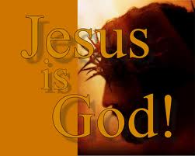
The Good Confession
1. BECAUSE OF WHO IT IDENTIFIES

Slide 9
The Good Confession
THERE WERE VARIOUS OPINIONS OF JESUS WHEN HE WAS ON EARTH
Matt 16:13-14 When Jesus came to the region of Caesarea Philippi, he asked his disciples, "Who do people say the Son of Man is?"

Slide 10
The Good Confession
THERE WERE VARIOUS OPINIONS OF JESUS WHEN HE WAS ON EARTH
Matt 16:13-14
14 They replied, "Some say John the Baptist; others say Elijah; and still others, Jeremiah or one of the prophets."

Slide 11
The Good Confession
THERE WERE VARIOUS OPINIONS OF JESUS WHEN HE WAS ON EARTH
Matt 16:15-16
"But what about you?" he asked. "Who do you say I am?"
Simon Peter answered, "You are the Christ, the Son of the living God."

Slide 12
The Good Confession
J.W. McGarvey—commentary on Acts
“The truth declared in the confession, that Jesus is the Christ, the Son of God, is, beyond controversy the foundation of the church...without it the church could not possibly exist.”

Slide 13
The Good Confession
IT IS IMPORTANT TODAY TO DECLARE THE DEITY OF CHRIST
Many efforts are made to reduce Christ to a mere mortal
Books—magazines—articles—and lectures
deny the Deity of Christ

Slide 14
The Good Confession
Asserts Jesus’ followers view Him as a “mortal prophet”

Slide 15
The Good Confession
Contends that Jesus’ establishment as the “Son of God” was proposed by the Council of Nicaea

Slide 16
The Good Confession
Attempts have been made to show that Jesus’ teaching was borrowed from the Greek-Roman culture of His time

Slide 17
The Good Confession
The “Good Confession” acknowledges:
That Jesus is the Savior
That He is the Anointed One
That He is prophet-priest-king

Slide 18
The Good Confession
Why Call It The "Good" Confession?
Notes:
7. Why Call It The “Good Confession”

Slide 19
The Good Confession
2. BECAUSE OF WHAT IT DECLARES
It is a declaration of COURAGE
John 12:42-43 Yet at the same time many even among the leaders believed in him.

Slide 20
The Good Confession
2. BECAUSE OF WHAT IT DECLARES
It is a declaration of COURAGE
But because of the Pharisees they would not confess their faith for fear they would be put out of the synagogue;

Slide 21
The Good Confession
2. BECAUSE OF WHAT IT DECLARES
It is a declaration of COURAGE
43 for they loved praise from men more than praise from God.
It takes courage today in our society to confess Jesus as Lord when so many deny Him

Slide 22
The Good Confession
2. BECAUSE OF WHAT IT DECLARES
It is a declaration of COURAGE
MANY RELIGIONS DENY THE PERSON OF JESUS CHRIST
ISLAM
JUDAISM
BUDDHISM
HINDUISM

Slide 23
The Good Confession
2. BECAUSE OF WHAT IT DECLARES
It is a declaration of COURAGE
MANY “CHRISTIAN” GROUPS DENY JESUS CHRIST
MORMONS
JEHOVAH’S WITNESSES
CHRISTIAN SCIENCE
ONENESS PENTECOSTALS
SCIENTOLOGY

Slide 24
The Good Confession
2. BECAUSE OF WHAT IT DECLARES
It is a declaration of COURAGE
“The person of Jesus Christ is an illusion of the deception or impermanent material world of duality/nothingness, therefore Jesus himself is an illusion and of no lasting or permanent value”

Slide 25
The Good Confession
2. BECAUSE OF WHAT IT DECLARES
It is a declaration of DEEP CONVICTION
W.E. Vine: “The effect of deep conviction of facts”

Slide 26
The Good Confession
2. BECAUSE OF WHAT IT DECLARES
It is a declaration of DEEP CONVICTION
Philosophy of relativism
god of tolerance
Rejection of absolute truth
TODAY:

Slide 27
The Good Confession
2. BECAUSE OF WHAT IT DECLARES
It is a declaration of DEEP CONVICTION
THE GOOD CONFESSION:
Believes there is TRUTH that makes men free – John 8:32

Slide 28
The Good Confession
Why Call It The "Good" Confession?
Notes:
7. Why Call It The “Good Confession”

Slide 29
The Good Confession
3. BECAUSE IT IS PART OF SALVATION
Heb 2:1-3 We must pay more careful attention, therefore, to what we have heard, so that we do not drift away.

Slide 30
The Good Confession
3. BECAUSE IT IS PART OF SALVATION
2 For if the message spoken by angels was binding, and every violation and disobedience received its just punishment, 3 how shall we escape if we ignore such a great salvation?

Slide 31
The Good Confession
3. BECAUSE IT IS PART OF SALVATION
Matt 1:21 She will give birth to a son, and you are to give him the name Jesus, because he will save his people from their sins."

Slide 32
The Good Confession
3. BECAUSE IT IS PART OF SALVATION
1 Tim 1:15 Here is a trustworthy saying that deserves full acceptance: Christ Jesus came into the world to save sinners

Slide 33
The Good Confession
3. BECAUSE IT IS PART OF SALVATION
Salvation is “Great” – Heb. 2:1-3
Salvation is implied in the name “Jesus” –Matt. 1:21
Christ came to “save sinners” –1 Tim. 1:15

Slide 34
The Good Confession
3. BECAUSE IT IS PART OF SALVATION
Rom 10:9-11 That if you confess with your mouth, "Jesus is Lord," and believe in your heart that God raised him from the dead, you will be saved.

Slide 35
The Good Confession
3. BECAUSE IT IS PART OF SALVATION
10 For it is with your heart that you believe and are justified, and it is with your mouth that you confess and are saved.

Slide 36
The Good Confession
3. BECAUSE IT IS PART OF SALVATION
Rom 10:11 For with the heart one believes unto righteousness, and with the mouth confession is made unto salvation. NKJV
The word “unto” is Greek “eis” and means “toward”
Confession is “toward” salvation

Slide 37
The Good Confession
Why Call It The "Good" Confession?
Notes:
7. Why Call It The “Good Confession”

Slide 38
The Good Confession
4. BECAUSE OF WHAT IT ANTICIPATES
Luke 12:8-10 "I tell you, whoever acknowledges me before men, the Son of Man will also acknowledge him before the angels of God.
“Acknowledge” is “confess” or “to assent”

Slide 39
The Good Confession
4. BECAUSE OF WHAT IT ANTICIPATES
The “good confession” anticipates being confessed by the Son of God whom we confess

Slide 40
The Good Confession
4. BECAUSE OF WHAT IT ANTICIPATES
God “confessed” that Jesus was His Son
At Christ’s baptism—Matt. 3:17
At the transfiguration—Matthew 17:5
“This is My Son whom I love, and with Him I am well pleased”

Slide 41
The Good Confession
4. BECAUSE OF WHAT IT ANTICIPATES
THINK ABOUT BEING ACKNOWLEDGED IN THE SAME WAY BY THE SAME GOD WHO ACKNOWLEDGED JESUS AS HIS SON

Slide 42
The Good Confession
4. BECAUSE OF WHAT IT ANTICIPATES
2 Cor 6:18 I will be a Father to you, and you will be my sons and daughters, says the Lord Almighty."

Slide 43
The Good Confession
4. BECAUSE OF WHAT IT ANTICIPATES
Gal 3:26-27 You are all sons of God through faith in Christ Jesus, 27 for all of you who were baptized into Christ have clothed yourselves with Christ.

Slide 44
The Good Confession
4. BECAUSE OF WHAT IT ANTICIPATES
Gal 4:6-7 Because you are sons, God sent the Spirit of his Son into our hearts, the Spirit who calls out, "Abba, Father."

Slide 45
The Good Confession
4. BECAUSE OF WHAT IT ANTICIPATES
7 So you are no longer a slave, but a son; and since you are a son, God has made you also an heir.

Slide 46
The Good Confession
4. BECAUSE OF WHAT IT ANTICIPATES
God acknowledged Jesus as His Son
God will acknowledge us as His Sons and Daughters

Slide 47
The Good Confession
WHEN DO WE MAKE THE GOOD CONFESSION?
Notes:
7. Why Call It The “Good Confession”

Slide 48
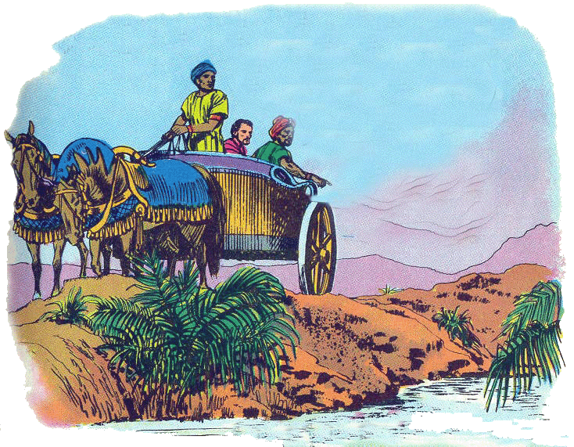
The Good Confession
WHEN WE OBEY THE GOSPEL
Acts 8:35-39 Then Philip opened his mouth, and beginning at this Scripture, preached Jesus to him.

Slide 49
The Good Confession
WHEN WE OBEY THE GOSPEL
36 Now as they went down the road, they came to some water. And the eunuch said, "See, here is water. What hinders me from being baptized?"

Slide 50
The Good Confession
WHEN WE OBEY THE GOSPEL
37 Then Philip said, "If you believe with all your heart, you may."
And he answered and said, "I believe that Jesus Christ is the Son of God."

Slide 51
The Good Confession
WHEN WE OBEY THE GOSPEL
38 So he commanded the chariot to stand still. And both Philip and the eunuch went down into the water, and he baptized him.

Slide 52
The Good Confession
BY THE LIFE WE LIVE
2 Tim 2:19 "The Lord knows those who are his," and, "Everyone who confesses the name of the Lord must turn away from wickedness."

Slide 53
The Good Confession
BY THE LIFE WE LIVE
2 Tim 2:19 "The Lord knows those who are his," and, "Everyone who confesses the name of the Lord must turn away from wickedness."

Slide 54
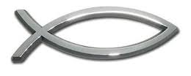
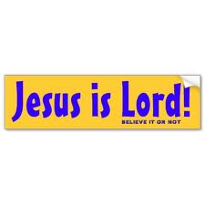
The Good Confession
BY THE LIFE WE LIVE
CONFESSION OF CHRIST INVOLVES MUCH MORE THAN A BUMPER STICKER

Slide 55
The Good Confession
BY THE LIFE WE LIVE
1 John 2:3-6 We know that we have come to know him if we obey his commands. 4 The man who says, "I know him," but does not do what he commands is a liar, and the truth is not in him.

Slide 56
The Good Confession
BY THE LIFE WE LIVE
5 But if anyone obeys his word, God's love is truly made complete in him. This is how we know we are in him: 6 Whoever claims to live in him must walk as Jesus did.

Slide 57
The Good Confession
BY THE LIFE WE LIVE
1 Tim 6:12 Fight the good fight of the faith. Take hold of the eternal life to which you were called when you made your good confession in the presence of many witnesses.

Slide 58
The Good Confession
BY THE LIFE WE LIVE
Heb 4:14 Therefore, since we have a great high priest who has gone through the heavens, Jesus the Son of God, let us hold firmly to the faith we profess.

Slide 59
The Good Confession
BY THE LIFE WE LIVE
Heb 10:23 Let us hold unswervingly to the hope we profess, for he who promised is faithful.
WORD “PROFESS” IS SAME AS “CONFESS” – ACKNOWLEDGE

Slide 60
The Good Confession
BY THE LIFE WE LIVE
A LIFE LIVED REPRESENTS A FAR GREATER CONFESSION THAN WORDS SPOKEN
1 John 4:15 If anyone acknowledges that Jesus is the Son of God, God lives in him and he in God.

Slide 61
The Good Confession
Are You Willing To Confess Him?
Jesus said:
“ Whosoever therefore shall confess me before men, him will I confess also before my Father which is in heaven. But whosoever shall deny me before men, him will I also deny before my Father which is in heaven.”
Notes:
Are You Willing To Confess Him?

Slide 62
The Good Confession
Are You Willing To Confess Him?
ONE DAY—ALL WILL CONFESS
Phil 2:10-11 that at the name of Jesus every knee should bow, in heaven and on earth and under the earth, 11 and every tongue confess that Jesus Christ is Lord,to the glory of God the Father.
Notes:
Are You Willing To Confess Him?

Slide 63
The Good Confession
Are You Willing To Confess Him?
ONE DAY—ALL WILL CONFESS
Rom 14:10-11 For we will all stand before God's judgment seat. 11 It is written:"'As surely as I live,' says the Lord,'every knee will bow before me; every tongue will confess to God.'"
Notes:
Are You Willing To Confess Him?

Slide 64
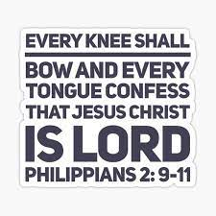

Slide 65
The Good Confession
Are You Willing To Confess Him?
ONE DAY—ALL WILL CONFESS
YOU WILL CONFESS JESUS AS THE SON OF GOD
DON’T WAIT UNTIL IT IS TOO LATE
MAKE THE GOOD CONFESSION NOW
Notes:
Are You Willing To Confess Him?

