Slide 1
ACCORDING TO THE CALENDAR—THE SEASON KNOWN AS CHRISTMAS IS ALMOST HERE

Slide 2
BUT WE DON’T NEED A CALENDAR TO REMIND US OF THIS
DECORATIONS STARTED GOING UP BEFORE THANKSGIVING
SANTA STARTED MAKING HIS APPEARANCE AT THE MALLS
NEWSPAPERS NEARLY DOUBLED IN SIZE BECAUSE OF THE ADVERTISEMENTS
AND THE TRAFFIC……..

Slide 3
BUT WE DON’T NEED A CALENDAR TO REMIND US OF THIS
MORE ATTENTION IS GIVEN TO SHOPPING HABITS ON THE DAY AFTER THANKSGIVING KNOW AS “BLACK FRIDAY”
PICTURES ON TV SHOW CROWDED MALLS & PEOPLE SHOPPING
WE ARE ENCOURAGED TO BUY THINGS WE CANNOT AFFORD—WITH MONEY WE DON’T HAVE—TO GIVE TO PEOPLE WE ARE NOT EVEN SURE WE LIKE

Slide 4
BUT WE DON’T NEED A CALENDAR TO REMIND US OF THIS
THE COMMERCIAL PART OF CHRISTMAS HAS ARRIVED
THE SOCIAL PART OF CHRISTMAS HAS ALSO ARRIVED
THIS IS A FESTIVE TIME
A TIME FOR DRESSING UP
A TIME TO GO TO PARTIES

Slide 5
BUT WE DON’T NEED A CALENDAR TO REMIND US OF THIS
MANY WILL TRAVEL “OVER THE RIVER & THROUGH THE WOODS” TO VISIT FAMILY
FAMILIES & FRIENDS WILL EAT TOGETHER AND SETTLE DOWN FOR AN AFTERNOON OF WATCHING A BALLGAME ON TV

Slide 6
ALL OF THESE ACTIVITIES ARE IN CELEBRATION OF THE BIRTH OF CHRIST
WE CAN BE CERTAIN THAT DECEMBER 25 IS NOT THE ACTUAL BIRTHDAY OF JESUS
WE DON’T KNOW FOR SURE—WE CAN BE CERTAIN IT WAS NOT IN THE WINTER MONTHS
BUT…IS IT EVER WRONG TO THINK ABOUT AND STUDY ABOUT HIS BIRTH?

Slide 7
ALL OF THESE ACTIVITIES ARE IN CELEBRATION OF THE BIRTH OF CHRIST
BUT…IS IT EVER WRONG TO THINK ABOUT AND STUDY ABOUT HIS BIRTH?
Rom 14:5 One man considers one day more sacred than another; another man considers every day alike. Each one should be fully convinced in his own mind.
WE NEED TO THINK ABOUT THE BIRTH OF CHRIST IN A DIFFERENT WAY

Slide 8
CHRIST BEING BORN RESULTED IN THINGS HAPPENING
FOR HIS BIRTH TO BE SIGNIFICANT TO US SOME THINGS HAVE TO HAPPEN
Gal 4:19 My dear children, for whom I am again in the pains of childbirth until Christ is formed in you,
PAUL USES THE “PAINS OF CHILDBIRTH” TO DEMONSTRATE HOW CHRIST IS “FORMED” IN US

Slide 9
THE BIRTH OF CHRIST RESULTED IN THINGS HAPPENING
Gal 4:19 My dear children, for whom I am again in the pains of childbirth until Christ is formed in you,
FORMED it is used in Gal 4:19, expressing the necessity of a change in character and conduct to correspond with inward spiritual condition, so that there may be moral conformity to Christ. (from Vine's Expository Dictionary of Biblical Words.)
THIS SAYS THAT CHRIST MUST BE “BORN” IN US

Slide 11
THE BIRTH OF CHRIST RESULTED IN THINGS HAPPENING
THE N.T. SPEAKS OF OUR BEING BORN AGAIN
John 3:5-7 Jesus answered, "I tell you the truth, no one can enter the kingdom of God unless he is born of water and the Spirit. 6 Flesh gives birth to flesh, but the Spirit gives birth to spirit. 7 You should not be surprised at my saying, 'You must be born again.‘
1 John 2:29 If you know that he is righteous, you know that everyone who does what is right has been born of him.

Slide 12
THE BIRTH OF CHRIST RESULTED IN THINGS HAPPENING
THE N.T. SPEAKS OF OUR BEING BORN AGAIN
1 Peter 1:23 For you have been born again, not of perishable seed, but of imperishable, through the living and enduring word of God.

Slide 13
THE BIRTH OF CHRIST RESULTED IN THINGS HAPPENING
THE N.T. SPEAKS OF OUR BEING BORN AGAIN
1 John 3:9 No one who is born of God will continue to sin, because God's seed remains in him; he cannot go on sinning, because he has been born of God.

Slide 14
THE BIRTH OF CHRIST RESULTED IN THINGS HAPPENING
THE N.T. SPEAKS OF OUR BEING BORN AGAIN
1 John 5:18 We know that anyone born of God does not continue to sin;
WHEN CHRIST IS “BORN” IN US—THINGS CHANGE IN OUR LIFE—CHRIST IS FORMED IN US
WE HAVE ADAPTED FAIRLY WELL TO OUR ENVIRONMENT

Slide 15
WE HAVE LEARNED TO CLEAN UP THE AIR WE BREATHE

Slide 16
WE HAVE LEARNED TO PURIFY THE WATER WE DRINK

Slide 17
WE HAVE LEARNED TO ENRICH THE FOODS WE EAT

Slide 18
THE BIRTHG OF CHRIST RESULTED IN THINGS HAPPENING
WE HAVE ALSO ADAPTED OURSELVES TO TECHNOLOGY

Slide 19
WE HAVE LEARNED HOW TO PROGRAM OUR COMPUTER

Slide 20
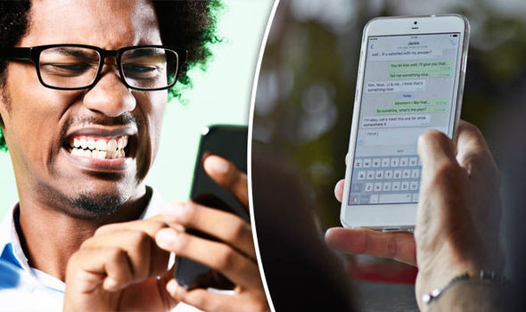
WE HAVE LEARNED HOW TO USE OUR SMART PHONES

Slide 21
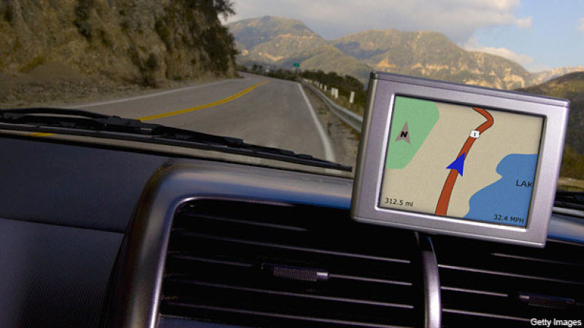
WE HAVE LEARNED HOW TO FIGURE OUT THE GPS SYSTEM

Slide 22
THE BIRTH OF CHRIST RESULTED IN THINGS HAPPENING
OVER ALL WE HAVE ADAPTED PRETTY WELL TO OUR MODERN WORLD
BUT THERE ARE SOME THINGS WE HAVEN’T LEARNED THAT THE BIRTH OF CHRIST SHOULD HAVE TAUGHT US
THE ANGELS ANNOUNCED TO THE SHEPHERDS “Peace on earth…good will toward men”
BUT WE HAVEN’T LEARNED TO LIVE IN PEACE WITH ONE ANOTHER

Slide 23
THE BIRTH OF CHRIST RESULTED IN THINGS HAPPENING
OUR GREATEST NEED IS TO HAVE JESUS FORMED (BORN) IN US
TO LIVE WITH US & IN US
TO SHOW US HOW TO BE AT PEACE WITH ONE ANOTHER

Slide 24
LESSONS WE NEED TO LEARN FROM THE COMING OF CHRIST
LUKE TAKES US THROUGH THE WHOLE STORY OF THE BIRTH OF JESUS
WE LEARN ABOUT SHEPHERDS AND ANGELS AND WISE MEN AND JESUS BEING BORN AND WRAPPED IN SWADDLING CLOTHES AND PLACED IN A MANGER
BUT THERE IS SOMETHING HE ADDS THAT WE COULD MISS

Slide 25
LESSONS WE NEED TO LEARN FROM THE COMING OF CHRIST
Luke 2:7 and she gave birth to her firstborn, a son. She wrapped him in cloths and placed him in a manger,
IT IS ALMOST AS IF LUKE ANTICIPATED THE QUESTION: “WHY WAS HE BORN IN A STABLE?”
AS AN AFTERTHOUGHT HE ADDS: “BECAUSE THERE WAS NO ROOM FOR THEM IN THE INN”

Slide 26
I. LESSONS WE NEED TO LEARN FROM THE COMING OF CHRIST
Luke 2:7 and she gave birth to her firstborn, a son. She wrapped him in cloths and placed him in a manger, because there was no room for them in the inn.
THERE IS NO CONDEMNATION OF THE INNKEEPER
LUKE DOESN’T SAY HE WAS BAD OR GOOD OR RIGHT OR WRONG
HE DOESN’T COMMENT ABOUT HIM

Slide 27
LESSONS WE NEED TO LEARN FROM THE COMING OF CHRIST
BUT THIS CROWDED INN STANDS AS A SYMBOL OF CROWDED-CLUTTERED LIVES THAT STILL HAVE NO ROOM FOR HIM
WE ARE BUSY WITH OUR LIVES AND OUR SCHEDULES ARE SO FULL
WORK
SCHOOL/ACTIVITIES
RECREATION
OTHER TIME CONSUMING ACTIVITIES

Slide 28
LESSONS WE NEED TO LEARN FROM THE COMING OF CHRIST
OUR CROWDED LIVES SOMETIMES CROWDS JESUS OUT COMPLETELY
WE HAVE NO TIME TO STUDY THE BIBLE
WE HAVE NO TIME TO ATTEND WORSHIP SERVICES
WE HAVE NO TIME TO “DO GOOD UNTO ALL MEN AND ESPECIALLY THOSE OF THE HOUSEHOLD OF FAITH”
THERE JUST IS NO ROOM FOR JESUS IN OUR LIVES

Slide 29
. LESSONS WE NEED TO LEARN FROM THE COMING OF CHRIST
IF WE DON’T HAVE TIME FOR JESUS—OUR SCHEDULES ARE JUST TOO CLUTTERED
Matt 6:33 But seek first his kingdom and his righteousness, and all these things will be given to you as well.
Rom 12:1-2 Therefore, I urge you, brothers, in view of God's mercy, to offer your bodies as living sacrifices, holy and pleasing to God — this is your spiritual act of worship.

Slide 30
LESSONS WE NEED TO LEARN FROM THE COMING OF CHRIST
LESSON ONE: WE MUST DE-CLUTTER OUR LIVES AND MAKE ROOM FOR JESUS
LESSON TWO: WE MUST DESIRE FOR CHRIST TO BE FORMED (BORN) IN US
WE WANT HIS BLESSINGS BUT NOT HIS CROSS
WE WANT HIS FORGIVENESS BUT NOT HIS JUDGMENT
WE WANT HIS SALVATION BUT WE DON’T WANT TO SERVE

Slide 31
LESSONS WE NEED TO LEARN FROM THE COMING OF CHRIST
THE ONE THING JESUS TEACHES OVER AND OVER
WE MUST MAKE HIM AND HIS KINGDOM OUR TOP PRIORITY

Slide 32
LESSONS WE NEED TO LEARN FROM THE COMING OF CHRIST
Matt 13:44 The Parable of the Hidden Treasure
"Again, the kingdom of heaven is like treasure hidden in a field, which a man found and hid; and for joy over it he goes and sells all that he has and buys that field.
The Parable of the Pearl of Great Price
"Again, the kingdom of heaven is like a merchant seeking beautiful pearls, 46 who, when he had found one pearl of great price, went and sold all that he had and bought it.

Slide 33
LESSONS WE NEED TO LEARN FROM THE COMING OF CHRIST
LESSON ONE: WE MUST DECLUTTER OUR LIVES AND MAKE ROOM FOR JESUS
LESSON TWO: WE MUST DESIRE FOR CHRIST TO BE FORMED (BORN) IN US
LESSON THREE: THE NEED FOR HUMILITY

Slide 34
LESSONS WE NEED TO LEARN FROM THE COMING OF CHRIST
CHRIST WAS BORN IN A STABLE
WE SEE MARY & JOSEPH ENTERING THAT SMELLING STABLE
INSIDE MARY’S WOMB IS GOD IN THE FLESH
I MARVEL THAT GOD WOULD COME DOWN THAT FAR
SACRIFICE THAT MUCH TO ENTER OUR WORLD

Slide 35
LESSONS WE NEED TO LEARN FROM THE COMING OF CHRIST
THERE IS A LESSON HERE
GOD WAS SAYING: “NOW THERE IS NOTHING THAT STANDS BETWEEN GOD AND MAN”
“THERE IS NO PLACE FOR ARROGANCE OR PRIDE”
WE CAN’T COME HERE IF WE ARE LOOKING DOWN OUR NOSE AT SOMEONE ELSE

Slide 36
LESSONS WE NEED TO LEARN FROM THE COMING OF CHRIST
THERE IS A LESSON HERE
GOD WAS SAYING: “NOW THERE IS NOTHING THAT STANDS BETWEEN GOD AND MAN”
“THERE IS NO PLACE FOR ARROGANCE OR PRIDE”
WE CAN’T COME HERE IF WE ARE LOOKING DOWN OUR NOSE AT SOMEONE ELSE

Slide 37
LESSONS WE NEED TO LEARN FROM THE COMING OF CHRIST
WE MUST DECLUTTER OUR LIVES AND MAKE ROOM FOR HIM IN THE INN OF OUR HEARTS
WE MUST WANT CHRIST TO BE FORMED (BORN) IN US
WE MUST HUMBLY BE WILLING TO GIVE EVERYTHING TO HIM
HAS CHRIST BEEN BORN IN YOU?
IF NOT WE FAIL IN THESE AREAS

