Slide 2
IT IS OBVIOUS THAT AMERICA IS IN TROUBLE
34 TRILLION $ DEBT— CLIMBING
MORAL CONDITIONS ARE GROWING WORSE
2 PSYCOLOGISTS, FROM COLUMBIA UNIVERSITY & HARVARD RECENTLY SAID: “THE WIDESPREAD PERCEPTION OF MORAL DECLINE IS AN ILLUSION.”
THE REASON? “WE TEND TO PAY CLOSER ATTENTION TO THE NEGATIVE THAN TO THE POSITIVE.”

Slide 3
IT IS OBVIOUS THAT AMERICA IS IN TROUBLE
34 TRILLION $ DEBT— CLIMBING
MORAL CONDITION GROWING WORSE
POLITICAL CORRUPTION ABOUNDS
Political Corruption in the United States is apparently at its worst in almost a decade, according to a new global report released by Transparency International.

Slide 4
IT IS OBVIOUS THAT AMERICA IS IN TROUBLE
34 TRILLION $ DEBT— CLIMBING
MORAL CONDITION GROWING WORSE
POLITICAL CORRUPTION ABOUNDS
ALL KINDS OF SOLUTIONS ARE OFFERED

Slide 8
A LESSON FROM HISTORY
DECLINE & FALL OF THE ROMAN EMPIRE, 1787, By Edward Gibbon
Higher and higher taxes—spending of public money for free bread
Mad craze for pleasure—sports becoming more exciting and brutal
Building HUGE armaments to protect from outside forces when the real enemy is within
The decay of religion—faith fading into mere form—losing touch with life and becoming impotent to guide the people

Slide 9
DO THESE REASONS FOR ROME’S FALL HAVE ANYTHING TO DO WITH OUR PRESENT SITUATION?
$18 million damage done by drunk drivers—90 million cans of beer are consumed
2,740 teenagers get pregnant
63,288 automobile accidents kill 129 people
3,231 women have abortions
THIS IS NOT YEARLY
THIS IS DAILY

Slide 10
A LESSON FROM HISTORY
DO THESE 5 REASONS FOR ROME’S FALL HAVE ANYTHING TO DO WITH OUR PRESENT SITUATION?
Growing acceptance of homosexuality
same-sex marriages are legal—now in 37 states (World Population Review)

Slide 11
Despite positive recent developments for LGBT people in the United States and other parts of the world, consensual same-sex relationships remain a crime in at least 64 countries. (Nearly half are African) (BBC)
THIS SHOULD INFURIATE US
64 COUNTRIES THAT DO NOT WORSHIP JEOHOVAH GOD—THAT DO NOT PRACTICE CHRISTIANITY—THAT DO NOT CLAIM TO BE FOUNDED ON “CHRISTIAN PRINCIPLES” ARE UPHOLDING GOD’S PLAN FOR MARRIAGE

Slide 12
DO THESE 5 REASONS FOR ROME’S FALL HAVE ANYTHING TO DO WITH OUR PRESENT SITUATION?
Growing acceptance of homosexuality
Legalizing same-sex marriages—now in 17 states
GUN VIOLENCE
THE NUMBER OF UNMARRIED PARTNERS LIVING TOGETHER IN THE UNITED STATES NEARLY TRIPLED IN TWO DECADES FROM 6 MILLION TO 17 MILLION, 8% OF THE TOTAL ADULT POPULATION
(Pew Research Center)

Slide 13
DO THESE 5 REASONS FOR ROME’S FALL HAVE ANYTHING TO DO WITH OUR PRESENT SITUATION?
INCREASE IN TRANSGENDERISM
WE CAN IDENTIFY WHO/WHAT WE ARE
RECENTLY A GIRL IDENTIFIED AS A CAT
(SCHOOL TEACHER WAS FIRED BECAUSE SHE REFUSED TO “MEOW” BACK TO THE GIRL)

Slide 14
DO THESE 5 REASONS FOR ROME’S FALL HAVE ANYTHING TO DO WITH OUR PRESENT SITUATION?
More & more government control in our choices and personal lives
What car we drive – no more gas powered cars
What appliances we can own – banning gas ranges
What we can eat
What we can say – loss of freedom of speech

Slide 15
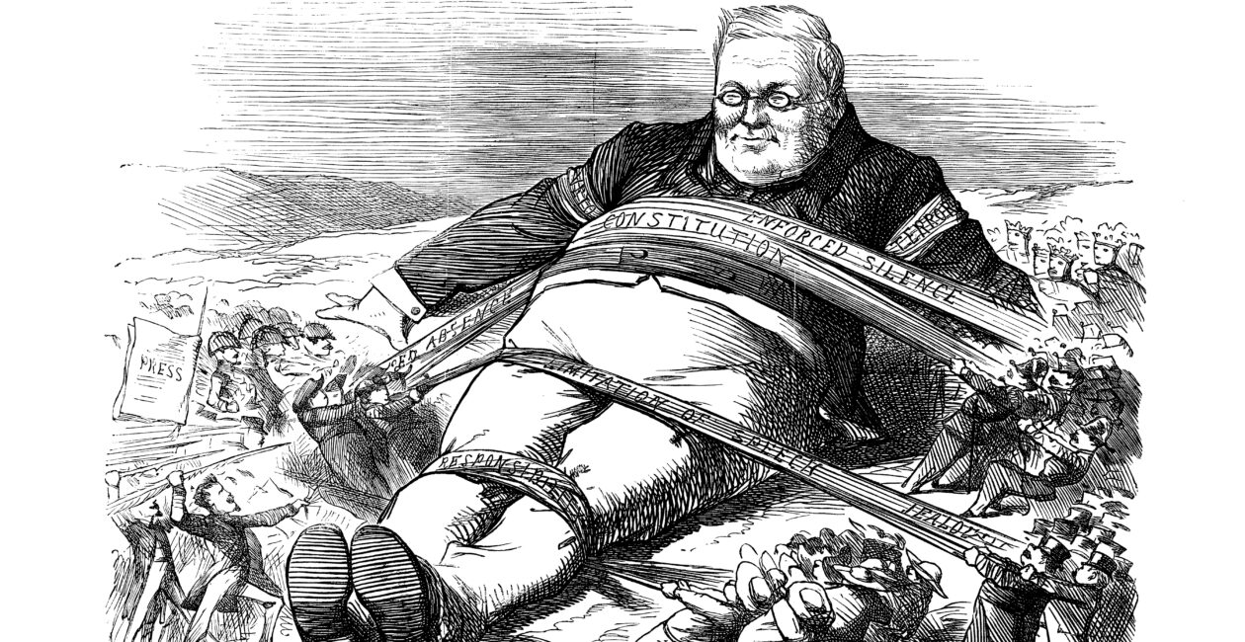

Slide 16
Will Rogers—in the 1930’s
A fool & his money are soon ELECTED
About all I can say for the USA Congress is that it opens with a prayer and closes with an investigation
Anything important is never left to the vote of the people—we only get to vote on some MAN—we never vote on what he is to do
Be thankful we are not getting all the government we are paying for
I don’t make jokes—I just watch the government and report the facts

Slide 17
Will Rogers—in the 1930’s
If I studied all my life, I couldn’t think up half the funny things passed in one session of congress
It’s easy being a humorist when you have the whole government working for you
Last year we said, “things can’t go on like this,” and they didn’t—THEY GOT WORSE
Our Constitution protects aliens, drunks & U.S. Senators
The only difference between death & taxes is that death doesn’t get worse when Congress meets

Slide 18
What would Will Rogers think about 21st Century America?
IS THERE HOPE FOR AMERICA?
IT IS NOT IN GOVERNMENT
IT IS NOT IN THE MILITARY
IT IS NOT IN THE GENUIS OF AMERICANS
NO QUESTION—AMERICA NEEDS HELP
BUT WHERE IS HELP COMING FROM?

Slide 19
Ps 121:1-2 I lift up my eyes to the hills — where does my help come from?
2 My help comes from the Lord , the Maker of heaven and earth.
THERE ARE 5 THINGS WE MUST DO
NOT NATIONALLY—BUT INDIVIDUALLY
THERE ARE THINGS WE CAN DO AS “JUST ONE” INDIVIDUAL
IF AMERICA CHANGES IT WILL BE A ONE ON ONE CHANGE

Slide 20
I. WE MUST REPENT
2 Chron 7:14 if my people, who are called by my name, will humble themselves and pray and seek my face and turn from their wicked ways, then will I hear from heaven and will forgive their sin and will heal their land.
THIS NATION IS NOT A “CHRISTIAN NATION” AND NEVER HAS BEEN
IT MAY HAVE BEEN FOUNDED ON “CHRISTIAN” PRINCIPLES
BUT “CHRISTIANS” ARE THE KEY TO TURNING AMERICA AROUND

Slide 21
I. WE MUST REPENT
2 Chron 7:14 if my people, who are called by my name, will humble themselves and pray and seek my face and turn from their wicked ways, then will I hear from heaven and will forgive their sin and will heal their land.

Slide 22
I. WE MUST REPENT
2 Chron 7:14 if my people, who are called by my name, will humble themselves and pray and seek my face and turn from their wicked ways, then will I hear from heaven and will forgive their sin and will heal their land.
IF CHRISTIANS DO NOT DO WHAT IS RIGHT—NO ONE ELSE IN AMERICA WILL DO WHAT IS RIGHT
1 Cor 11:1 Follow my example, as I follow the example of Christ
WE MUST SET THE EXAMPLE FOR OTHERS TO FOLLOW

Slide 23
I. WE MUST REPENT
SOMETIMES EVEN THE BEST OF US HAVE THE WORST IN US
SOMETIMES WE ALLOW “SELF” TO RULE OUR LIVES INSTEAD OF THE LORD

Slide 24
HERE IS THE TEST:
Luke 6:46 "Why do you call me, 'Lord, Lord,' and do not do what I say?
Matt 7:21-23 "Not everyone who says to me, 'Lord, Lord,' will enter the kingdom of heaven, but only he who does the will of my Father who is in heaven. 22 Many will say to me on that day, 'Lord, Lord, did we not prophesy in your name, and in your name drive out demons and perform many miracles?' 23 Then I will tell them plainly, 'I never knew you. Away from me, you evildoers!'

Slide 25
WE MAY CALL HIM “LORD” BUT ARE WE DOING WHAT HE SAYS?
WE CANNOT BE “PERFECT” IN OUR OBEDIENCE
BUT WE NEED TO CONSTANTLY SAY “NO” TO SELF AND “YES” TO JESUS

Slide 26
II. WE MUST PRAY
2 Chron 7:14-15 if my people, who are called by my name, will humble themselves and pray and seek my face and turn from their wicked ways, then will I hear from heaven and will forgive their sin and will heal their land.
15 Now my eyes will be open and my ears attentive to the prayers offered in this place.

Slide 27
II. WE MUST PRAY
2 Chron 7:14-15 if my people, who are called by my name, will humble themselves and pray and seek my face and turn from their wicked ways, then will I hear from heaven and will forgive their sin and will heal their land.
15 Now my eyes will be open and my ears attentive to the prayers offered in this place.

Slide 28
II. WE MUST PRAY
1 Tim 2:1-2 I urge, then, first of all, that requests, prayers, intercession and thanksgiving be made for everyone— 2 for kings and all those in authority, that we may live peaceful and quiet lives in all godliness and holiness.

Slide 29
II. WE MUST PRAY
1 Tim 2:1-2 I urge, then, first of all, that requests, prayers, intercession and thanksgiving be made for everyone— 2 for kings and all those in authority, that we may live peaceful and quiet lives in all godliness and holiness.
HOW OFTEN DO WE ASK GOD’S HELP AND BLESSINGS FOR OUR NATION’S LEADERS?
BUT I DON’T LIKE OUR POLITICIANS
PAUL SAID WE ARE TO PRAY FOR OUR ENEMIES

Slide 30
III. WE MUST TRUST
Prov 3:5-6 Trust in the Lord with all your heart and lean not on your own understanding; 6 in all your ways acknowledge him, and he will make your paths straight.
Ps 22:28 for dominion belongs to the Lord and he rules over the nations.
Dan 4:17 "'The decision is announced by messengers, the holy ones declare the verdict, so that the living may know that the Most High is sovereign over the kingdoms of men and gives them to anyone he wishes and sets over them the lowliest of men.'

Slide 31
III. WE MUST TRUST
DO WE REALLY BELIEVE THAT GOD IS IN CONTROL?
DO WE BELIEVE THAT HE IS IN CONTROL OF THE POLITICAL ARENA OF OUR NATION?
WE CAN DO OUR PART BY VOTING FOR CANDIDATES THAT HAVE A MORAL CONSCIENCE
BUT—WE HAVE TO BELIEVE AND TRUST THAT GOD IS IN CONTROL

Slide 32
IV. WE MUST EVANGELIZE
Mark 16:15 "Go into all the world and preach the good news to all creation.
Matt 28:19 Therefore go and make disciples of all nations, baptizing them in the name of the Father and of the Son and of the Holy Spirit,
Acts 8:4 Those who had been scattered preached the word wherever they went.

Slide 33
IV. WE MUST EVANGELIZE
1 Tim 2:1-7 I urge, then, first of all, that requests, prayers, intercession and thanksgiving be made for everyone— 2 for kings and all those in authority, that we may live peaceful and quiet lives in all godliness and holiness.
3 This is good, and pleases God our Savior, 4 who wants all men to be saved and to come to a knowledge of the truth. 5 For there is one God and one mediator between God and men, the man Christ Jesus, 6 who gave himself as a ransom for all men — the testimony given in its proper time.

Slide 34
IV. WE MUST EVANGELIZE
3 This is good, and pleases God our Savior, 4 who wants all men to be saved and to come to a knowledge of the truth. 5 For there is one God and one mediator between God and men, the man Christ Jesus, 6 who gave himself as a ransom for all men — the testimony given in its proper time.
ALL MEN INCLUDES PRESIDENT BIDEN, PRESIDENT TRUMP, EVERYONE IN CONGRESS—IN THE SENATE
“ALL” MEANS “EVERYONE, THE WHOLE”

Slide 35
IV. WE MUST EVANGELIZE
WHAT IF EVERY AMERICAN CITIZEN WAS A CHRISTIAN?
NOT POSSIBLE!!!
WHAT IF ½ OF THE POPULATION WERE CHRISTIANS?
WHAT IF ¼ OF THE POPULATION WERE CHRISTIANS?
WOULD THIS HAVE AN EFFECT ON OUR NATION?

Slide 36
IV. WE MUST EVANGELIZE
THE MORE CHRISTIANS—THE MORE INFLUENCE FOR GOOD
EVERY PERSON CONVERTED IS ONE MORE POWER AGAINST THE DEVIL AND HIS FORCES OF EVIL
WHAT ARE YOU DOING TO BRING MORE PEOPLE TO CHRIST?

Slide 37
Institute For American Church Growth asked 10,000 people: ”What was responsible for you coming to Christ?
I had a special need – 2%
I just walked in—3%
I like the preacher—6%
I visited a church—1%
I liked the Bible classes—5%
I attended a revival service—1/2 of 1%
I like the programs—3%

Slide 38
8. A friend or relative invited me—
79%
YOU can do this—I can do this—WE can do this

Slide 39
V. WE MUST LIVE A GODLY LIFE
“BUT I AM JUST ONE PERSON—WHAT CAN I DO?
Titus 2:11-14 For the grace of God that brings salvation has appeared to all men. 12 It teaches us to say "No" to ungodliness and worldly passions, and to live self-controlled, upright and godly lives in this present age, 13 while we wait for the blessed hope — the glorious appearing of our great God and Savior, Jesus Christ, 14 who gave himself for us to redeem us from all wickedness and to purify for himself a people that are his very own, eager to do what is good.

Slide 40
V. WE MUST LIVE A GODLY LIFE
Titus 2:7-8 In everything set them an example by doing what is good. In your teaching show integrity, seriousness 8 and soundness of speech that cannot be condemned, so that those who oppose you may be ashamed because they have nothing bad to say about us.

Slide 41
V. WE MUST LIVE A GODLY LIFE
2 Peter 3:11-12 Since everything will be destroyed in this way, what kind of people ought you to be? You ought to live holy and godly lives 12 as you look forward to the day of God and speed its coming.

Slide 42
V. WE MUST LIVE A GODLY LIFE
1 Peter 3:15-16 But in your hearts set apart Christ as Lord. Always be prepared to give an answer to everyone who asks you to give the reason for the hope that you have. But do this with gentleness and respect, 16 keeping a clear conscience, so that those who speak maliciously against your good behavior in Christ may be ashamed of their slander.

Slide 43
V. WE MUST LIVE A GODLY LIFE
THERE IS ONLY ONE WHO CAN MAKE THINGS RIGHT WHEN THINGS GO WRONG
TRUE—INDIVIUALLY AND NATIONALLY
OUR ONLY HOPE IS IN JESUS CHRIST

Slide 44
V. WE MUST LIVE A GODLY LIFE
1 Peter 1:3-5 Praise be to the God and Father of our Lord Jesus Christ! In his great mercy he has given us new birth into a living hope through the resurrection of Jesus Christ from the dead, 4 and into an inheritance that can never perish, spoil or fade — kept in heaven for you,
WHAT IS AMERICA’S HOPE?
FAITH & TRUST IN GOD
OBEDIENCE TO HIS WILL

